Slide 1
Zero Stress
Presented By:
<PRESENTOR’S NAME>

Slide 2
Find a Balance
Understand the responsibilities you already have
Don’t overload yourself with work
Don’t neglect some of your responsibilities to make time for others.
Notes:
Minimizing stress is all about balance.
-Balance between school and extra curriculars
-Balance between planning and execution
-Balance between responsibilities and hobbies
Emphasize the point of not overloading yourself with work. Don’t take on a new role or job if you are completely booked.

Slide 3
Time Management
Don’t procrastinate!
Estimate how long it will take you to complete larger tasks
Try putting in a small amount of work each day rather than a huge amount of work one day
Notes:
Most stress comes from a lack of time management
-Procrastination is tempting but will lead to a load of stress.
-Understand how long it will take you to complete a task- don’t fool yourself into thinking a task
will take one hour when in reality it may take much longer. It may be hard to face the reality but this will help you budget your time correctly.
-A task becomes much less daunting when part of it has already been completed.
Presenter tip: ask your audience, by a show of hands, how many of them struggle with time management. Then ask if anyone has a tip that you have not mentioned

Slide 4
To Do Lists
Keep track of what you need to complete
Do not complete the shortest or easiest tasks first- it may feel good to check them off but that means you are leaving the most daunting tasks for later.
Notes:
-To do lists can be valuable tools when used correctly
-The danger of to do lists- it feels great to check off tasks so people will often do many small tasks rather than the most important tasks.
-You should start each day by completing your most daunting task.
-THEN you should proceed to your smaller tasks
-Tip: Try making your to do lists in order of importance or deadlines

Slide 5
Delegation
If you are leading a project this may be useful
If you are delegating, you should still be working hard!
Do not forget to check in with you team members
Notes:
-Delegation is a great tool for project leaders! -However, just because you are delegating doesn’t mean you shouldn't’t be working
-Make sure to follow up on tasks you have delegated
-Teach your team members how to perform their tasks rather than just telling them to do so
-Another great aspect of delegation is that you are forming future leaders.

Slide 6
Organization
It’s easier to start a task if you know when and where you are going to do so
Organization also helps you complete tasks faster
Find out what works best for you
Notes:
-Organization is a great skill that will help you throughout life
-Try keeping all of your work for school or Key Club in one central location.
-Different organizational techniques help different people
- Cluttered desks really do lead to a cluttered mind. Having a clean and organized place to work helps tasks get done quicker and easier.
Try:- keeping a calendar
-keeping an agenda

Slide 7
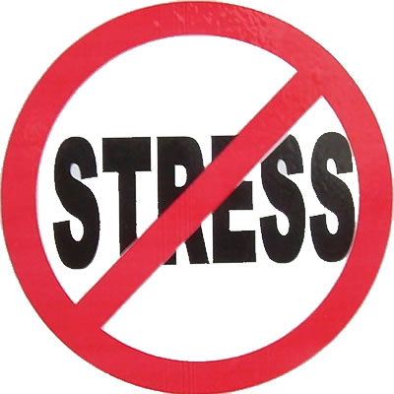
Know Your Limits
If you have difficulty completing tasks, do not take extra work
Ask yourself:
How long can I work for?
What do I manage well?
Do I need help with this task?
Notes:
-Don’t be afraid to say no to taking on more work!
-You should be able to complete your current work before taking on more responsibility
-Understand that it may take you longer to complete a task than it take others
-Know your strong suits
-Don’t be afraid to ask for help on a project
-Talk to people who have already completed whatever task you are struggling with.

Slide 8
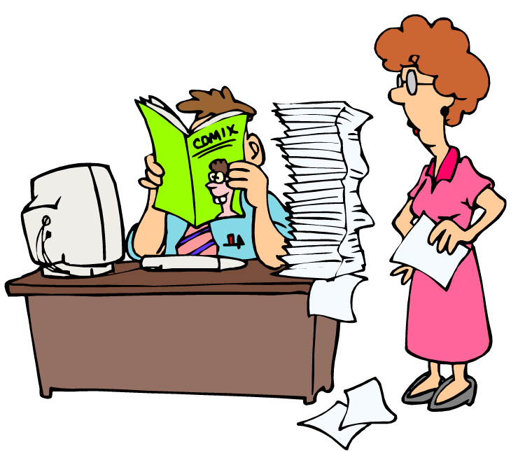
Facing Procrastination
Set your own deadlines
Take it one step at a time
Start your task as soon as it is assigned
There is no easy way out of procrastination
Notes:
There is no cure all to procrastination.
-Once you begin a task you will be motivated to finish it.
- Begin as soon as you can. Starting a project can be the hardest thing. Once you have started, you will be more motivated to finish.
-Set your own deadlines
-Don’t rely on reminders
-Ask others what helps them

Slide 9
What Causes You Stress?
Notes:
-Ask the audience what causes them stress

Slide 10
How do you deal with stress?
Notes:
Ask the audience how they deal with stress
encourage them to give tips on what works and what doesn’t work

Slide 11
Comments?
Questions?
Concerns?
Notes:
- Wrap up by thanking them for coming to the workshop

