Slide 1
Time Management and Organization

Slide 2
ICEBREAKER
“Indian Chief”
Notes:
One person will be asked to leave the room while the rest of the group decides who is going to be the “indian chief”. This person will start and action and change it at random. Try not to look at the “indian chief” directly or you will give their identity away (use peripheral vision)!!! The person who was asked to leave the room will return and attempt (with three tries) to guess who the “Indian chief” is. The “indian chief” from one round will be the “guesser” next round! ☺

Slide 3
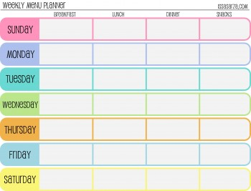
Time Management
Prioritize
Use a calendar
Manage Stress Levels
Learn to SAY NO!
Notes:
Prioritize activities and responsibilities by level of importance and level of difficulty.
Calendar - When organizing your schedule take into account the fact that activities often take more time than predicted. Also make sure to factor in transportation time in order to make sure you are not overloading yourself and your schedule. (calender, planner, phone, apps)
Manage Stress - Don’t waste time freaking out about task, JUST DO IT.. This will reduce the quality of your work and focus, and will result in a weaker product. Swallow the frog.
4th bullet- Doing few things well is better than doing a lot of things when the product is not your best work.
Often people experience anxiety about saying no because that would make them “a mean person” or think people will believe they are “not a team player”. It is essential that everyone understands that there is ONLY SO MUCH YOU CAN DO!

Slide 4
Time Management (cont.)
Learning to delegate
Take care of yourself
Do NOT procrastinate!
Notes:
Learning To Delegate - can eliminate a lot of unnecessary stress. Together we can do a lot more than on our own! We see this in Key Club as we all set forward to accomplish a few common goals, but this can also be seen in everyday life. Work smarter, not harder.
Take Care of Yourself: Sleeping, eating, etc. are necessary to a productive lifestyle. Neglecting your basic needs is definitely not something that will help you in your accomplishments. Working to complete you allotted requirements in a reasonable time period will get you much farther in life and you will feel so much better than if you stayed up until 2am working on that project you have to pull together last minute.
Don’t Procrastinate – We have this saying “Swallow the frog”.....

Slide 5
Organization
Different is OK
Common organization methods
Management
Set Goals
Notes:
Different is OK – everyone is different, your organization methods may be different from everyone in this room
Common Suggestions – Binders, planners, folders (laptop and other), sticky note
Time Management – time management leads to success, you must make the best use of your time
Set Goals – setting goals inspires you to achieve them, sets a standard to only yourself

Slide 6
Tell Us!
How do you stay organized?
What are some ways you manage your time?
(Key Club, Extra Curricular Activities, etc.)
Notes:
Ask the audience these questions

