Slide 1
The Eliminate Project

Slide 2
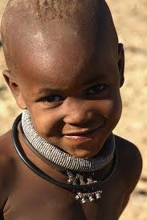
What is The Eliminate Project?
A global campaign to eliminate Maternal/Neonatal Tetanus (MNT)
A chance for you to change the world
Notes:
A global partnership between Kiwanis International and UNICEF.
The Kiwanis Family has made The Eliminate Project a priority.
If your club hasn’t participated lately, try doing a car wash or bake sale *What has your club done to support The Eliminate Project?*

Slide 3
Eliminate Video
https://www.youtube.com/watch?v=NK9nl-ahHYo
Notes:
If youtube is accessible from your location go to https://www.youtube.com/watch?v=NK9nl-ahHYo

Slide 4
Maternal & Neonatal Tetanus
Cause?
Tetanus spores, found in soil everywhere
Tetanus is contracted through open wounds during childbirth
Outcome of Contracting MNT?
Notes:
Tetanus spores are found in soil everywhere.
Often times, bamboo that is grown in a nearby region is used to cut the umbilical cord.
Since the bamboo is grown in soil this is how tetanus is often contracted.
Outcome?
Tiny newborns suffer repeated, painful convulsions and extreme sensitivity to sound, light and touch and even worse that baby will die after 7 days of excruciating pain.

Slide 5
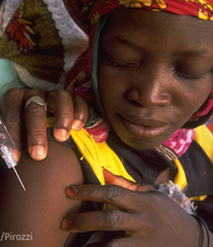
Who does it affect?
The most underprivileged regions of the world
There are still 23 countries affected by MNT
Notes:
The people that are effected are those who do not access to the medical supplies we have in 1st world countries. The victims of MNT do not have the resources that countries like the US have and are unaware of sterile heath care. UNICEF and Kiwanis are working tirelessly to change this.

Slide 6
How do we stop this?
It only takes $1.80 to vaccinate a mother and all of her future babies
110 million dollars = over 61 million lives saved
Notes:
The reason we don’t have to worry about MNT here is because of the vaccinations we have received.
The vaccination for MNT is given in three 60 cent doses.
There are millions women and children who are susceptible to contracting MNT.
In order to vaccinate and protect everyone at risk, we must raise 110 million dollars and save 61 million lives.
The money we raise does not only save lives, but it prevents them from contracting the disease again.
We help support UNICEF send people to not only vaccinate, but to educate and teach mothers on how to prevent the contraction of this deadly disease.

Slide 7
Where does the money go?
Money goes towards vaccinations as well as to help educate the women and midwives in these areas on how to perform clean and sterile deliveries
Notes:
Your $1.80 goes towards vaccinations as well as to educate the women and midwives in these areas on how to perform clean and sterile deliveries
This vaccination has the power to help save the lives of a mother and all her future babies.

Slide 8
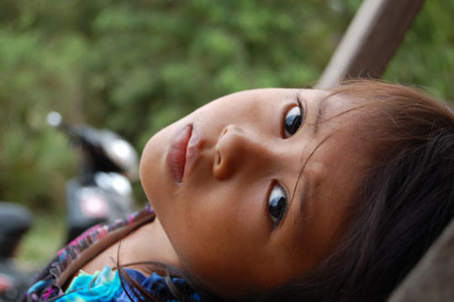
Important numbers
Goal: 110 Million dollars
$1.80 saves a life
61 million lives protected
1 baby dies every 9 minutes
Notes:
Numbers are important when it comes to Maternal/ Neonatal Tetanus. Currently, 1 baby dies every 9 minutes due to MNT. Our goal to raise the 110 million dollars which, when successful, will have saved and protected over 61 million mothers and all of their future children.

Slide 9
Our Progress
Since 2000 we have eliminated MNT from 36 countries
As of July 16th, 2015, we have help raise $84,686,783.93 to save over 47,000,000 lives.
Notes:
Since 2010 when we were approached by UNICEF to partner with them , Kiwanis International and UNICEF have eliminated MNT in 11 countries. As of July 16th, 2015We have helped raise $84 million dollars saving over 47,000,000 lives! I think that deserves a round of applause. From Eliminate Project coordinators, We are right on track to reach and exceed our 110 million dollar goal.

Slide 10
District Merchandise
Merchandise can be ordered by clubs, divisions or zones
For ideas of merchandise your club can order and sell – check out our District Website.
Notes:
The district merchandise is sold to help support TEP. Anyone can sell the merchandise.

Slide 11
Ways to Get Involved
Hold an Eliminate Dance
Eliminate MNT Car Smash
Trick-or-Treat for UNICEF
Hold an Eliminate car wash
Notes:
There are many ways to get involved with The Eliminate Project, You can do just about anything for the Eliminate project! Be creative!
There are many ideas on the district website underneath the category “The Eliminate Project”
You can also check out the Sunshine Source which features many different ideas for TEP.

Slide 12
How to send donations
1.Write a check to the Kiwanis International Foundation
2.Put “The Eliminate Project” on the memo line
3. Print and fill out The Eliminate Project Donation Slip
4.Please mail checks to the following address:
Kiwanis International Foundation
3636 Woodview Trace Indianapolis, IN
46268-3196
Notes:
The Eliminate Project Donation Slip can be found on our Florida District website on The Eliminate Project tab.

Slide 13
Awards & Recognition
Club:
  The Trick-Or-Treat Banner Patch
  Becoming a 1k Key Club
  Various awards given to clubs from the district each year
Notes:
Club:
The Trick-Or-Treat Banner Patch
Becoming a 1k Key Club
Various awards given to clubs from the district each year
Individual:
Become a Zeller fellowship holder
Receive the Elimidalion

Slide 14
#Elimin8
This is the official hashtag used for The Eliminate Project.
Why?
Because when Key Clubbers see the awesome work you do, it starts a movement!
Notes:
By using this you will spread the word of our commitment to end Maternal and Neonatal Tetanus
#Elimin8 is an easy way to spread the word of our project to anyone that uses social media or checks trends.
Getting this to trend on social media informs people all around the world about our campaign
YOU can make a difference!

Slide 15
What can you do today?
Spread the information!
Hold a fundraiser for the Eliminate Project
Donate money yourself
Use #Elimin8 on social media
Notes:
- Spread the information- Bring back the information you learned today to your club and plan a fundraiser for The Eliminate Project
Go to floridakeyclub.org/the-eliminate-project/ and show them around a little.

Slide 16
Questions?
Contact your Lieutenant Governor if you ever have any questions about The Eliminate Project!
Notes:
**IF THERE ARE NO QUESTIONS!**
If you have questions you can contact your lieutenant governor

