Slide 1
Trick-or-treat for UNICEf
By: ZONE X

Slide 2
What is Trick-or-treat for unicef?
Key Club and UNICEF are currently helping to Eliminate Maternal and Neonatal Tetanus (MNT) through Trick-or-Treat for UNICEF.
Has helped to raise more than $175 million since 1950

Slide 3
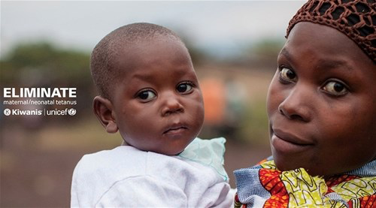
What is Maternal/neonatal Tetanus
Affects mothers and babies in unsanitary birthing conditions.
Affects over 110 million women & children worldwide.

Slide 4
How to get involved
For how to order boxes or more fundraising ideas:
http://floridakeyclub.org
Vaccine = $1.80

Slide 5
Questions?
Email Trick-or-Treat for
UNICEF Committee:
UNICEF@floridakeyclub.org

