Slide 1
Service and Major Emphasis
“Service is what it is all about”

Slide 2
Key Club International Service Partners
UNICEF
March of Dimes
Children’s Miracle Network
4. Thirst Project
Notes:
Key Club is partnered with three organizations:
UNICEF- an agency designed to protect rights of children and mothers, help meet their basic needs, and ensures their education
March of Dimes - a charity that is focused on promoting health for babies by preventing birth defects, prematurity, and polio.
Children’s Miracle Network - a non-profit organization that raises money in order to provide comfort, treatment, and hope to children in hospitals.

Slide 3
UNICEF
Serves children internationally with food, education and medical attention.
Example:
Trick or Treat for UNICEF/ Eliminate
http://www.unicefusa.org/
Notes:
Why support UNICEF?
They operate in more countries and help more children then any other humanitarian organization.
They do whatever it takes to reach vulnerable children, from stopping wars to trekking through the remotest deserts. For example, they pioneered ‘Days of Tranquility’ to arrange ceasefires in times of war so children can be reached with lifesaving healthcare.
They work with and coordinate everyone who cares about children - partner organizations, governments, communities, parents and children themselves - to make sure no child is forgotten.
Ways to be involved
Trick or Treat – Helps with funds for the Eliminate project from beginning of August to December fundrasing going on. Boxes ordered early to help with project.
Eliminate- Goal for both Maternal and Neonatal Tetanus to be eliminated. Just $1.80 saves a life. By fundrasing for the Eliminate Project you are helping save lives. For ideas on projects go to floridakeyclub.org and go to the Eliminate tab.

Slide 4
March of Dimes
Helps mothers to have to carry their babies to a full term and helps to prevent problems during pregnancies.
How can my club support?
Host a Campaign Walk.
Volunteer at a local March of Dimes Walk http://www.marchofdimes.org/
Notes:
Visit the March of Dimes website, find the select a category button and select the mission tab in order to find out more about the mission of March of Dimes
Wondering how to support March of Dimes. Become a Team Captain and host a walk where the proceeds will go to the March of Dimes organization.
Set up your team page at marchforbabies.org
• Assemble your core team
(complete the sheet on the next page)
Organization and spirit are all it takes to make your March for Babies
campaign a success.
how a great campaign
takes shape
1. Organize
• Set up your team page at marchforbabies.org
• Assemble your core team
(complete the sheet on the next page)
2. Recruit
• Get the word out about March for Babies
• Grow the team, ask fundraisers to sign up online
3. Fundraise
• Encourage walkers to utilize online fundraising
• Set individual and team fundraising goals
• Share the team goal and give weekly progress updates
Now you may be wondering, how do I get a business to donate to my cause? Elevator speeches. Short to the point speeches that will explain exactly what cause you are supporting.
(Encourage the class to write down what march of dimes means to them and then share the 30-60 second elevator speech about march of Dimes)
Elevator speech:
“ I volunteer for the March of Dimes, which helps moms have full-term
pregnancies and healthy babies. Nearly 4 million babies were born
last year, and the March of Dimes helped each and every one through
research, education, vaccines and breakthroughs. The March of Dimes
offers programs that focus on healthy pregnancy for women, while also
offering comfort and information to families with a premature or very
sick newborn in intensive care. Each day, the March of Dimes helps more
babies be born healthy.”
Anastasia Morrison, Clemson University
4. Walk
• Bring your energy and excitement to March for Babies day
• Thank everyone who helped make your team a success!
Consider asking businesses for donations towards the March of Dimes cause or if you can set up a station in their business where their customers can donate loose change.
“ Youth are truly blessed to be healthy and to be able to serve others.
We have the mission to help those in need, especially babies who are
suffering from premature birth (March of Dimes) or maternal and neonatal
tetanus (Kiwanis International). We need to set a brighter future for
coming generations, and I believe students are fully capable of doing
so by being a part of the March of Dimes and Key Club International.”
Eric Yoon, Past Key Club International Trustee

Slide 5
March of Dimes
Simple Fundraising:
How can I raise $300?
Start with your own $25 donation =$25
4 family members for $25 each= $100
4 $10 donations after a Facebook post =$40
5 neighbors for $10 each =$50
5 local businesses for a $15 donation =$75
1 teacher for $10=$10
Notes:
Fundraising for March of Dimes, or any nonprofit organization, is as simple as this.

Slide 6
Children’s Miracle Network
Established to help children by actively supporting improved health care for millions of young people around the world.
Notes:
CMN's mission is to generate funds and awareness programs for the benefit of children served by its associated hospitals, now numbering more than 170 nationwide.

Slide 7
Children’s Miracle Network
Participate or Fundraise for this cause through:
Dance Marathon
Miracle Treat Day
IHOP National Pancake Day
http://give.childrensmiraclenetworkhospitals.org/
Notes:
More ideas:
IHOP National Pancake Day
Miracle Jeans Day
Miracle Treat Day
Book a Tee Time and Help Kids
Play Games. Heal Kids. Join Extra Life
Champions Across America
Visit the website to find out more information on your local Children’s Miracle Network Hospital.

Slide 8
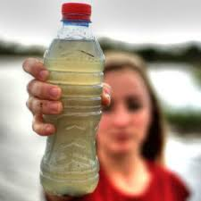
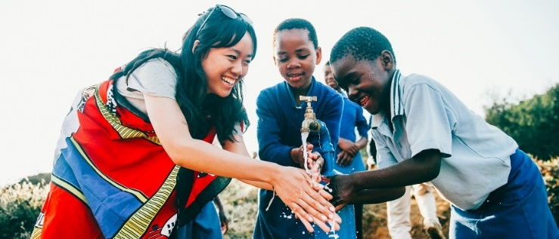
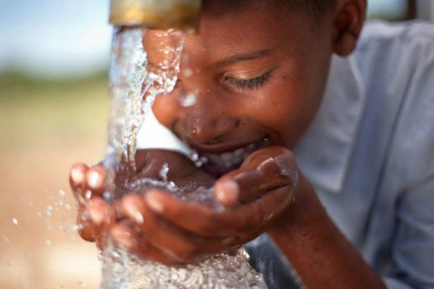
Thirst Project
“Dirty Little Secret” Campaign
Go Silent on World Water Day
Reserve a Speaker!
For more information, visit https://www.thirstproject.org/
Notes:
Thirst Project: https://www.thirstproject.org/
- The Thirst Project is the largest youth water activism charity in the world. In just 5 years, they have worked with developing communities to bring safe, clean water to more than 200,000 people in 11 different countries.
“Dirty Little Secret” Campaign
- One of the most important projects you can do to raise awareness for the Thirst Project is simple, actually, and you don’t even have to raise any money! Spread the word through this campaign. Most people aren’t talking about the issue of clean water, even though it’s one of the biggest “dirty little secrets” in the world. Spread the word-and share the secret! All you have to do is carry around a bottle of dirty water with you all month long. Bring it to your desk at school (if that’s allowed), the dinner table, the gym, everywhere you go. Turn your bottle into a conversation starter. People will ask you why you’re carrying around a bottle of dirty water, which gives you the perfect opportunity to talk about the global water crisis and what the Thirst Project is doing about it.
“Go Silent” on World Water Day
- The Thirst Project encourages everyone to “go silent” on March 22, World Water Day, to stand in solidarity with the 780 million people whose voices go unheard every day.
Reserve a Speaker
- Another way to raise awareness for the Thirst Project is to host a few assembly for your entire student body or make a presentation to your club. Email Amber@ThirstProject.org to set something up today!

Slide 9
Service Related Awards
Major Emphasis Award
&
Single Service Award
Notes:
These awards at awarded at DCON. Applications are available on the Florida Key Club website under awards and contests

Slide 10
Major Emphasis Award
Given to the Key Club which, through its unselfish efforts, has produced the best Major Emphasis Project following the theme:
“Children: Their future, Our Focus.”
Notes:
Major Emphasis Award: The activity described can cover any phase of Key Club Major Emphasis involvement specifically highlighting personal development and social interaction of children during the year from district convention to district convention. The report may include newspaper clippings, substantiating photographs or other pertinent information. Projects acceptable for this award may include both hands-on service and fundraising efforts.
Judged off of:
THE NEED
2. THE PLAN
3. IMPLEMENTATION
4. FINAL RESULTS.
5. PARTNERSHIPS WITH THE KIWANIS
FAMILY AND OTHER ORGANIZATIONS
6. PERCENTAGE OF CLUB MEMBERS
PARTICIPATING (10 points)—
7. CLUB’S OVERALL PROGRAM DEALING
WITH MEP

Slide 11
Single Service Award
A single service project shall be defined as a club service project, planned, organized and produced by the Key Club.
Can occur on a single day, consecutive days or recurring on different days.
Notes:
Single Service Award is judged off of:
-Service need
-Project plan
-Project implementation
-Final results
-Public awareness
-Members participation

Slide 12
OTHER KEY CLUB SERVICE PARTNERS:
Hershey Track and Field
Rustic Pathways
Every Child a Swimmer
Kiwanis One day
Trick-or-Treat for UNICEF/
The Eliminate Project
Notes:
These are some other Key Club Service opportunities

Slide 13
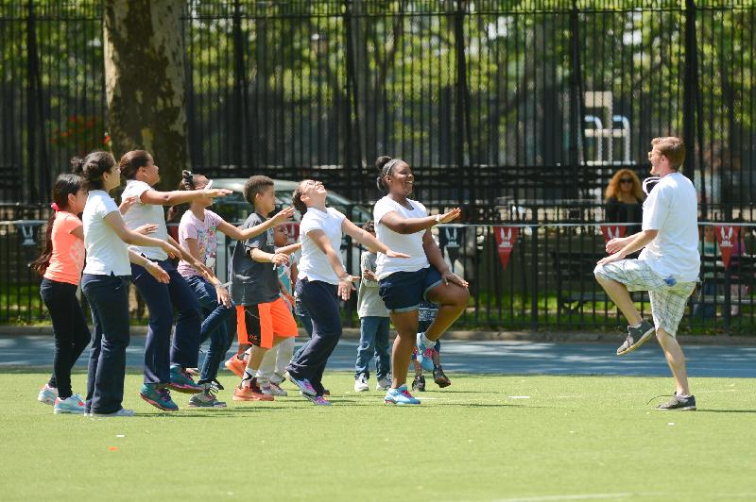
Hershey’s Track and Field
The largest youth sports program of its kind in the United States and Canada.
Notes:
We are partnering up with Hershey’s Track and Field and Key Clubbers all over Florida to encourage children to stay healthy, active, and friendly with others.
What is the Event?
- A chance for kids and families in the communities to get active and learn about being healthy and safe.
There will be awards, fundraisers, food and so much more.
What will volunteers be doing?
helping Hershey's Track and Field set up events and run this day
They will assist with food, parking, set up, breakdown and so much more
will help kids of all ages have fun and learn about being active and healthy.
Find an event near you: You can help by:
Gathering equipment
Running a registration desk
Acting as Clerk of the Course
Coordinating other volunteers
Timing or measuring the events
Serving as judge, official or announcer

Slide 14
Rustic Pathways
Key Club has partnered with Rustic Pathways in order to take our service internationally.
10 International service programs customized for Key Club members.
Visit www.rusticpathways.com/keyclub
Contact them by phone at 800-321-4353 or by email at keyclub@rusticpathways.com to invite them to your meetings
Notes:
Programs to choose from include Summer Programs, Spring Break Programs, and Regional Programs in places such as the Dominican Republic, Costa Rica, or design a custom service trip for your club.
Representatives from Rustic Pathways would be happy to speak at a club meeting, participate at a rally or lead a workshop at your district convention.

Slide 15
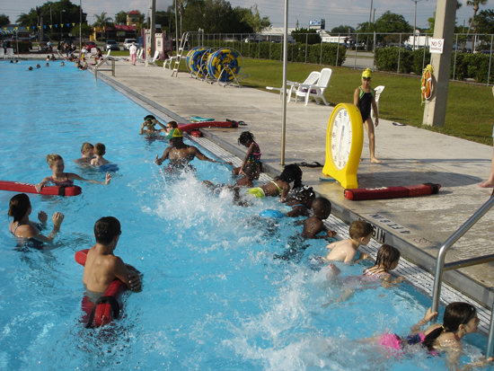
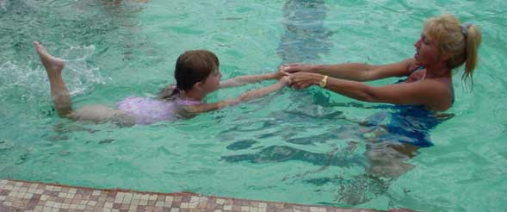
Every Child a Swimmer
Purpose: aims to lessen the number of fatalities and teach kids how to swim.
How can your club get involved?
For more information visit:
http://floridakeyclub.org/resources/
Notes:
Every year in the United states, 8,000 people die from drowning and more than 80,000 near-drowning occur in which people can be severely injured.
How can your club get involved?
Select a person or persons to meet with local school officials, to discuss making ECAS a part of their elementary school curriculum
Find a pool that is available for lessons; if there isn’t one located on the schools property you could possibly use a county or city owned pool
Find a certified swimming instructor
Advertise for financial and volunteer support in the school and local media

Slide 16
Kiwanis One Day
Date: October 22nd, 2016
What is it: An Annual Kiwanis observed day of service
What can your club do? Connect with other branches of your local Kiwanis Family
Purpose: Provides an opportunity to showcase the Kiwanis Family and our commitment to service
Notes:
It was inspired by Past International President Nelson Tucker’s initiative to create a day that unites the entire Kiwanis family in service.
Other branches include K-Kids, Builders, Aktion, CKI and Kiwanis clubs.

Slide 17
Learn more about Service and Major Emphasis Programs
Visit: http://floridakeyclub.org/service-major-emphasis/
http://floridakeyclub.org/resources/
Follow the link above, scroll down to Club Resources/Service
- Check out the 2016-2017 Service Directory provided by your Service and Major Emphasis committee!
Notes:
On both of these websites you will find links to service directories and more information about our 3 Service Partners

Slide 18
Questions, Comments, or Concerns?
Contact the Committee Chair, Marissa Molloy
Email: division4@FloridaKeyClub.org
Adult Advisor: Beverly Baird,
Email: aazonec@FloridaKeyClub.org
Executive Committee Advisor: ​Sabrina Flores,
Email: secretary@FloridaKeyClub.org

