Slide 1
Running for Higher Office
Notes:
Deciding what to run for
District
Seniors – only have one year, so only going to be one position → recommended 1 year in advance
Lower Classmen – that plan to run for exec board position, recommend 2 years planning (1st year ltg, 2nd year exec) Also mention this is not the only way, they could potentially go immediately exec
International
Explain the chain. MOST go the path of LTG → EXEC → IT → IVP/IP
Again, mention this is not necessary but how it usually works
Campaigning – explain why (unfair advantages) Make sure to mention NOT TO TELL ANYONE ABOUT YOUR INTENT

Slide 2
The Three Most Frequently Asked Questions:
Why? When? What?
Notes:
“so that’s what we’re going to cover”

Slide 3
Running for Higher Office
Why Should I Run?
Develop Leadership Skills.
The ultimate way to take your leadership to the next level.
Create new friendships that will last a lifetime.
Notes:
Everything with the club officers except multiplied by 1,000,000
Huge opportunity to develop your leadership skills
Great chance to campaign on a grand scale
Learn to oversee large groups of people

Slide 4
Running for Higher office
When should I start?
Deciding What to Run For
District
International
Campaigning
Lieutenant Governor (LTG) – Not until Spring Zone Rally
District Office – Not until DCON
Notes:
Deciding what to run for
District
Seniors – only have one year, so only going to be one position → recommended 1 year in advance
Lower Classmen – that plan to run for exec board position, recommend 2 years planning (1st year ltg, 2nd year exec) Also mention this is not the only way, they could potentially go immediately exec
Plan – Up to 1year in advance
International
Explain the chain. MOST go the path of LTG → EXEC → IT → IVP/IP
Again, mention this is not necessary but how it usually works
Campaigning – explain why (unfair advantages) Make sure to mention NOT TO TELL ANYONE ABOUT YOUR INTENT
Up to 1-3 years in advance

Slide 5
What
are the positions I can run for?
Notes:
As a Key Club Member, you can run for any position but, what are the responsibilities of other positions and what can you run for?
To start, lets look at the Lieutenant Governors.

Slide 6
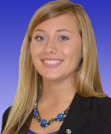
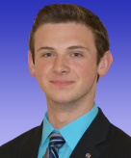
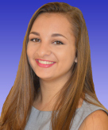
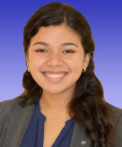
Lieutenant Governors
Is a member of the District Board
Sits on a committee on the district board
Represents clubs that make up a division
Division 4
Division 5
Division 8
Division 19A
Division 24B
Notes:
Expand on each bullet point
Represents their division on a district level at board meetings and votes on District matters to best suit their division.
A Lieutenant Governor is required to send out monthly newsletter and emails and is considered the club link to the district and international levels of Key Club.
To Become: Fill out required paperwork before Spring Zone Rally, Talk to current Lieutenant Governor, and run at your Spring Zone Rally
You must have these forms filled out before Spring Zone rally to run for LTG or any other position.

Slide 7
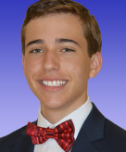
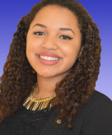
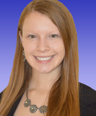
Appointed Positions
Webmaster
Editor
Executive Assistant
Webmaster Caleb
Executive Assistant Gabriela
Editor Carly
Notes:
Webmaster – website, technical questions. Typically “Techy” people
Webmaster-updates and maintains Florida Key Club website and deals with any technical questions or issues
The Webmaster has a very difficult job, they serve as the “Tech” person that everyone in the district will run to with their computer or email problems.
Editor – sunshine source, help LTGs with Newsletter Creation
Editor-charged with sharing news and correspondence from the district board to the clubs in your district and with promoting district events in your community
If you look on the Florida Key Club Website (floridakeyclub.org) you will see a magazine, called The Sunshine Source. This magazine is created by the district editor as she receives information about what is going on in the divisions and what is going on district and internationally.
Executive Assistant – right hand man to Gov. (like a V.P) also helps entire exec board
To become: Fill out forms online, apply and interview with Governor
These appointed positions will be decided on by the next District Governor.

Slide 8
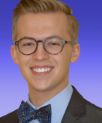
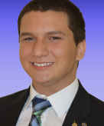
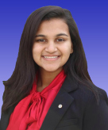
Executive Board
Governor
Secretary
Treasurer
Governor Shane
Secretary Jose
Treasurer Palak
Notes:
Governor- provides guidance and leadership for the entire district and the district officers and committee chairmen. The governor is considered the face of the district and represents the district on the international level on the Key Club International council. The Governor must establish District goals, committees, and create a Governor’s project that they will also use as their foundation for campaigning at Spring Zone Rally and DCON.
Secretary-tracks pride report submissions, create monthly newsletters/blurbs, and take minutes at all meetings. The District Secretary works with all the club secretaries in the district to help them complete Pride Reports, update the Officer Information Forms, and help update the Membership Update Center in the beginning of the year. The district secretary also must produce a monthly newsletter to send out to the district updating the secretaries of upcoming dates and reminders about the OPR system.
Treasurer-charged with accurately tracking and reporting the district financial accounts. This person is in charge of creating a budget for the district as well as helping create the District Education and Leadership Conference (DCON) budget.
To Become: Fill out all forms online and send to the elections committee chair, campaign at all the SRZ’s, and get elected at DCON.
These positions are the highest ranking of the district.

Slide 9
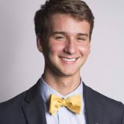
International President
Presides over the international convention and all meetings of the Board of Trustees and the International Council
Rip Livingston
Notes:
The International President is the FACE of Key Club International. This person prepares the goals and theme of Key Club for the service year. The International President leads the entire organization based off of the goals that were established and campaigned on at Spring Zone Rally, District Conference, and ICON.
To Become: Fill out forms and submit them to the election committee chair, Campaign at SZR’s, receive endorsement at District Convention, Campaign at ICON, and get elected at International Convention

Slide 10
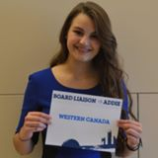
International Vice President
Chairs at least one international committee, supports all other committee chairmen and performs duties and attends events
Addison Clipfell
Notes:
What does the International VP do?: Chairs at least one international committee, supports all other committee chairmen and performs duties and attends events
The International Vice President is the right hand to the president and assist the International President whenever needed.
To Become: Fill out required forms and submit them to the election committee chair, Campaign at SZR’s, receive endorsement at District Convention, Campaign at ICON, and get elected at International Convention

Slide 11
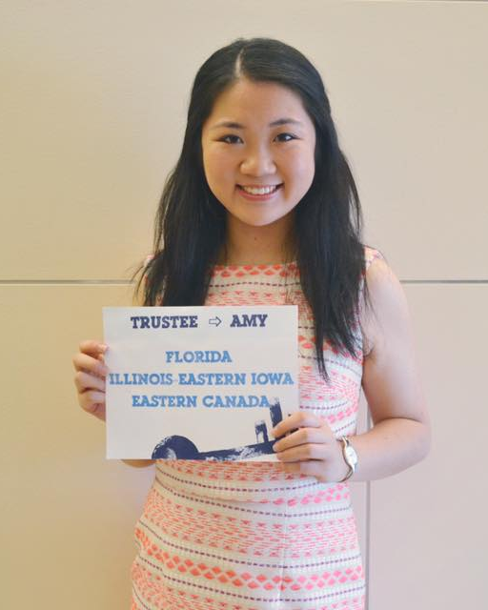
International Trustee
Key Club International board of Trustees is made up of the President, V.P., and 11 trustees.
The leading body of all Key Club
Sets Policy and Procedure for Key Club International
Assists Governors
Amy Jiang
Notes:
The Key Club International board of Trustees is made up of the President, V.P., and 11 trustees.
What does an international Trustee do?
The leading body of all Key Club
Sets Policy and Procedure for Key Club International
Assists Governors
She attends district board meetings and helps serve districts on the international level.
Our current International trustee is Laken Kelly and our sister Districts are: Mississippi-Arkansas, and West Virginia.
To Become: Fill out required forms and submit them to the election committee chair, Campaign at SZR’s but DO NOT CAMPAIGN BEFORE THEN, receive endorsement at District Convention, Campaign at ICON, and get elected at International Convention

Slide 12
Questions?
Notes:
Be prepared to answer questions. Please note that for positions such as ones on the district board, executive district board, or international board you cannot campaign until at Spring Zone Rally. If election violations are made you will be reported and eliminated from your campaign.
Questions?

