Slide 1
Online Pride Report (OPR) System Contents

Slide 2
Registration Note: Registration is only required for when your club is newly chartered, newly reactivated, or never registered.

Slide 3
Access the Florida Key Club Website
Click “OPR System”

Slide 4
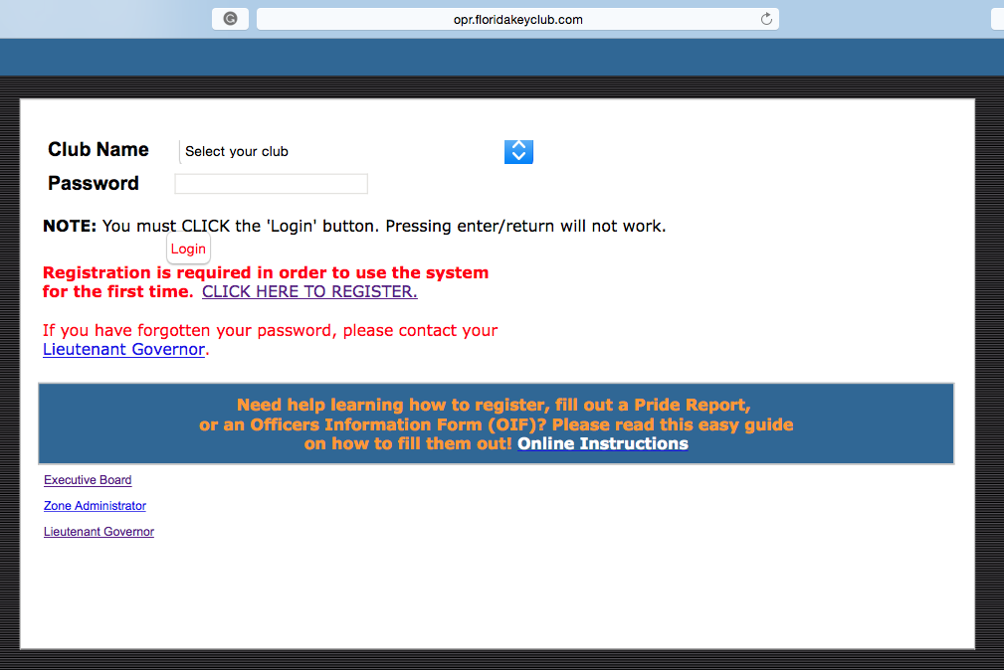
Click the registration link

Slide 5
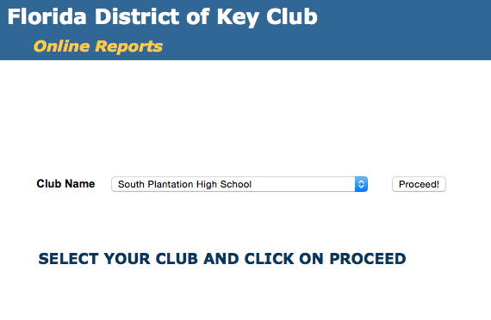
Select your club and then click proceed.

Slide 6
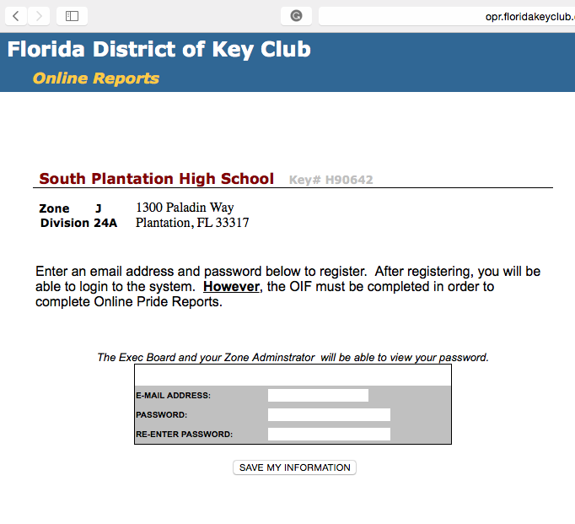
Insert your Faculty Advisor’s email
Create a unique password. Remember Secretary, President, and Faculty Advisor needs to know the password.
Save the information you filled into the boxes.
After registering your club, you will be able to login into the OPR system.
Your Lt. Governor, Zone Administrator, and District Secretary have your password in case you forget it.

Slide 7
Officer Information Form (OIF)

Slide 8
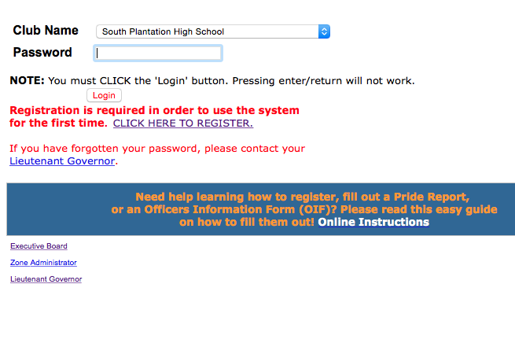
Select your club, enter your password, and click login to enter your club’s OPR account.

Slide 9
To enter/update your club’s OIF, press on “2016-17 OIF”

Slide 10
Complete all fields for all positions. Note that some positions are required to be completed.

Slide 11
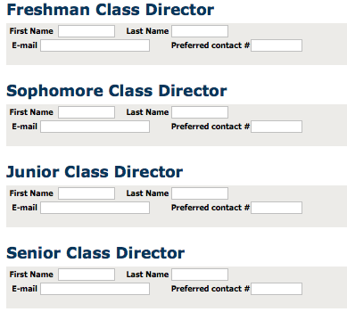
Class Directors
Make sure to input Class Directors’ information on the OIF. They will receive the same updates from the Lt. Governor and the Executive Officers.

Slide 12
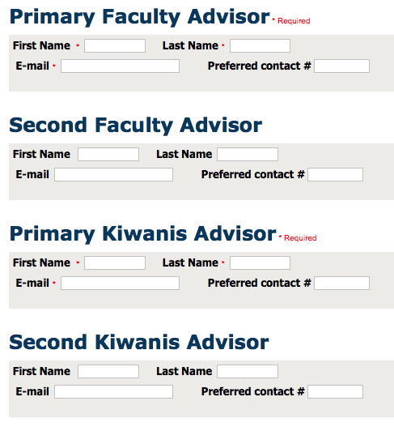
Advisors
In order to submit the OIF, you are required to enter the names and emails of the Faculty and Kiwanis Advisors
If your club does not have a Faculty Advisor, then you can enter your principal’s name and email until a Faculty Advisor is chosen.
If your club does not have a Kiwanis Advisor, then you should enter your sponsoring Kiwanis Club President name and email until a Kiwanis Advisor is chosen.

Slide 13
Done!
When you are done entering all the information on the OIF, press “Save My Information” and then press “Send Form Now”
If any information ever changes with one of the officers and/or advisors, please update it on the OIF.

Slide 14
Pride Reports
Due the 10th of each month

Slide 15
First, access the Florida Key Club website home page.
Then, click on the OPR system link.

Slide 16
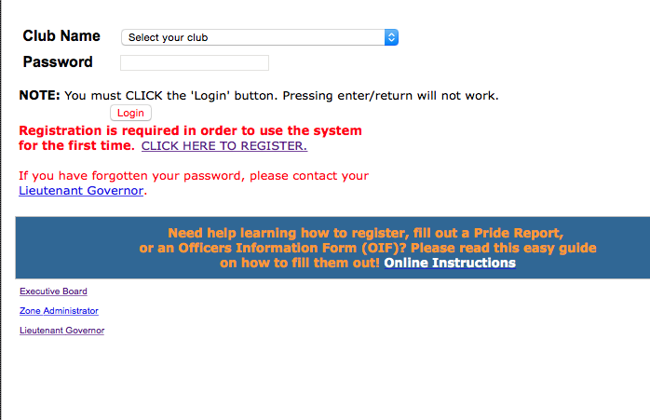
Once on the OPR system’s log-in page, you need to select your club and then enter your password.
If you need help with the OPR system, you can find online instructions here.

Slide 17
To start a Pride Report, select the month you wish to fill out the report for. Then click “start report”.
This is where you can view and update Pride Reports.

Slide 18
You should see this page once you click “Start report”. From here you can complete the report.

Slide 19
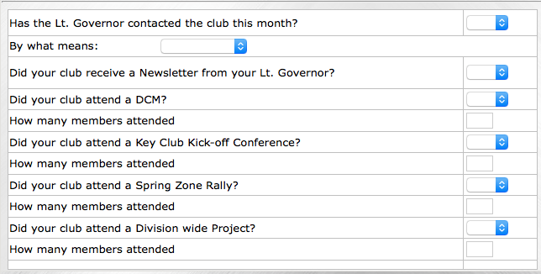
Your Lt. Governor (LTG) can contact you via email, phone, or a personal visit.
LTGs have the option of sending informational emails instead of a newsletter. So if your LTG sent an informational email, put yes for this line.
On the left of your pride report, you will find contact and attendance information.
For attendance, please take note:
Clubs will NOT attend Key Club Kick-Off Conference(KCKC) until the Fall. Just leave it blank until your club attends for the current year.
Clubs will NOT attend Spring Zone Rally until the Spring (SZR) (same as above)
When your club does attend a DCM, Division Wide Project, KCKC, or SZR for that month, click "Yes" and note how many members attended in the line below it.

Slide 20
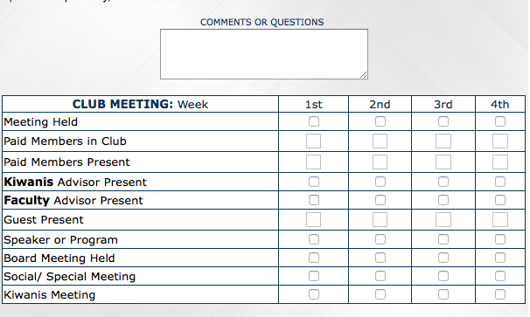
Taking attendance at club meetings will make this box easier to fill out.
Be sure “Paid Members in Club” corresponds to the number of dues paid members.
Meet with your club Treasurer or Faculty Advisor to determine how many members are in the club.
Above, there is a comments or questions box
If you ever have any questions about Pride Reports, you can enter them here.
You can also clarify certain things. Such as, why your club didn’t do service or have a meeting, and so forth.

Slide 21
After you are done filling out the top portion, press “Save Changes” before moving on.

Slide 22
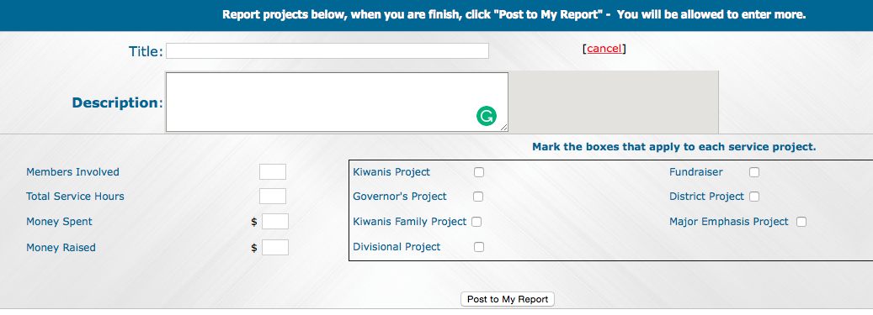
Adding Service Projects
Click “Add Projects” to add service projects. The section below will be opened.

Slide 23
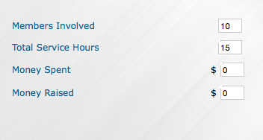
In the title section, you will put the title of your service project and a brief description of the service project
In members involved, you will put the number of paid members involved
In total service hours, put the total hours worked by each member, including hours spent planning the project.
If the club spent any money and/or raised any money you would put the amounts here.

Slide 24
If any of your service projects fall into one or more of the categories above, please check the box next to the category.
Kiwanis Project: Any project that is with a Kiwanis Club.
Governor’s Project: Any project that falls under the current year’s Governor’s Project
Kiwanis Family Project: Any project involving two or more Kiwanis Family Clubs (Ex. Kiwanis and CKI)
Divisional Project: Any divisional project conducted by your Lt. Governor
Fundraiser: Any fundraiser that is done for a charity or for the club. (Please note fundraisers done for the club does not count as service hours.)
District Project: Any project that is conducted district wide.
Major Emphasis Project: Any project that deals with any of the three Major Emphasis Partners; March of Dimes, UNICEF, and Children Miracle Network.

Slide 25
If you have more service projects to post, press “Add Projects”
If you have pictures of any of the service projects post it to your report! Choose the File first, then press “Upload”.
When you are ready to submit your report “Press Submit Report”
After you are done posting the service project press “Post to My Report”

Slide 26
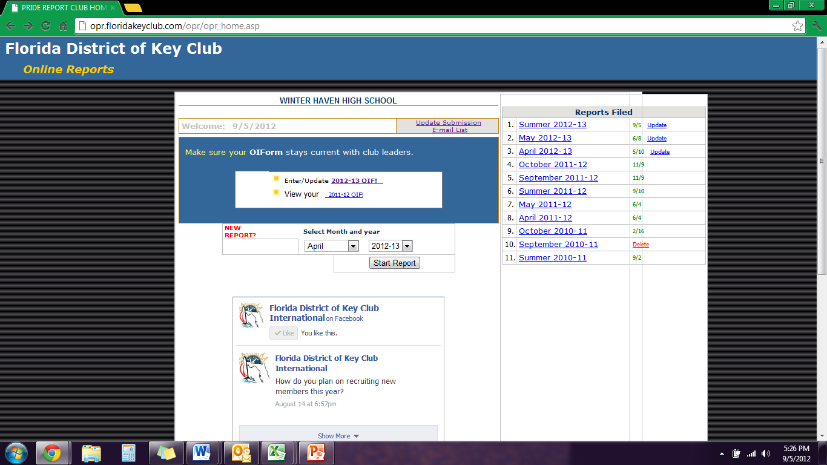
You can add additional people to receive the Pride Reports by clicking “Update E-mail Submission List” on the right hand side of the blue OIF box.

Slide 27
You can club committee chairs, Kiwanians from your sponsoring Kiwanis Clubs (Ex. Club President and Secretary), and school officials (Ex. Principal, Activities Director).
The Pride Report is e-mailed to everyone on your club’s Officer Information Form, the District Secretary, your Lt. Governor, and your Zone Administrator.
Make sure to click “UPDATE MY INFORMATION” before exiting the page, or the updated information will not be saved.

Slide 28
If you have any further questions or help with anything, you can contact the following:
Your Lt. Governor
http://floridakeyclub.org/contact-information/#Board
Or
District Secretary
secretary@floridakeyclub.org

