Slide 1
New Membership Update Center Tutorial

Slide 2
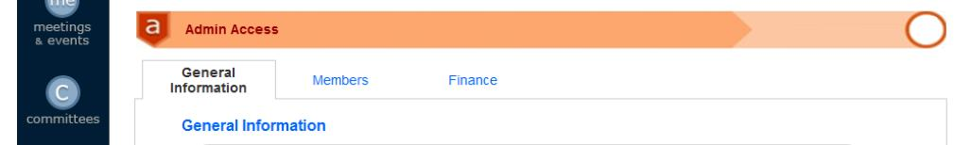
Initial Ribbon when you log in

Slide 3
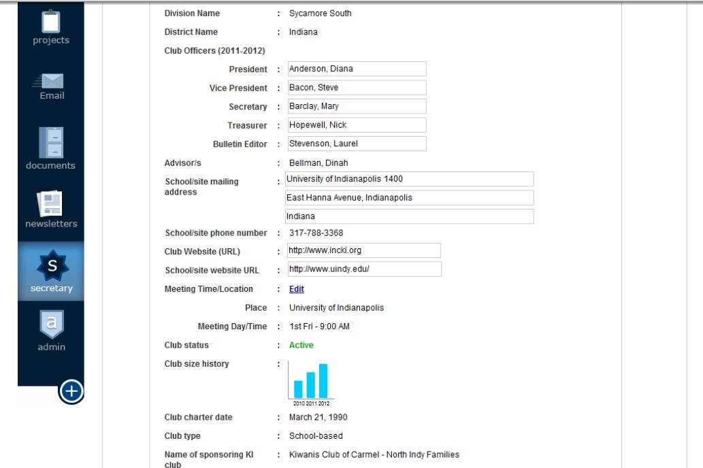
General Information Page
Clubs Officers can be edited each year
Can also be edited each year
Click on the bar graph to have it expand

Slide 4
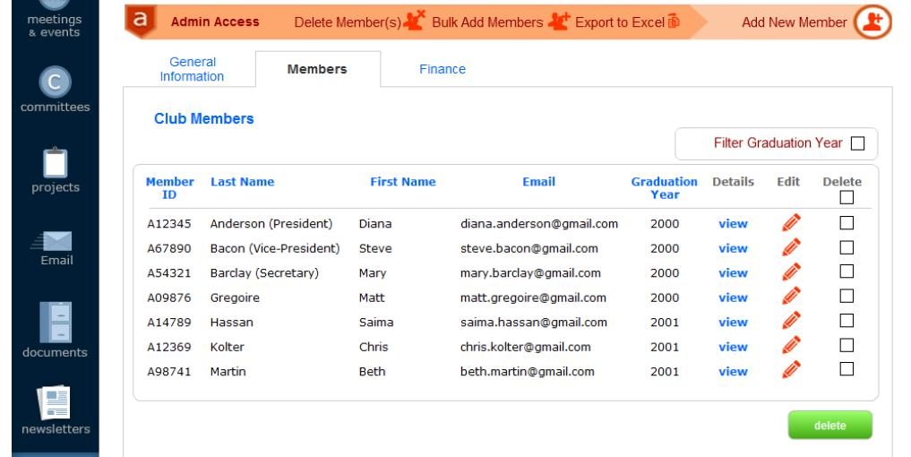
When you click on the “Members” tab, this page will appear with all of your club’s members from the previous year.

Slide 5
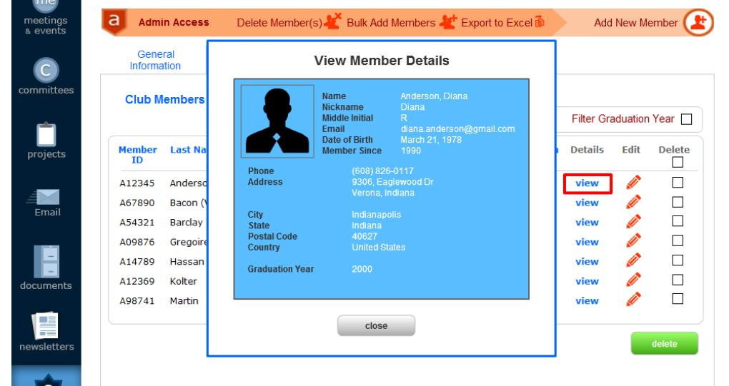
Click “Add New Member” to add more members
When you click view, this pop-up box will appear with each member’s details.

Slide 6
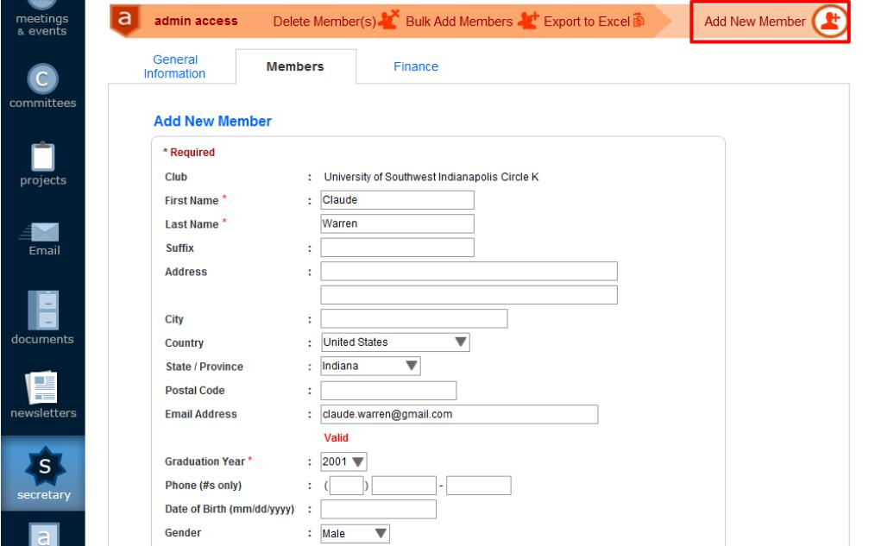

This will appear when you click “Add New Member.” Fill in your member’s information and then click “SAVE.”

Slide 7
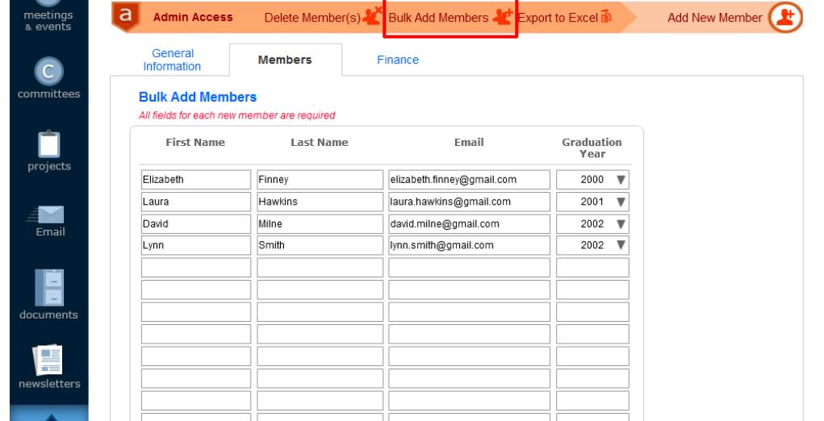

You can now “Bulk Add Members.”
Insert each member’s First Name, Last Name, Email, and Graduation Year. Click “ADD” when you are finished.

Slide 8
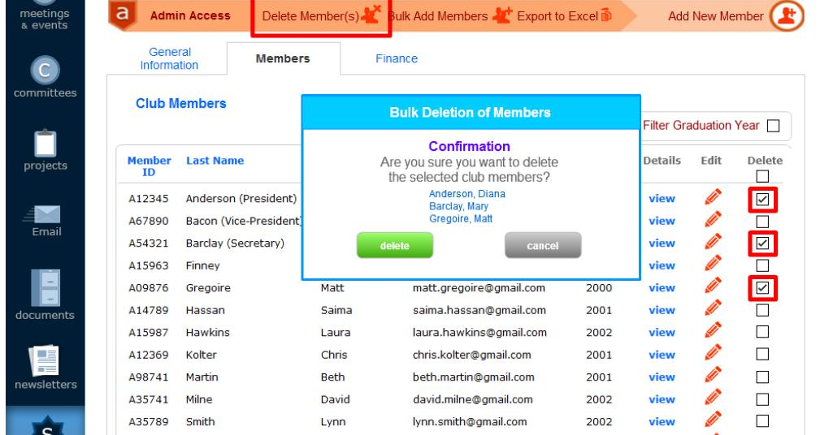
Then click “Delete Member(s).”
You can also delete more than one member by clicking the check box on their name line.
A pop-up box will appear with the names of the selected members and confirmation of deleting them. Click “DELETE” if the correct members are selected.

Slide 9
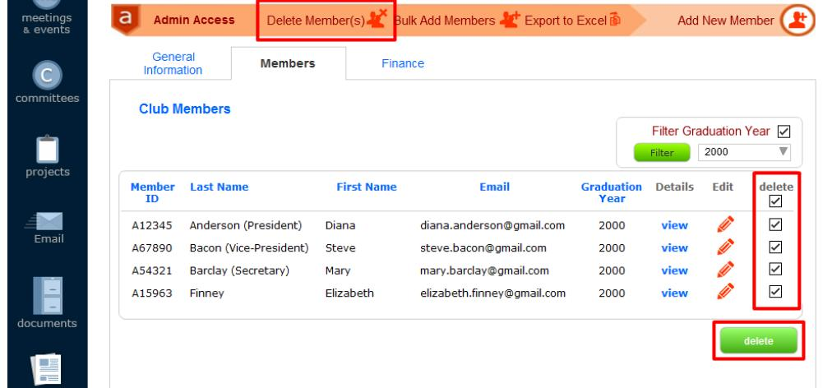
You can also delete members according to graduation year.
Checkmark “Filter Graduation Year”
Use the drop-down menu to select the graduation year that you wish to view. Then click “FILTER”
Click the checkmark under “Delete” to select all members in your list. Click “DELETE”

Slide 10
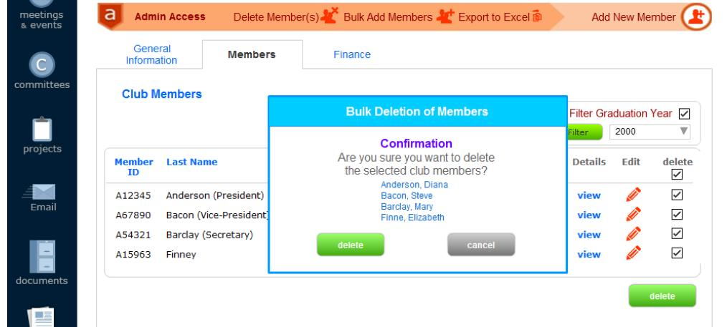
Once again a pop-up box will appear to confirm deleting your members. Click “DELETE” if the correct members are selected.

Slide 11
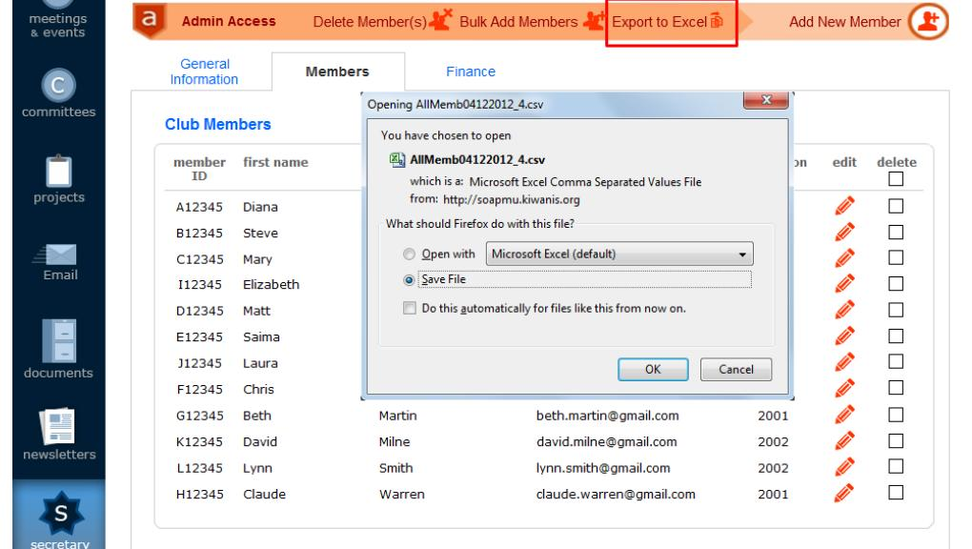
You can also transfer all of your club members’ information in to an Excel Spreadsheet. Click on “Export to Excel” to do so. A pop-up box will appear to confirm.

Slide 12
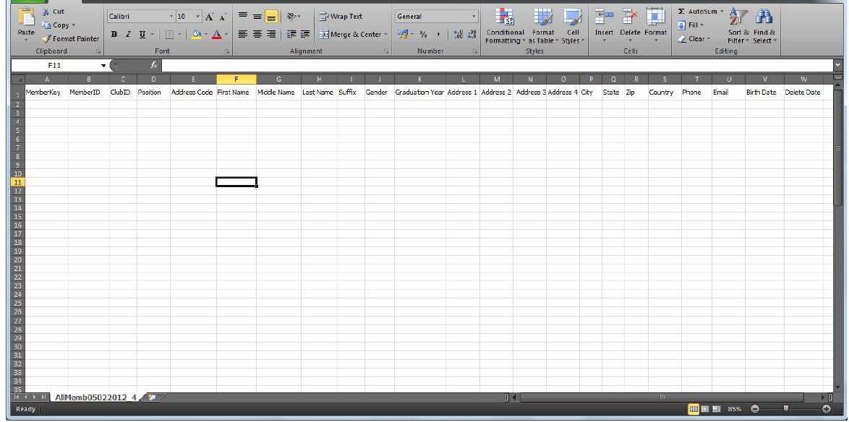
The Excel Spreadsheet will appear with all of your members’ information.

Slide 13
If you have any questions, feel free to contact your District Treasurer at treasurer@floridakeyclub.org

