Slide 1
MEMBERSHIP GROWTH

Slide 2
Membership Drives
What is this?
Why?
TIPS
Notes:
What? - A central focus/event where the main aim is to attract to members
Why? - Through membership drives or club rushes you are able to recruit members and let them know what Key Club is about, maintaining a high participation rate in key club. Have one in the beginning of the year (September) and one near the end (February)
If you are in need of recruiting members than have a drive at whatever time of year.
TIPS:
-include food
Promote it well in advance
Add ice-breakers for fun breaks from information
Be prepared well in advance!!
Inform members of why they should join. Ask audience why they joined key club or why other should join

Slide 3
How Membership Drives Work
When?
What should I do?
Notes:
When? – Right at the start of the school year! Helps to attract freshmen who are new to the school. (During lunch! Or After School! Or at a School function!)
What to do? - set-up a table that has information about Key Club and the events you have done so far. Order materials from key club store such as brochures that can be handed out. Display your banner, awards or any other interesting Key Club related items.
Make sure to wear Key Club shirts so that students can easily see Key Clubbers at the booth.
Invite interested people to your next meeting to see how great the club is and make sure to get their email address or phone number so that you can remind them about upcoming meetings.
Put announcements on school media- news station
Use Facebook, email, other social media, and Remind 101
ADVERTISE!!!

Slide 4
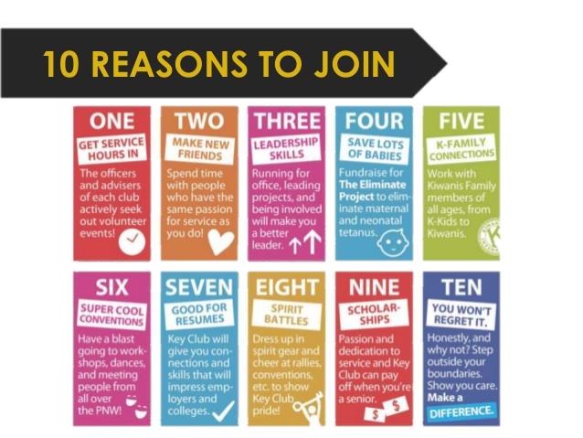
Why Members Should Join
Notes:
Some examples of why members should join. Made by Pacific Northwest District.
Explain that these are just some of the reasons that people join/should join Key Club
-Discuss and explain each reason
Ask some Key Clubbers why they first joined Key Club and why they stay committed to it.

Slide 5
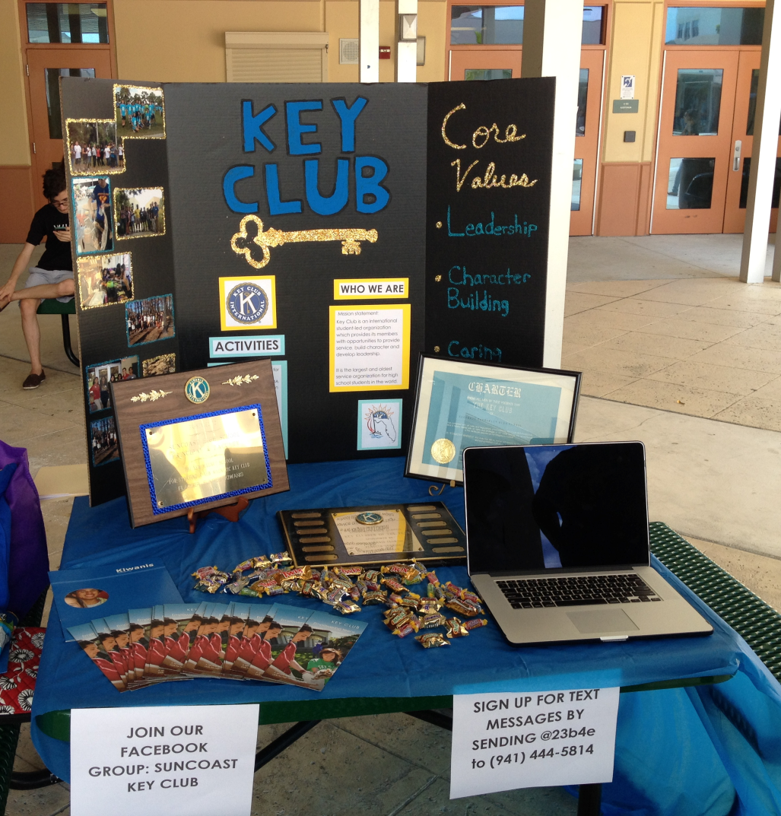
Examples of Membership Drives
Notes:
What aspects of each of these membership booths make it appealing?
How can each booth be made better?

Slide 6
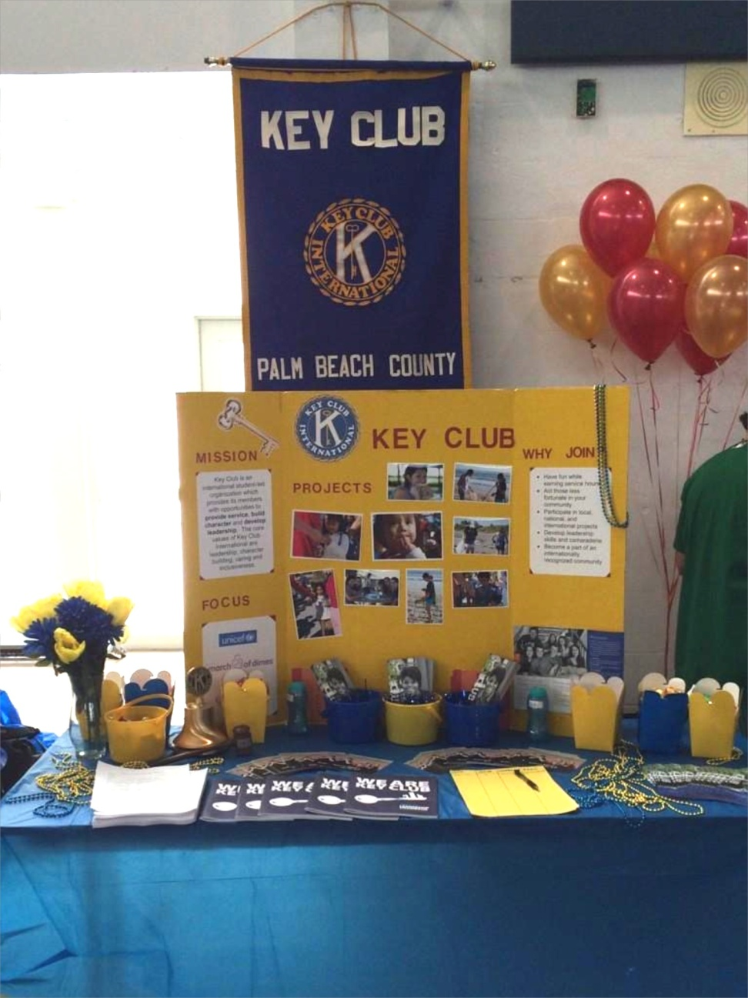
Examples of Membership Drives
Notes:
What aspects of each of these membership booths make it appealing?
How can each booth be made better?

Slide 7
Keeping Membership
Constant Activity
FUN is key!
Attendance at District & Zone Events
Offer Incentives
Notes:
So you have the members, now what? KEEP THEM INVOLVED
Constant Activity: Constant activity allows members plenty of options and avoids lags in key club spirit – keep them involved
FUN is Key!: Would you go to a boring meeting and listen to someone talk for 30 minutes, 45 minutes, an hour? NO! Get your members up, get energy flowing, get them excited to be there (Icebreaker examples on Florida website)
District and Zone Attendance: DCON attendance has been proved to increase members excitement about key club. Being in an environment with several other key clubbers that are excited to be there is an amazing and impactful experience. Bring members to KCKC and SZR- meet new key clubbers and show them what Key Club is about. Interconnectedness.
Offer Incentives: such as a Member of the Month award or Key Club chord for graduating seniors.

Slide 8
Keeping Membership
Meetings should be smooth
No chaos or last minute planning
Professional yet calm
Notes:
So you have the members, now what? KEEP THEM INVOLVED
Meetings should not be chaotic, they should be calm and easygoing
Everything for the meeting should be planned ahead of time such as who is talking about what. Never wait till the meeting to figure out these details
Keep the meeting calm and fun but don’t make it foolish. You are representing an international organization

Slide 9
Practice and Share
How does your club recruit members? How often?
Do you have any tips and tricks for recruiting members?
How does your club recruit members?

Slide 10
Resources
Need more help with membership development or retention?
Contact …
Lieutenant Governor
Membership Development Committee Chair: Maria Landron
division20b@floridakeyclub.org
Visit: floridakeyclub.org/resources/
Notes:
In the Florida Key Club website you will find a PowerPoints on How to Increase Membership and a guide to membership recruitment

Slide 11
Questions and Discussion
Notes:
Open the floor for discussion, questions, and tips.

