Slide 1
Membership 101
PRESENTED BY: ENTER PRESENTER’S NAME HERE!

Slide 2
What is Key Club?
Key club is the oldest and largest service organization in the world!
Key Club is a student-led service organization consisting of 5,000 clubs in over 30 countries!
Notes:
Largest student led service organization- Almost 250,000 members.
Key Clubbers have documented 12 million hours of service each year.
Key Club members are known for its leadership skills.
2

Slide 3
Membership 101
Vision: To develop competent, capable, caring leaders through the vehicle of service.
“Mission: An international, student-led organization providing its members with opportunities to perform service, build character, and develop leadership.”
Notes:
Key Club was created in mind to help create strong, helpful, servant youth leaders that will one day grow into servant adult leaders. This all was to help better the world and help the youth become bright, caring, individuals. Key Club is completely run by students with some help and advisory from a faculty and Kiwanis advisor. Key Club International is a servant organization sought to help its’ members preform service, build character, and develop leadership.
3

Slide 4
What is Student-led?
Key Club members decide how:
Club will function
Budget will be administered
Issues will be addressed
Notes:
Key Club is lead by its members, with the support of Kiwanis.
Young developing leaders have a unique opportunity to lead an enormous organization doing millions of hours of service each year.
Student led makes Key Club different from other youth organizations.
From the club to the International Board young men and women are leading this organization.
4

Slide 5
Where it begins… The Structure of Your Club
Officers and class directors deal with these matters:
Administration and planning of club.
Business of club.
Membership
Budget
Planning
Notes:
The Key Club board class directors consist of two members from each class level.
The Club board decides on such things as planning of service events, meetings, and special projects. They also create a club budget with the help of the District Treasurer, and they are in charge of holding meetings and gaining membership.
Did you know that the club bylaws set the price of membership?
5

Slide 6
Dues
Florida Key Club Dues are $11.50
Your club can add on an additional amount for funding.
Notes:
International Dues: $7.00
District Dues: $4.50
These dues go to Key Club International and then are split on the International level.
This does not include club dues
6

Slide 7
Key Club International Structure
International Board of Trustees
International Council: Board and Governors
District Boards
34 Districts
Divisions
Clubs
Board of Directors
Members
Notes:
Similar structure to Kiwanis.
How Key Club functions is different at times, because they are a different generation with different needs and interests.
The Key Club International structure is a little more confusing just because it is including people internationally which makes up for a larger board than one would see on a district board.
7

Slide 8
Structure: Who is on the district board?
Voting Members:
Governor
Secretary
Treasurer
Executive Assistant
Editor
Webmaster
Lieutenant Governor
Non-Voting Members:
Committee Chairs
Florida District Governor Shane Meagher
Notes:
The Florida District board is made up of 1 Governor, 1 Secretary, 1 Treasurer, 47 lieutenant Governors. These are the board members that can vote on district matters at board meetings. Non-voting members include: The DCON committee chair. This means that this member cannot vote on district matters at board meetings.
For more information see the Running for Higher Office Power Point!
8

Slide 9
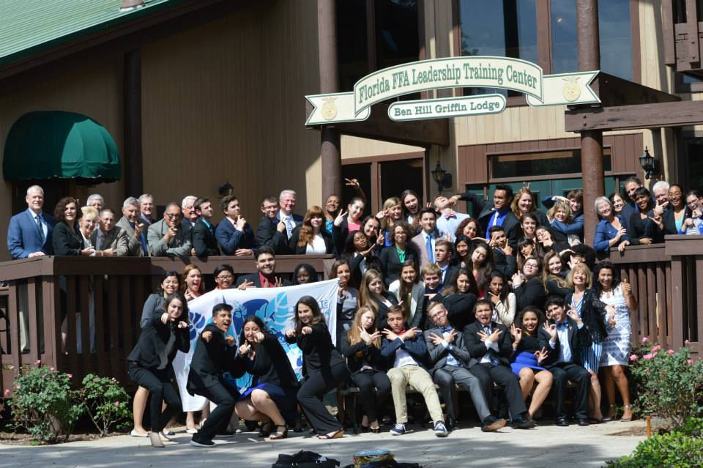
Structure: What do the Lieutenant Governor’s do?
Direct link to clubs.
Provides mentoring, education and knowledge
Holds divisional council meetings.
Provides training for club officers
Notes:
The Lieutenant Governor’s are the direct link to the clubs and provide mentoring, education and knowledge of service opportunities, hold DCM’s, and provide training for club officers and personal development. These leaders serve as representatives of the division on the district level. LTG’s also provide their divisions with information directly from the District and Key Club International.
9

Slide 10
Helpful Hints for K.C. Lingo!
K.C: Key Club
LTG: Lieutenant Governor
DCM: Divisional Council Meeting
DCON: District Conference
ICON: International Convention
ZA: Zone Administrator
M & M: Mentoring and Modeling Program
FDKC: Florida District of Key Club
SLP: Student Leadership Programs
Notes:
The “lingo” is important to know since often times Key Club members will talk in acronyms.
K.C: Key Club
LTG: Lieutenant Governor
DCM: Divisional Council Meeting
DCON: District Convention
ICON: International Convention
ZA: Zone Administrator
M & M: Mentoring and Modeling Program
FDKC: Florida District of Key Club
SLP: Student Leadership Programs
DA: District Administrator
KCKC: Key Club Kick-Off Conference
SZR: Spring Zone Rally
FLOF: Florida Opportunity Fund
OIS: Officer Information Sheet
MEP: Major Emphasis Program
KI: Kiwanis International
MNT: Maternal Neonatal Tetanus
KCI- Key Club international
CKI- Circle K International
That is some of the Key Club Lingo that you will see throughout the year!
10

Slide 11
Helpful Hints for K.C. Lingo!
DA: District Administrator
KCKC: Key Club Kick-Off Conference
SZR: Spring Zone Rally
FLOF: Florida Opportunity Fund
OIF: Officer Information Form
MEP: Major Emphasis Program
KI: Kiwanis International
MNT: Maternal Neonatal Tetanus
Notes:
DA: District Administrator
KCKC: Key Club Kick-Off Conference
SZR: Spring Zone Rally
FLOF: Florida Opportunity Fund
OIS: Officer Information Sheet
MEP: Major Emphasis Program
KI: Kiwanis International
MNT: Maternal Neonatal Tetanus
KCI- Key Club international
CKI- Circle K International

Slide 12
Major Emphasis Program
A service program to bring together all Key Club members to focus energies on making an international impact benefiting children.
How?
The Service Initiative
Service partnerships
Serving children by any means
Notes:
A service program to bring together all Key Club members to focus energies on making an international impact benefiting children.
How?
The Service Initiative
Service partnerships
Serving children by any means
There is information on the Service and Major Emphasis section on the District Website (www.floridakeyclub.org) with a Service Directory that list ideas for how to participate in Service and Major Emphasis.
12

Slide 13
KEY CLUB WEEK
WHAT? : Each day places an emphasis on service; including a Key Club Week fundraising project.
WHY? : Objective is to promote Key Club and seek media coverage, to make Key Club a household name.
WHEN?: November 2-6
Notes:
Key Club Week is the week that you can truly allow your club to shine in your school and community! This week was created to allow Key Club International Members show off just how awesome being in Key Club is and that being servant leaders is an important part of our society.
Talk to your club leaders about what your club is doing to celebrate!
13

Slide 14
Membership 101
The duties of a member of Key Club International are:
Pay Dues
Plan service projects
Help with committees
Attend weekly/monthly meetings
Notes:
The duties of a member of Key Club International are:
Pay Dues
Plan service projects
Help with committees
Attend weekly/monthly meetings
“Although not as many responsibilities as an officer, you still have responsibility.”
All of these things also depend on your club.
Your dues are established in your bylaws. You do not have to be an officer to plan service projects you simply must plan the details and present it to your club leaders as a service project.
14

Slide 15
Committees
What are Committees?
Why are they important?
What kinds of committees can you form?
How to start a committee?
Notes:
Include answers in notes
What are Committees?
Why are they important?
What kinds of committees can you form?
How to start a committee?
15

Slide 16
Everyone Needs Help! – Committees!
A committee is a group of people that work together to accomplish a goal.
Committees are important because they come up with many decisions that help shape your club’s year of service
Notes:
**DELEGATION IS KEY**
Examples of Committees include: DCON committee, ICON Committee, Service Project Committee,
Committees are given an assignment or a topic to research and accomplish goals that cannot be achieved at membership or at board meetings!
16

Slide 17
Want to Know More?- Resources
Key Club TV
View online at www.keyclub.org
District of Florida Key Club YouTube channel
Key Club International YouTube channel
Notes:
Key Club TV
View online at www.keyclub.org
New videos every week
Current and engaging video stories about the members and clubs
Great information on Key Club International News
17

Slide 18
Want to Know More?- Resources
www.floridakeyclub.org
Sunshine Source Magazine created by District Editor, Katt Crowdis
(http://floridakeyclub.org/sunshine-source/)
Project Ideas
Leadership Resources
Officer Resources
Submit questions
Notes:
Be sure to check out the Florida Key Club Website! There are tons of online resources that answer many FAQs!
18

Slide 19
Developing leaders through service since 1925...
Key Club International

