Slide 1
Robert F. Lucas Outstanding LTG Award
2015 - 2016
Notes:
This template can be used as a starter file for presenting training materials in a group setting.
Sections
Sections can help to organize your slides or facilitate collaboration between multiple authors. On the Home tab under Slides, click Section, and then click Add Section.
Notes
Use the Notes pane for delivery notes or to provide additional details for the audience. You can see these notes in Presenter View during your presentation.
Keep in mind the tt size (important for accessibility, visibility, videotaping, and online production)
Coordinated colors
Pay particular attention to the graphs, charts, and text boxes.
Consider that attendees will print in black and white or grayscale. Run a test print to make sure your colors work when printed in pure black and white and grayscale.
Graphics, tables, and graphs
Keep it simple: If possible, use consistent, non-distracting styles and colors.
Label all graphs and tables.

Slide 2
What You Need To Getting Started
Binder
Tab dividers
Florida District Lucas tab cover sheets
Notes:
Give a brief overview of the presentation. Describe the major focus of the presentation and why it is important.
Introduce each of the major topics.
To provide a road map for the audience, you can repeat this Overview slide throughout the presentation, highlighting the particular topic you will discuss next.

Slide 3
1. Club Newsletter (100 points maximum)
Produce and distribute at least ten monthly publications (minimum 6 Newsletters and 4 informational emails) for his/her club presidents. The following are to be taken into consideration.
a. Appearance
b. Content including Major Emphasis Program, Youth Opportunities fund
c. Timeliness of covered materials
d. Spelling/Grammar
(100 points maximum) TOTAL POINTS: ______
Minimum Documentation: Six Monthly Newsletters and Four Informational EMAILS
Notes:
This is another option for an overview using transitions to advance through several slides.

Slide 4
2. Club Officer Training (100 points maximum)
By November 15, the lieutenant governor must work with Kiwanis to provide the prescribed training of all club officers at a divisional training conference or a prearranged meeting with club officers. This can be held in conjunction with regional or zone conferences or can be done individually with the club. The prescribed training should at a minimum include position responsibilities. Committee structure, executing meetings, Kiwanis relations communication, Major Emphasis Program Youth Opportunities Fund, and Key Club and Kiwanis education.
NOTE: Include proof of Kiwanis involvement in your effort to train club officers.
The percentage of clubs receiving training will equal the total number of points awarded out of 80 (max 80) __________
Quality of the content of training: (max 20) ____________
(100 points maximum) TOTAL POINTS: ____________
Minimum Documentation: KCKC Agenda and Attendance Report
Notes:
Keep it brief. Make your text as brief as possible to maintain a larger font size.

Slide 5
3. Face–to–Face Contact (150 points max)
I. To earn the first 100 points, the Lieutenant Governor (LTG) must visit every club in his/her Division at least once. A visit is defined in the Florida District Visitation Form. The percentage of clubs visited will equal the total number of points out of 100.
Percentage of clubs visited (100 points max) _______________
II. To earn the remaining 50 points, the Lieutenant Governor may choose one of the following options:
A. The Lieutenant Governor attends club projects planned by clubs in his/her Division in addition to his/her first visit. Half the percentage of the clubs visited twice (calculated by dividing the number of clubs visited twice by the total of clubs within the Division and then dividing by two) will equal the total number of points out of 50.
B. Hold at least five Division Council Meetings (DCM). For each DCM at which a majority of the clubs is in attendance, the LTG will be awarded 10 points.
C. Options A and B may be combined
Club project/divisional council meeting (50 points max) _______
(150 points maximum) Total Points _________
Minimum Documentation: Visitation Report Form & LTG Monthly Report

Slide 6
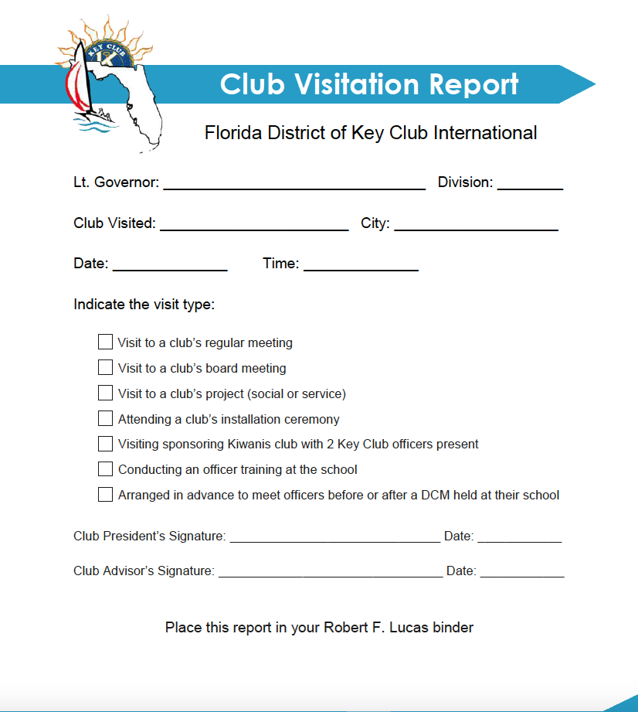

Slide 7
4. Required Attendance (250 points maximum)
The lieutenant governor must attend the following:
District Convention at the beginning and end of his/her term as lieutenant governor. __________________
All district board meetings __________________
c. District Officers Training Conference __________
200 points for attending all the above – Add 50 Bonus points for LTGs who attend the International Convention (ICON).
(250 points maximum) TOTAL POINTS:___________
Minimum Documentation:
1. Reports from DCON and ICON Conference Committees.
2. District Board Meeting minutes (page with listing of those in attendance)

Slide 8
5. Delegates at District Conference (100 points maximum)
Two-thirds of the clubs within the division must be represented by at least two delegates at the District Conference. The attendance of a two-thirds quorum results in 100 points while a one-third quorum results in 50 points.
(100 points maximum for 2/3 quorum)
(50 points for 1/3 quorum)
(100 points maximum) TOTAL POINTS ___________
Minimum Documentation: Report from District Election Committee

Slide 9
6. Dues Collection (100 points maximum)
The average percentage of district and International dues
collected by December 1 will equal the total number of points awarded.
(100 points maximum) TOTAL POINTS:___________
Minimum Documentation: Key Club District Dues Reports
(Be sure to retrieve and file the first December version of this report or get the report from the District Secretary)

Slide 10
7. Club Growth (100 points maximum)
You may receive points in either I or II for a maximum of 100 points for this section. If you accomplish more than what you may earn points for, include in Section 13 – Miscellaneous
I. Work with Kiwanis to increase the number of active clubs within the division during the administrative year as defined by Key Club International by either building new clubs or reactivating suspended clubs. (100 points maximum)
a. A new K-Family club will result in 100 points
b. Clubs on suspended status before the lieutenant governor’s term or revoked at International Convention will not affect points awarded. However, clubs reactivated from suspended status during the lieutenant governor’s term will receive 100 points each.

Slide 11
7. Club Growth (100 points maximum) Continuation
II. Work to increase the number of members in each club within the division from October 1 to February 28 of the Key Club year.
a. Increasing division membership by 20% will result in 75 points.
b. Increasing division membership by 30% will result in 100 points.
Note: To receive points all clubs in the division must meet district goals of having at least 20.
(100 points maximum) TOTAL POINTS _______
Minimum Documentation:
List of new Division clubs and reactivated clubs sent b District Secretary.
Copy of Florida District Secretary’s Report on Increase of Division Membership.
Evidence, communications or documentation showing how you assisted your clubs to increase numbers.

Slide 12
8. Submission of New Club Officer Information (100 points maximum)
New club officer information must be submitted by all clubs within the division to the Florida District Office.
a. By September 15 (100 points)
b. By October 15 (75 points)
(100 points maximum) TOTAL POINTS _________
Minimum Documentation: Copy of Florida District Secretary’s Report on Officer Information Forms

Slide 13
9. Division-Wide Function (100 points maximum)
Lieutenant governor are encourage to hold a division-wide
Function. President Council Meeting (or DCM's) do not count.
The percentage of clubs participating will equal the total number of points awarded.
(100 points maximum) TOTAL POINTS: ____________
Minimum Documentation: Submit function report ---
evidence of the time / location and percentage of clubs participating.

Slide 14
10. Communication (100 points maximum)
a. Committee Correspondence: (25 points maximum) ________ Lieutenant Governors are encouraged to communicate with members of their District committees regularly and to report the committees’ progress in the district. (25 points maximum – 5 points awarded for each piece of correspondence)
Minimum Documentation: Include correspondence you sent to your committee.
b. Monthly Communication: (50 points maximum) ____________ Lieutenant Governors are required to EMAIL and/or call the following once a month: District Governor, District Secretary, District Treasurer, District Administrator and Club Presidents.
Minimum Documentation: A hard copy of EMAIL correspondence or phone log should be submitted as proof of the initiation of the monthly communication.
c. Miscellaneous: (25 points maximum) __________________
Minimum Documentation: Submit sufficient proof that communication throughout the Lieutenant Governor’s term has gone above and beyond that of which is required. Points are awarded at the discretion of the judges.
(100 points maximum) TOTAL POINTS ___________

Slide 15
11. Monthly Reporting (50 points maximum)
Complete and file monthly reports regarding Board member performance with District Governor and District Secretary by pre-established deadlines. Deduct 5 points for each report not submitted and 2 points for each late report.
(50 points maximum) Total Points ___________
Minimum Documentation: District Secretary’s Spreadsheet showing Lieutenant Governor monthly reporting.

Slide 16
12. Service to Home, School and Community (150 points maximum)
Perform at least 50 hours of service to home, school and community through Key Club activities. Verification shall consist of a description of service performed certified by the Club President and Faculty Advisor. Deduct 5 points for every hour below 50.
(150 points maximum) TOTAL POINTS ____________
Minimum Documentation: Service verification letter from Club President and Faculty Advisor.
13. Miscellaneous (100 points maximum)
Submit evidence of performance above and beyond the call of duty, including recommendation of achievements not covered by these criteria. Points shall be awarded at the discretion of the judges.
(100 points maximum) TOTAL POINTS __________
Minimum Documentation: Evidence of performance above and beyond the call of duty and your letter describing such.

Slide 17
Questions?

