Slide 1
LARGE CLUB ADMINISTRATION

Slide 2
What is a “Large Club”?
How many member does a “large club” have?
Notes:
Ask the audience what they think??

Slide 3
What is a Large Club?
Any club with 50 members or more!
An “Extra-large club” is a club that has 85 members or more.
Notes:
As said by Key Club international.
Ask “So by this definition, how many of you have a large club?”
“an ‘extra-large’ club?”

Slide 4
Advantages of Having a Large Club
More Service
Diversity within the club and the projects
Notes:
The bigger the club the more types of members you will have. To have a successful club you should promote yourself to people of all different back grounds.

Slide 5
Challenges of Running a Large Club
Not all of your members will be able to participate in a single project
Will have to plan larger projects to have all of your members participate
Keeping track of your members service hours and involvement
Notes:
-Examples of large projects:
Carnivals
“Walk-A-Thons”
Campus/Street/Beach Clean-Ups
-Have time sheets at all events to keep track easier
Meet with officers to MAKE SURE ALL MEMBERS STAY INVOLVED
Avoid “ghost members” i.e paid dues, but no service

Slide 6
Member Recruitment
8th Grade/ Incoming Freshman Orientation
Social Networks
Flyers
Promotional Videos
For free recruitment materials
Call 1-800-Kiwanis
(1-800-549–2647)
Notes:
Incoming 8th graders are great to get into your club. They are looking for something to be apart of so go out there and sell yourself.
Social media is a wonderful tool when it comes to recruiting members.
You can put up flyers around your school to promote Key Club.
Or, you can use official Key Club promotional videos.

Slide 7
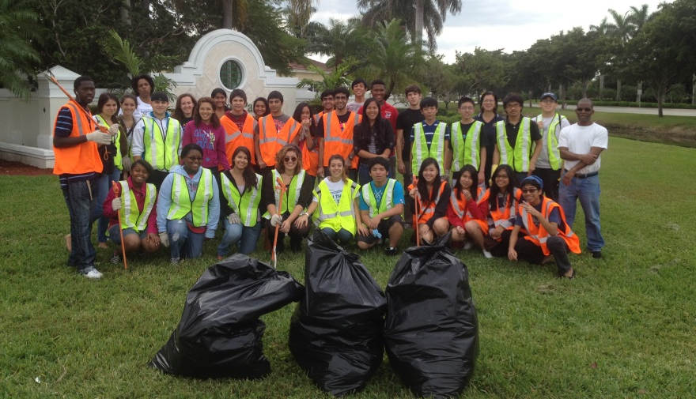
Member Retention
You need 3 things:
Service Projects
Ice Breakers
Communication
1
2
3
Notes:
Fun, creative, OFTEN are key aspects to service projects
Lacking ice breakers? Check out our district website!
Make sure your post on Facebook are short and to the point.

Slide 8
1. Service Projects
School campus clean-up
Nursing home visit
Volunteering at a local hospital
Tutoring
Recurring projects
Notes:
-Long term projects: Ex: Reading to children at a local elementary school every week, month, or semester. Every Child a Swimmer during the summer. Tutoring kids after school.
-Make a list and have a limit to how many people will be allowed to attend (this makes it seem like a privilege to attend)

Slide 9
2. Ice-Breakers
Extreme Rock, Paper, Scissors
2 truths and a lie
Boy and Girl Musical Chairs
Notes:
Boy and girl team. They play until there is one girl and one boy, who play a match.
3. You say 2 truths and one lie. The group has to pick which is the lie.
Boys kneel down and are the chairs. Girls sit down.

Slide 10
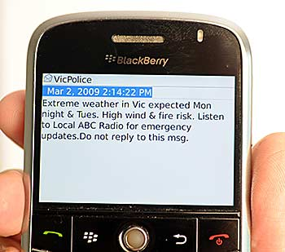
3. Communication
Phone Calls
Texts
Social Networks
Class Directors
School Announcements
Website
Bulletin Board outside of meeting room
Check out the app
“Remind101” Text Messages
Key Club Meeting Tomorrow!
Notes:
Text messaging- remind 101 – briefly describe
Ask the audience for their opinions on which are the best.

Slide 11
Location
Large space
Auditorium, large classrooms, gym, cafeteria, etc.
Make sure that you speak loudly
Notes:
Make sure to check with your school well in advance for a meeting places
Auditoriums
Chorus rooms
Larger classrooms
Speak loudly

Slide 12
Class Directors
Class Directors help communicate with the members in each grade
Helps relay messages from the board to the members
Notes:
Class directors are required and should be voted on by the club as a representative from the board to the members.

Slide 13
Take Attendance at Meetings
Class Directors can take roll for each class
Could choose to have members sign in and sign out
Notes:
Class Directors doing this, allows the meeting to move along, rather than the secretary calling every name in a large club
Whatever works best for your club

Slide 14
Club Social Events
Helps retain members in the club
More club bonding
Makes students who are not members, want to be apart of the club.
Notes:
Examples
Movie Nights (If you charge a fee, the money could go to a cause)
Picnics
Ice-Cream Socials
Pool Party

Slide 15
Key Parents
They can help plan events, projects, and fundraisers
Help monitor members at big events
Will allow more adults to be aware of the Kiwanis Family as well
Notes:
Get the parents involved

Slide 16
If You Follow These Tips, Your Club Will Be Very Successful!

