Slide 1
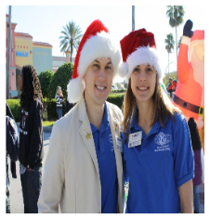
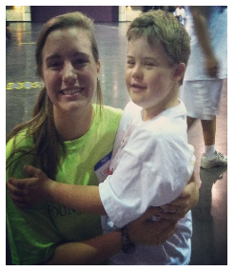
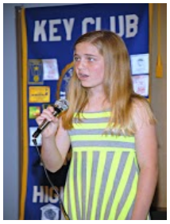
Kiwanis Family Relations
BY THE KIWANIS FAMILY RELATIONS COMMITTEE

Slide 2
What is the Kiwanis Family?
Consists of the various branches of Kiwanis International: K-Kids, Builders Club, Key Club, Circle K, Kiwanis, and Aktion Club

Slide 3
Why Should You Work with the Kiwanis Family?
The Kiwanis Family can help your projects come to life!
Funding
Set up and take down
Planning
Advertising

Slide 4
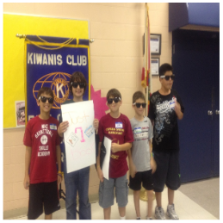
K-Kids
Objectives
To provide opportunities for working together in communities
To develop leadership potential
To foster development of a strong, moral character
To encourage loyalty to school, community, and nation
K-Kids is Kiwanis for elementary school children. It is a part of the Kiwanis Kids Program, which includes Bringing Up Grades (BUG) and Terrific Kids.

Slide 5
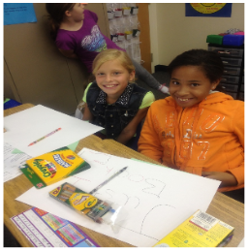
K-Kids
Cont.
Why Co-Sponsor?
Become a role model and mentor to the K-Kids Club
Help create the leaders of tomorrow
Recruit new Key Club members
Projects with K-Kids are inspiring and appeal to many volunteers

Slide 6
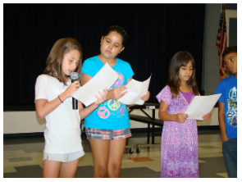
Builders Club
Builders Club is Kiwanis for middle school children. Their objective is to develop competent, capable, caring leaders through the vehicle of service.

Slide 7
Builders Club Cont.
How to Charter a Club
Talk with your Kiwanis Club to see if they are willing to co-sponsor with you
Aim for starting a club at “feeder” middle schools
Talk to the Principal of the middle school and get their support
Find a Faculty Advisor for the club
Find interested students
Hold club elections
Create club bylaws
Get them excited about Key Club!

Slide 8
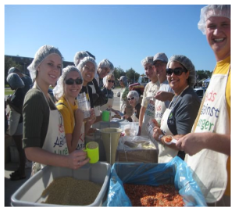
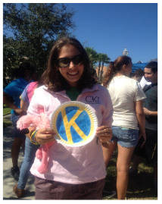
Circle K
Benefits
Everyone is in it for the love of service
It is often a smaller and more tight-knit group of people
It has more freedom when it comes to what projects it can do
Circle K is Kiwanis for college students.

Slide 9
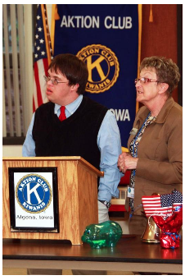
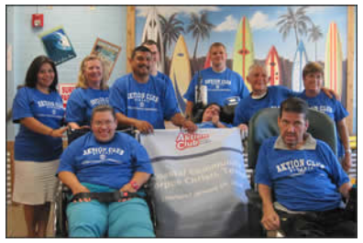
Aktion Club
Aktion Club is Kiwanis Sponsored for adults with disabilities.

Slide 10
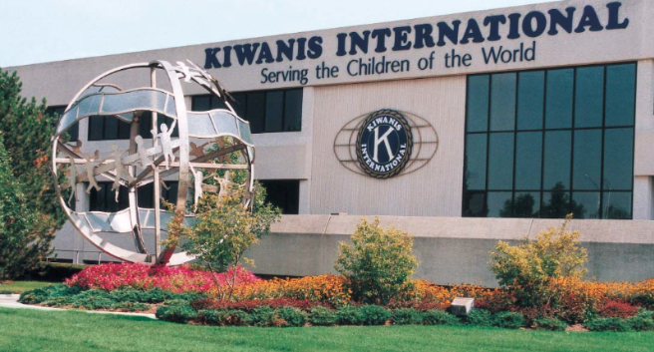
Kiwanis
Kiwanis International, made up of adults, is the head of the Kiwanis organization. It is the top of the K-Family and very much like Key Club in its structure. Kiwanis supports Key Club in many of its projects and endeavors.

Slide 11
Kiwanis Cont.
Benefits
Long term friendship and trust
Life mentors, best friends, dedicated neighbors, and professional role models
Funding for Key Leader, DCON, and ICON

Slide 12
Kiwanis Cont.
Possible Projects
Clean ups
Garage sales
Talent shows
Dinner/breakfast
Joint walk-a-thons
Dances
Fundraisers
Anything you can possibly imagine! If you need any ideas, ask around. Or, ask your LTG/Club Officers.

Slide 13
Kiwanis Cont.
Things to Keep in Mind when Working with Kiwanis
Always keep the Kiwanis Club up to date on what your Key Club is doing
Invite them to your Key Club meetings
Attend their meetings
Offer to help with their service projects and fundraising
Schedule a monthly/bimonthly K-Family event
Dress to impress
Keep a positive attitude
Always say thank you

