Slide 1
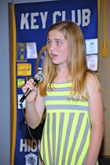
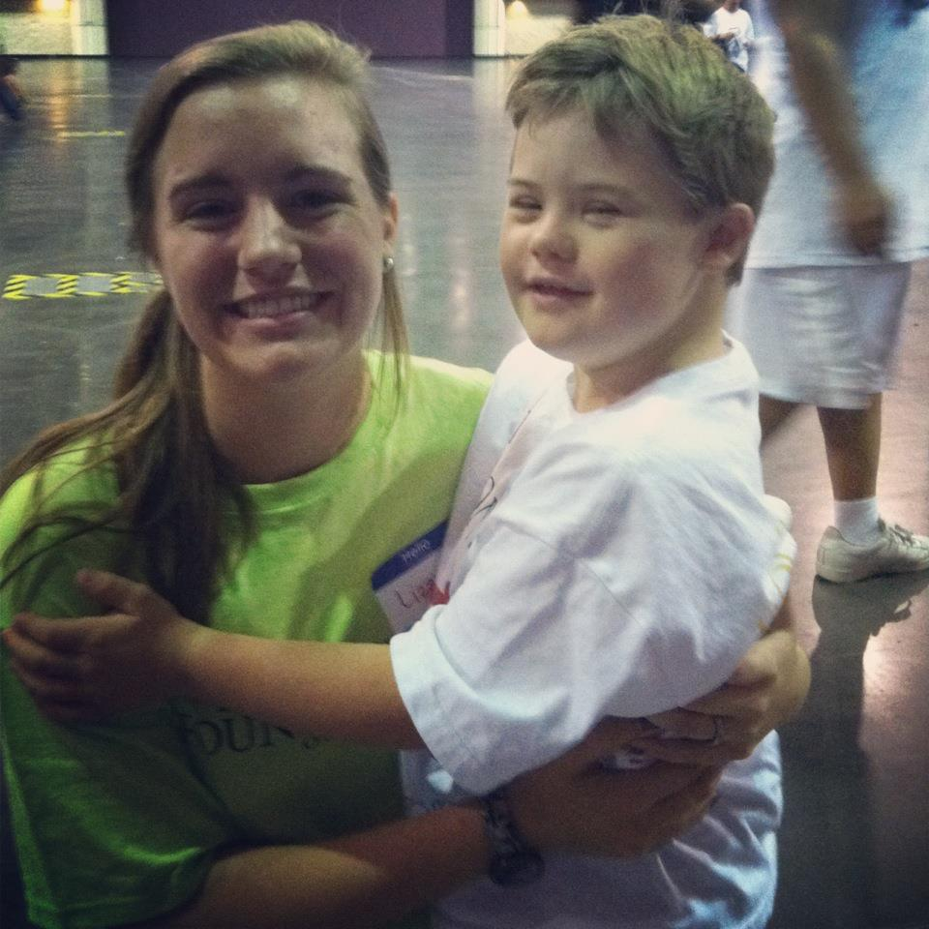
We are the Kiwanis Family
Notes:
Introduction: Hello! I am Lieutenant Governor _____ from ____ and I am so excited to be teaching you about how to work with the Kiwanis Family! I have worked with the various branches of the Kiwanis Family, and it is my goal that at the end of this workshop you will have the tools you need to forge a positive relationship with the Kiwanis family in your area!

Slide 2
Kiwanis Family Relations
The Kiwanis Family: K-Kids, Builders Club, Key Club, Circle K, Kiwanis, and Aktion Club
Notes:
Make sure to specify that K-Kids is the elementary version, Builders Club is the middle school version, Key Club is high school, etc.

Slide 3
Why Should You Work With the Kiwanis Family?
Kiwanis makes your Key Club dreams a reality!
Take-down
Set up
Volunteering
Funding
Planning
Advertising
Notes:
Can give personal experiences of helpful Kiwanis clubs
Kiwanis is always prepared to assist your club with it’s service projects, whether it is helping serve at an event or just giving advice
It is always a great idea to work with other Kiwanis Clubs

Slide 4
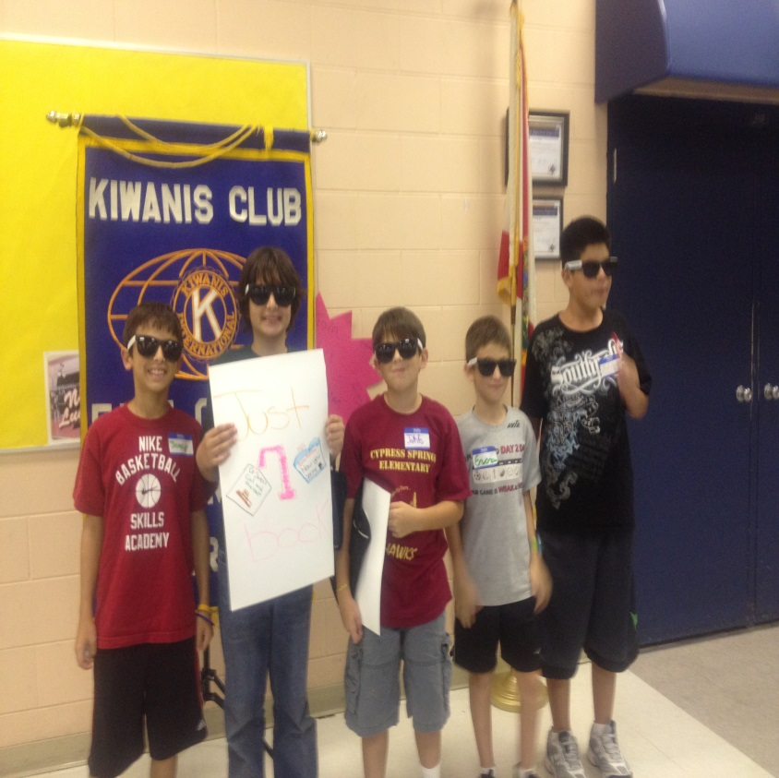
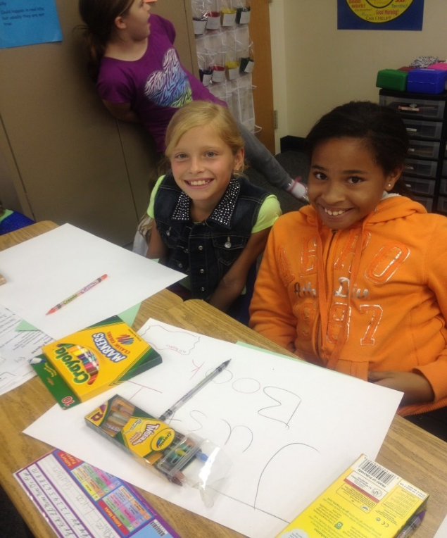
K-Kids
Notes:
A service club for elementary school students
Participate in Trick-or-Treat for UNICEF and March of Dimes
Terrific Kid is part of the K Kids program

Slide 5
K-Kids
K-Kids is Kiwanis for elementary school children.
It is part of the Kiwanis Kids Program, which includes:
-Bringing Up Grades and Terrific Kids.
Notes:
-Make sure to note that the Kiwanis Kids programs (Bringing up grades and Terrific Kids) aim to develop a child’s leadership and scholarly skills.
-Mention that an initiative of ours is to get more Key Clubs to sponsor K-Kids; they are self-sufficient and service-oriented!

Slide 6
-To provide opportunities for working together in our communities -To develop leadership potential -To foster development of a strong, moral character -To encourage loyalty to school, community, and nation
K-Kids Objectives

Slide 7
-You become a role model and mentor to the members of the K-Kids Club -You help create the leaders of tomorrow -You can recruit future Key Club members
K-Kids: Why Co-Sponsor? .
Notes:
Projects with the K-Kids are often very inspiring and appeal to many volunteers
Try to add your own personal experiences with working with K-Kids. People love to hear personal stories!

Slide 8
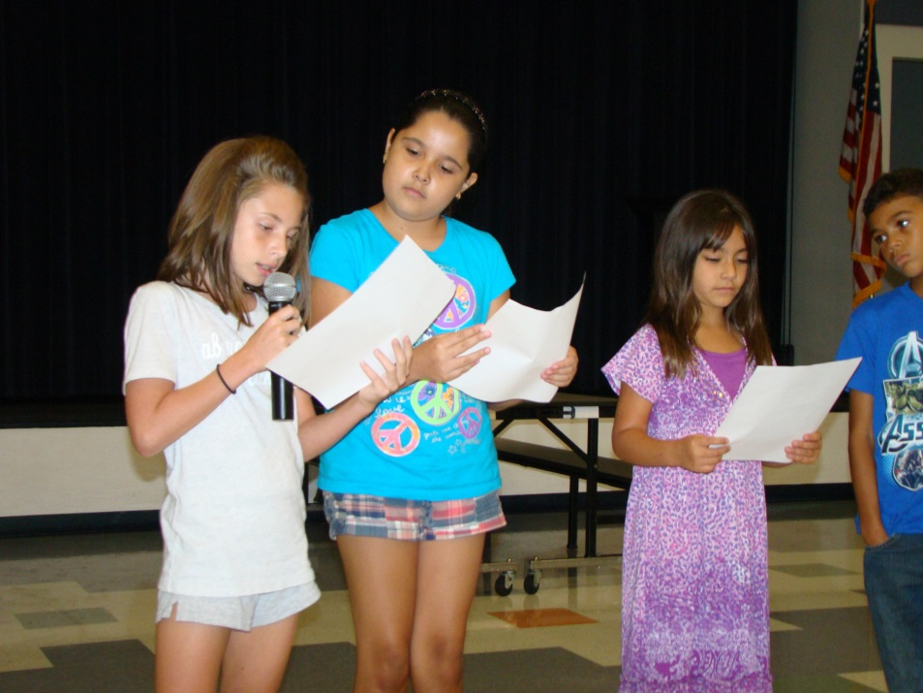
Builders Club

Slide 9
Builders Club
This is the middle school version of Kiwanis.
Objectives:
To develop competent, capable, caring leaders through the vehicle of service.
Notes:
Again add your own personal stories to make a connection. Give examples of service projects you can do with Builders Club (planting trees, car washes, cleaning parks)

Slide 10
1. Talk with your Kiwanis Club to see if they are willing to co-sponsor with you. 2. Talk to the Principal of the middle school and support. 3. Find a Faculty Advisor 4. Find interested students 5. Hold club elections 6. Create club bylaws
Builders Club- How to Charter a club
Notes:
- Be sure to mention the “How to Charter a K-Kids/Builders Club” power point on the Kiwanis Family Relations Page on our website!
*Hint: Aim for starting a club at your “feeder” middle schools
Define “feeder” school: school that feeds into your high school- this allows middle schoolers to become familiar with Kiwanis Family. Once they go into high school they are more likely to join KC.
create a flyer, talk to students, etc. to get students interested

Slide 11
Once you get started… What do you do?
Builders Club
Get them excited about Key Club!
Notes:
Once you get started - After starting or chartering a Builders Club start helping them with service and even invite them to help with your Key Club’s projects.
Get them excited about Key Club - As middle school students they have a few years to be in Builders Club and then it’s off to high school! Always encourage them to join Key Club!

Slide 12
Key Club
Notes:
Key Club International is the high school organization sponsored by Kiwanis International. Key Club assists Kiwanis in carrying out its mission to serve the children of the world. High school student members of Key Club perform acts of service in their communities, such as cleaning up parks, collecting clothing and organizing food drives. They also learn leadership skills by running meetings, planning projects and holding elected leadership positions at the club, district and international levels.
{Filling shoeboxes for local children, painting signs for Kiwanis Medieval Faire}

Slide 13
What we stand for
Vision
We are caring and competent servant leaders transforming communities worldwide.
Core values
Leadership, character building, caring and inclusiveness.
Motto
Caring–Our Way of Life
Notes:
Key Club International is the high school organization sponsored by Kiwanis International. Key Club assists Kiwanis in carrying out its mission to serve the children of the world. High school student members of Key Club perform acts of service in their communities, such as cleaning up parks, collecting clothing and organizing food drives. They also learn leadership skills by running meetings, planning projects and holding elected leadership positions at the club, district and international levels.

Slide 14
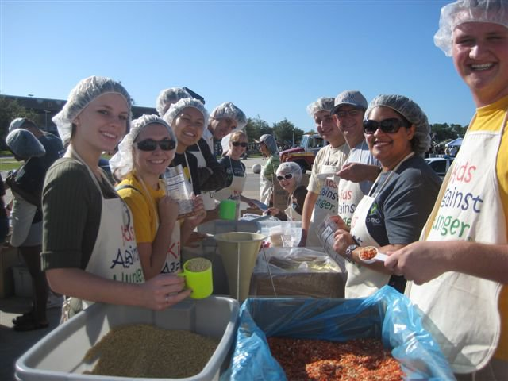
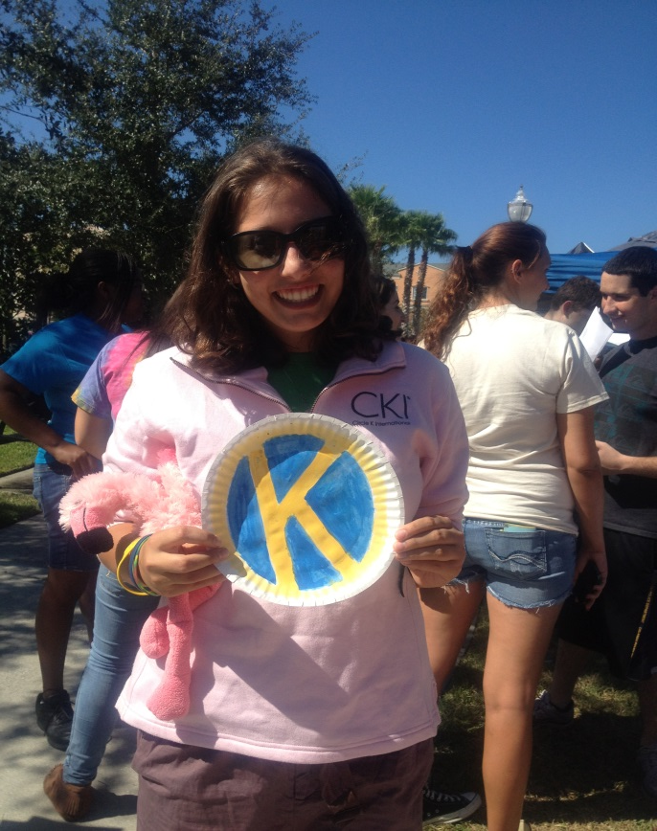
Circle K International
Circle K International

Slide 15
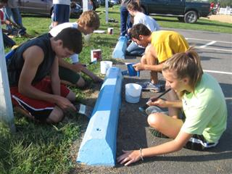
Circle K is Kiwanis for college students
Circle K International
Notes:
Again personal stories!
Benefits of joining CKI: - Everyone is in it for the love of service! - It is often a smaller and more tight-knit group of people - It has more freedom when it comes to what projects it can do(doesn’t have to go through faculty advisor as much)

Slide 16
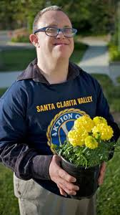
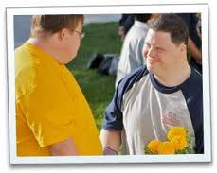
Aktion Club

Slide 17
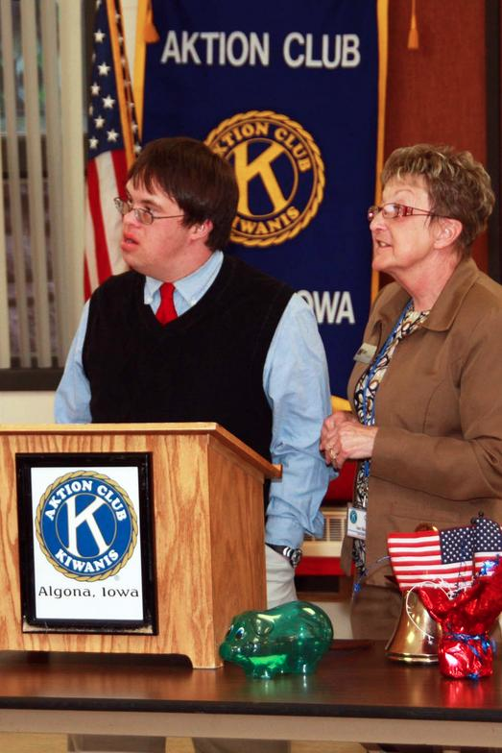
-Aktion Club is Kiwanis Sponsored for disabled or disabled adults -It is the only service club for adults with disabilities
Aktion Club
Notes:
Personal Stories!
With more than 12,000 members worldwide.
Volunteer with Kiwanis Clubs that help with Aktion Clubs and get Key Clubbers involved

Slide 18
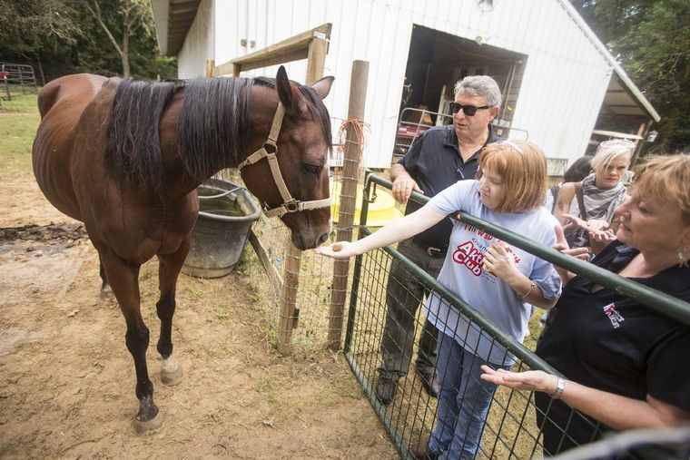
-Assist in training of new Aktion Club officers -Plan an Aktion Club prom for members -Organize a car wash to raise funds for a charity
Aktion Club – How Your Club can get involved
Notes:
There are many cool service projects that your club can get involved with a local Aktion Club. Some awesome service project ideas are:
Aktion Club’s Service Partner, Sleeping Children Around the World, (SCAW)

Slide 19
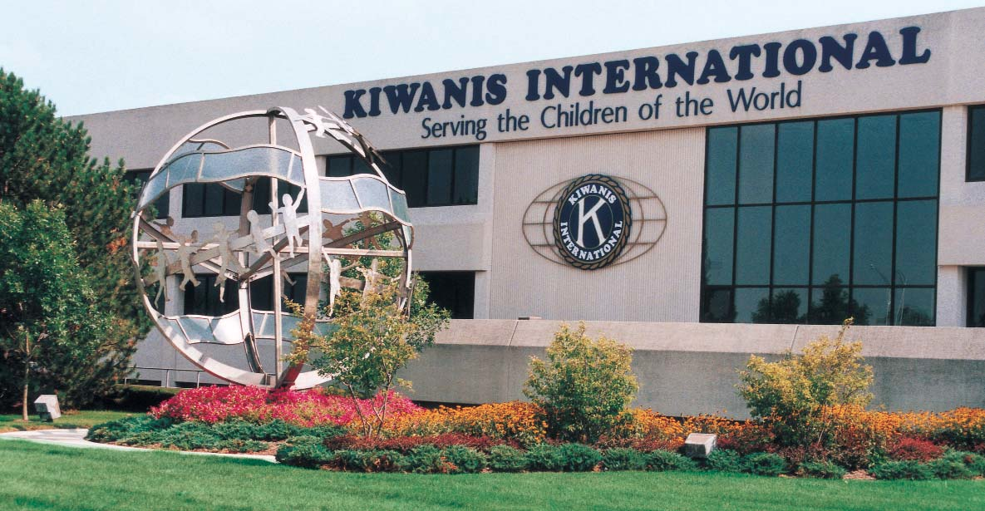
Kiwanis

Slide 20
- Kiwanis International is the head of the Kiwanis organization - Top of the Kiwanis-Family - It is very much like Key Club in its structure
Kiwanis
Notes:
made up of adults. Kiwanis supports Key Club in many of its projects and endeavors
Structure and leadership is similar (ex. Governor presides over district, Lt. Governors preside over divisions) Clubs operating all around the globe.

Slide 21
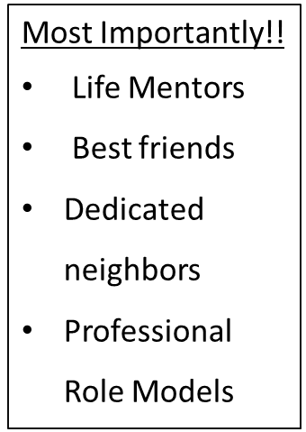
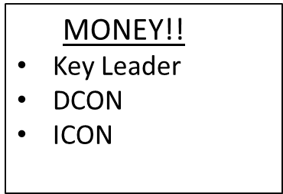
The Benefits of Working with Kiwanis

Slide 22
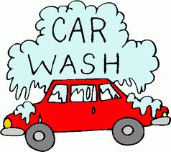
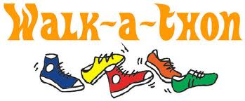
Potential Projects to get you connected: -Joint picnic -Clean ups -Garage sales -Talent shows
Kiwanis Family Projects!
Notes:
Ask people what they have done with their Kiwanis clubs
Other ideas to mention:
-Dinner/breakfast -Joint walk-a-thons -Dances -Fundraisers of all kinds -Hot Dog Eating Contest
Anything you could possibly imagine! If you need any ideas, ask around! Or, ask your LTG’s and Club Officers!

Slide 23
Things to Keep in Mind when working with Kiwanis
Invite them to your Key Club meetings and service projects
Offer to help with their service projects and fundraising
Schedule a monthly/bimonthly Kiwanis Family Event
Keep a positive attitude
Notes:
Attend their meetings and build a mutual relationship.
Instead of attending their project, create a joint project together
Other ways to work with them:
Keep Kiwanians up to date on Key Club events
Always say thank you!
Dress to impress

Slide 24
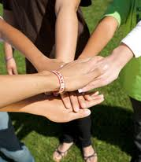
Remember we are family!
Notes:
If you have extra time at the end of the power point feel free to pull up the Kiwanis Family Relations Page and quickly go over the resources there.

