Slide 1




KEYS TO FUNDRAISING

Slide 2
The Basics
Two types of fundraising:
  Fundraising for your club
  Fundraising for service
  * Only fundraising for service results in service hours.
Notes:
Reasons for Fundraising:
To generate enough funds to support both our administrative and service accounts, we fundraise.
Explain that a service fundraiser is one in which all proceeds go to a service project such as March of Dimes or Children’s Miracle Network.
A fundraiser for a club, goes toward paying for an installation ceremony or for larger events like DCON.

Slide 3
CLUB FUNDRAISING

Slide 4
Club Fundraisers
A club fundraiser will bring in funds that are meant to directly benefit your members.
Club fundraisers do not count toward service hours.
For example:
  Fundraising for DCON
  Fundraising for club T-shirts
  Fundraising for a club social event
Notes:
What fundraisers do you have for DCON?
Ask the audience to raise their hands.
Encourage them to fundraise, for a greater amount of attendance at DCON.
Give examples of fundraisers
Yard/Bake Sales
Car washes
Etc.

Slide 5
FUNDRAISING FOR SERVICE

Slide 6
Fundraising for Service
In these fundraisers, proceeds go to a worthy cause.
You may also claim service hours for these events.
You can get service hours for participating and planning.
Notes:
If you need ideas as to organizations you can fundraise for, visit floridakeyclub.org to work with our partners or search for local charities.
You can seek out any organizations that need your help and are local to you, they most likely will be open to helping out.

Slide 7
Fundraising for Service
Our Partners:
Trick-or-treat for UNICEF
Children’s Miracle Network
March of Dimes
What other examples are you familiar with?
Notes:
- Some examples of our Key Club partners include Trick-or-Treat for UNICEF, Children’s Miracle Network, and March of Dimes
Are there any organizations you know of or work with, you would like to share?
Provide Examples of local organizations
Help Centers
Homeless Coalitions
Etc.

Slide 8
What Fundraisers Work?
  The ideal fundraiser requires little or no money to put on, but will result in great funds.
  Planning and effort is the key in any fundraiser!
Notes:
The ideal fundraiser requires little or no money to put on, but will result in great funds.
For any fundraiser to work well, the club must put planning and effort into conducting it.

Slide 9
What Fundraisers Work?
  Examples may include:
  Car Washes
  Bake Sales
  Pancake Breakfasts
  Movie days after school
  Raffles
Notes:
Ask your audience to get involved!
- What does your club do to fundraise?
Ask if anyone would like to share examples of fundraisers that have worked in the past.
Stress planning. The next slide will give a general outline for a fundraiser, but, this will be the number one way to guarantee a successful one.

Slide 10
Planning Fundraisers

Slide 11
One Step at a Time
Step 1:
Decide where you would like the funds you raise to go.
Do you want to fundraise for a charity or your club?
-Make sure everyone in your club is in accordance and is informed.
Notes:
This is a general outline for a fundraiser.
-Make sure to mention that each fundraiser is unique and will require different steps, but, all fundraisers can follow this general outline.
All officers should be well informed and in accordance of what/who you’re fundraising for. This will reduce any difficulties with the fundraiser, and increase your chances of participation and success with each officer. Members and volunteers should also understand this.

Slide 12
One Step at a Time
Step 2:
Decide what donations you might need to start.
What will this fundraiser cost you?
Notes:
Minimizing costs is always a plus when it comes to fundraisers.
Club officers, committee chairs, and advisors should work together to figure out what you’ll need to start off the project.
Make sure to track how much money you spend initially, and pay back (if that is the case) those who may have loaned your club money to kick start your fundraiser.

Slide 13
One Step at a Time
Step 3:
Approve any in-school fundraisers with your
club coordinators and school administrators.
Notes:
Every school has a different policy when it comes to fundraisers.
Most schools require that fundraisers be approved by administration before they begin.
Make sure that you, your club, and your school are on the same page with your fundraiser.

Slide 14
One Step at a Time
Step 4:
Make sure there is a clear leader of the project. For example, a designated officer or committee chair.
This will make the entire fundraiser run smoothly.
Notes:
This is where committee chairs might come in handy.
Look for dedicated members to run a fundraiser. This will create a sense of responsibility and also build future leaders for your club and will ensure that volunteers know who will be able to answer their questions.
If your fundraiser is large and requires more planning, it may be helpful to establish several committees along with their own committee chair, to get smaller goals done.

Slide 15
One Step at a Time
Step 5:
Gather Volunteers!
Make sure all your volunteers understand their role within the fundraiser and know the tasks assigned to them.
Notes:
Volunteers should come from within your club, and should be dues paid members.
Well in advance your volunteers should know when and where they will be volunteering.
-If necessary, establish members or adults who can assist with rides to the fundraiser if it isn’t local.
Creating a schedule will help everyone understand their role, and what days/times they will be working.
In addition, make sure all your volunteers know where the funds will be going and are knowledgeable about the organization. Everyone on your volunteer staff should be able to answer questions about whatever organization you are fundraising for.

Slide 16
One Step at a Time
Step 6:
Execute your fundraiser and follow through with your plans.
If planned correctly, your fundraiser should go well!
If things are not going according to plan, stay calm, have patience, and work to fix the issues.
Notes:
Following through:
If you offered volunteer hours to your volunteers make sure they do get those hours. This will reflect on you, your club, and Key Club in general.
Finally, when it comes time to sending in or counting money, make sure you do this in a timely and orderly fashion.

Slide 17
Sales Fundraisers
Fundraisers that sell products.
Key Club International and Kiwanis both have licensed merchandise that can be found at:
  www.keyprofits.com: Lollipops, Candy, and Smencils
  www.kiwanispeanutday.com: Candies, Nuts, Snacks
  You can also get involved in fundraisers where merchandise is provided.
Notes:
Some schools will allow you to sell treats (such as cookies or other food) after school, not during school. This can still raise plenty of money if it is done a few times during the year, so make sure you plan ahead. Before actually selling products, however, speak to your faculty advisor about your school’s policy on fundraising.
Sales Fundraisers are very common.
Again, these must be approved by your school!

Slide 18
Sponsorship Fundraisers
These fundraisers will require lots of planning but can be extremely successful.
Sponsors to consider:
Kiwanis
Local Businesses
Credit Unions
Individual Clubs

Slide 19
Sponsorship Fundraisers
Examples include:
  Bowl-a-thons
  Dance-a-thons
  Walk-a-thons
  Dinner Galas
Notes:
You can seek corporate sponsors by selling advertisements or by telling them they can make a tax-deductible donation.
Make sure to thank your sponsors for participating, and keep them updated with photos, phone calls, emails, or letters on how your fundraiser has been doing.

Slide 20
Donations
Start with donations from:
Kiwanis
Grants for projects
  FLOF and YOF (visit floridakeyclub.org)
Businesses
Sponsorships
Bucket Drops
Notes:
Kiwanis clubs will usually be willing to start a joint project, especially if you have a strong relationship with your Kiwanis Club. If you don’t have a relationship with your Kiwanis Club or they are not willing to participate, ask your Lieutenant Governor for help getting them to be active in your club.
Businesses will definitely want to help, because they can get a tax deduction (meaning that they can deduct the expense from their income on their tax return). Make sure to mention 501c3 status (non-profit organizations are tax-exempt)

Slide 21
Donations
Donations can come in the form of money or goods.
A business may be willing to give your club a discount.
Time frame must be considered.
Notes:
NOTE: Businesses such as Costco and most other chains will require at LEAST a few months notice. It is always beneficial to ask for donations as early as possible and plan your fundraisers in advance.
When it comes to donations, time frame for fundraising should always be considered.

Slide 22
Working With Businesses
Every business has its own protocol for donations.
You should first check a businesses' website for any paperwork.
Larger business will need lots of notice.
Notes:
Every Business will have its own protocol for donations.
You should first check a businesses' website for any paperwork concerning donations.
Most larger businesses will need advanced notice in order to give a donation.
Plan on searching for donations at least 2 months prior to your project. This will help you hone in on which businesses you can work with

Slide 23
How to Ask for Money
Be polite
Have confidence
Know your facts and information
Be professional
Notes:
Be extremely knowledgeable about your project and explain the impact it has on the community
Thank those who you are asking, regardless whether they are able to work with you
Don’t be pushy! Ask others for their help the way you would want someone to ask for your monetary assistance

Slide 24
FLOF & YOF

Slide 25
FLOF
The Florida Opportunity Fund (FLOF) is a grant for service projects available only in the Florida District of Key Club International.
FLOF can give clubs up to 2/3 the money necessary for service projects; however, schools must provide 1/3 of the amount they wish to receive.
The amount of money you can get ranges from $100 to $1,000.
Notes:
For more information on FLOF funding, visit floridakeyclub.org

Slide 26
YOF
The Youth Opportunities Fund (YOF) is Key Club International’s grant program for service projects.
You can receive funding for projects between $100-$2,000 once a year. Applicants must have an adult advisor.
Applications must be received by Key Club International on or prior to October 15.
Decisions are released Mid-January.
Notes:
For more information on YOF funding, visit keyclub.org or floridakeyclub.org

Slide 27
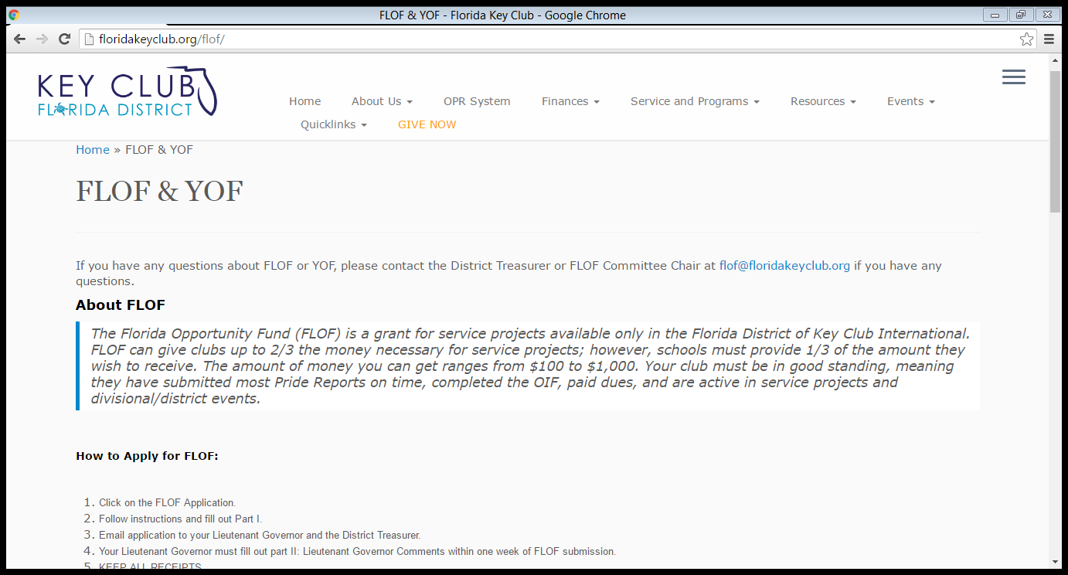

Notes:
In order to apply, go to www.floridakeyclub.org
Under the Finances Label you will find the “FLOF/YOF” Tab . The information necessary to apply to both FLOF/YOF is all on this page.

Slide 28
Resources
If you need help, contact one of these people:
Lieutenant Governor
Zone Administrator
District Treasurer
Online Resources
www.FloridaKeyClub.org/theeliminateproject
www.FloridaKeyClub.org/dcon
Key Club Fundraising Guide
Notes:
www.FloridaKeyClub.org/theeliminateproject >> Eliminate Project Idea Book
www.FloridaKeyClub.org/dcon >> DCON Fundraising Ideas
Key Club Fundraising Guide >> Key Club International Fundraising Ideas (simply Google Key Club Fundraising Ideas)

Slide 29
Questions?

