Slide 1
Keys to College
Presented by: Circle K International

Slide 2
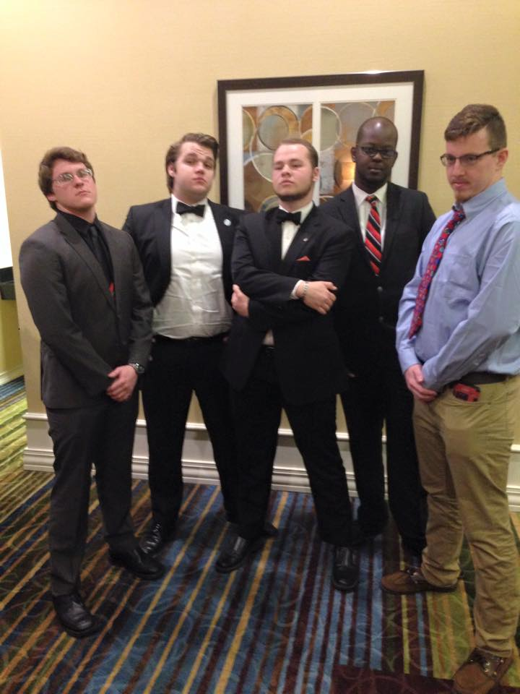
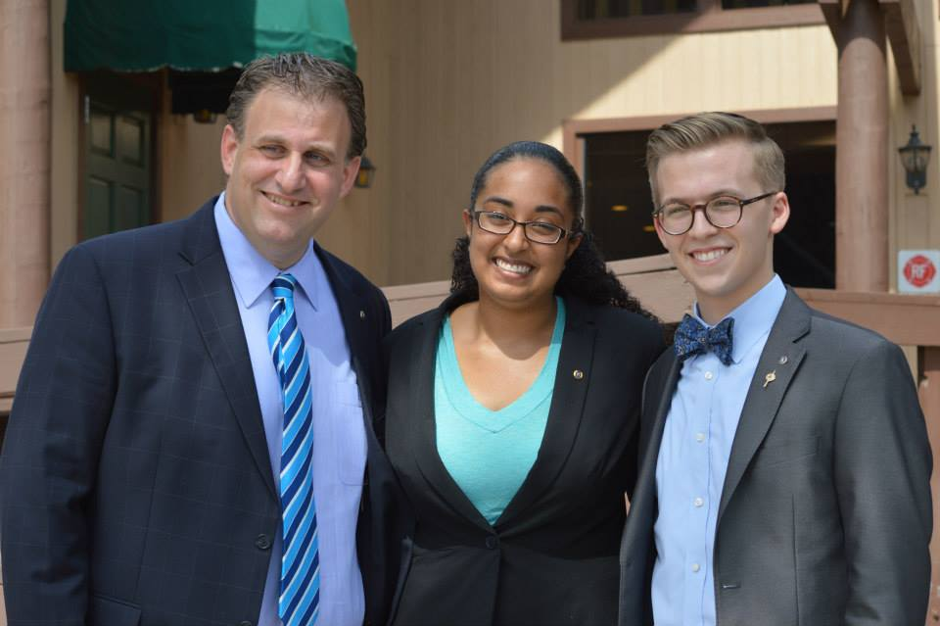
Why should I go to College?
Better job opportunities
Marketability (set yourself apart from others)
Learn a trade or a skill
Meet new people

Slide 3
Types of Schools
A 4 year public university
A 4 year private university
A 2 year community/state college
Satellite campus’ of larger universities
i.e USF St. Pete, FSU Panama City
What are the differences?
The cost of attendance, the class size, and the programs offered
Q/A
What type of college do you think would best fit you?

Slide 4
What Do Colleges Consider?
Difficulty of courses you have taken
Test Scores – ACT/SAT
Resume (extracurricular activities, jobs, leadership roles, awards)
Letters of Recommendation – Start asking teachers early & keep extra/digital copies for future use, may need 3 to 4 Recommendations
Essays – write clearly and concisely to help illustrate who you are and your passions; essays include personal statement
Your interest in the school
Q/A
What do you think you could bring to the college community?

Slide 5
The Application Process
Once you decide what schools fit you best, start applying!
Submit your applications early – the sooner you apply, the sooner you may be accepted
Mail/Online applications – most colleges use online applications; some out-of-state and private schools use mail applications
Common App – possibly your best friend, this allows you to apply to multiple schools if they use Common App
Make copies/keep digital copies of all information (resumes, letters of recommendation, essays, etc)

Slide 6
The College Essay
Possible Topics (from Common App)
Discuss an accomplishment or event, formal or informal, that marked your transition from childhood to adulthood within your culture, community, or family.
The lessons we take from failure can be fundamental to later success. Recount an incident or time when you experienced failure. How did it affect you, and what did you learn from the experience?
Describe a problem you've solved or a problem you'd like to solve. It can be an intellectual challenge, a research query, an ethical dilemma - anything that is of personal importance, no matter the scale. Explain its significance to you and what steps you took or could be taken to identify a solution.
Ask for feedback from teachers, parents, counselors, etc. – give them enough time to really review your essay

Slide 7
Paying for it All
Money for college is everywhere!
Federal Financial Aid
Complete FASFA every year (this is your ticket to all things federal aid) – this year it opens October 1st! You will need your parents’ tax information to complete FASFA
Grants – Federal and State governments provide grant funds, must apply for FASFA to receive grants
Scholarships – apply for as many as possible; the more you apply for the better chances you have in receiving scholarships; ask counselors/career center for local list of scholarship
Websites for Scholarships
Fastweb.com
Cappex.com
College Board’s Scholarship Search
Zinch.com
Student Loans
Finding a job (on or off campus)
Q/A
Do you feel you should get a job while in college?

Slide 8
Where Should You Live? On-Campus vs. Off-Campus
DORM LIFE
APARTMENT LIFE
Close to classes and campus activities
A great way to meet people
Parking is usually not an issue (because if you have a car, it is parked before everyone else gets to campus)
Dorms are sometimes more expensive but everything is included (water, electricity, etc.)
Have more independence
More privacy
Live with friends/people you know
Sometimes less expensive
Q/A
Where do you think you might live while in college?

Slide 9
How to Get Involved
Go to involvement fairs
Join clubs that spark your interest
Find clubs that relate to your possible major
Greek Life
CIRCLE K INTERNATIONAL!

Slide 10
What is Circle K International?
An international collegiate service organization sponsored by Kiwanis
Our Three Tenets: Service, Leadership, and Fellowship
Our Mission: to develop college and university students into a global network of responsible citizens and leaders with a lifelong commitment to service
Our Motto: Live to Serve, Love to Serve!

Slide 11
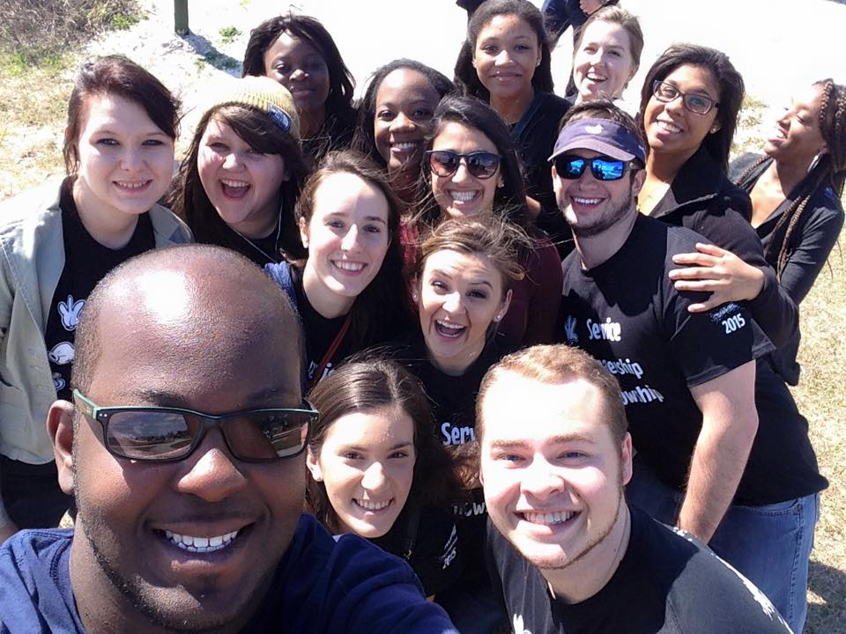
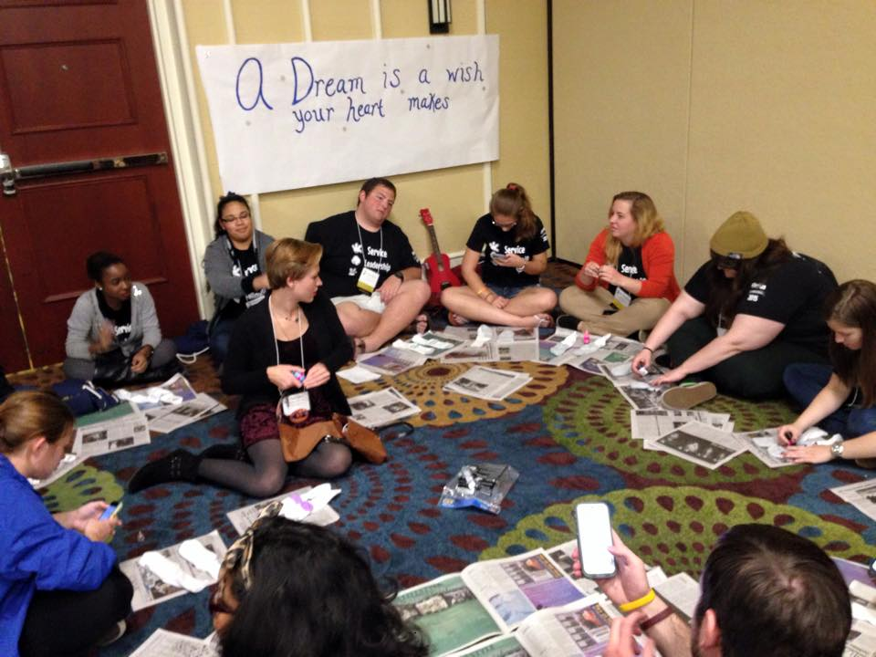
What is in CKI?
Community
Organized on more than 550 college and university campuses around the world; this provides a diverse network where ideas are shared and friendships are formed
Individual Development
Opportunities to develop professional and leadership abilities
Make professional connections
Scholarships
With the support of Kiwanis, scholarships are made available to Circle K members at both District Convention and International Convention

Slide 12
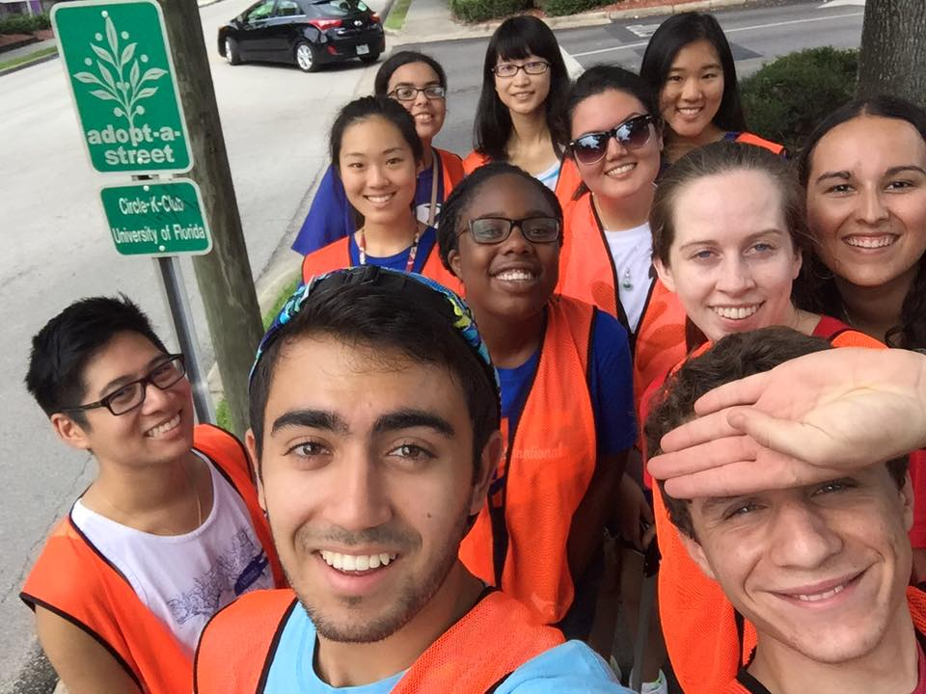
CKI Members Are Here to Help!
Just like we help in our communities, we are here to help you!
CKI members have been in your shoes! We don’t mind taking the time to chat with you!
To get an inside look, contact a college’s Circle K club and ask for a personal tour when you are looking at colleges or at the beginning of freshman year
Wondering how to contact us?

Slide 13
Tips WE Learned the Hard Way
Go to class – the one you decide to skip might be the one you have a pop quiz, the professor gives extra credit, or there is a test review
Do not take filler classes – they will ultimately delay your graduation date so take classes in your major and classes you need to fulfill graduation requirements
Rate my Professor is great, but can be wrong because of students who want revenge
Do not lose your Syllabus, you will need to refer back to it throughout the semester; luckily most professors post the class syllabus on the course website
Go to your professors’ office hours – the one on one time is where you can ask as many questions as you want
Leave yourself enough time to find parking and walk to class when you get to campus
Take care of yourself; get sleep, eat right, and exercise!

Slide 14
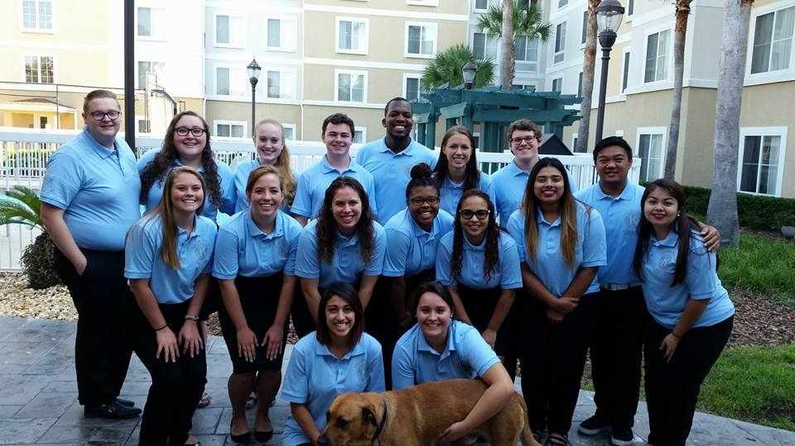
Ending Remarks
College is what YOU make of it
Take advantage of any opportunities that come your way
Most of all – have FUN!!
We hope to see you around!

