Slide 1
Key-Ping It Classy
A quick guide to dress codes and etiquette

Slide 2
Part I: Dress codes in Key Club
In Key Club, there are different dress codes that you will be expected to follow. Some examples are spirit wear, classy casual, business casual, business professional, and formal wear. They will be covered in order from least to most formal.

Slide 3
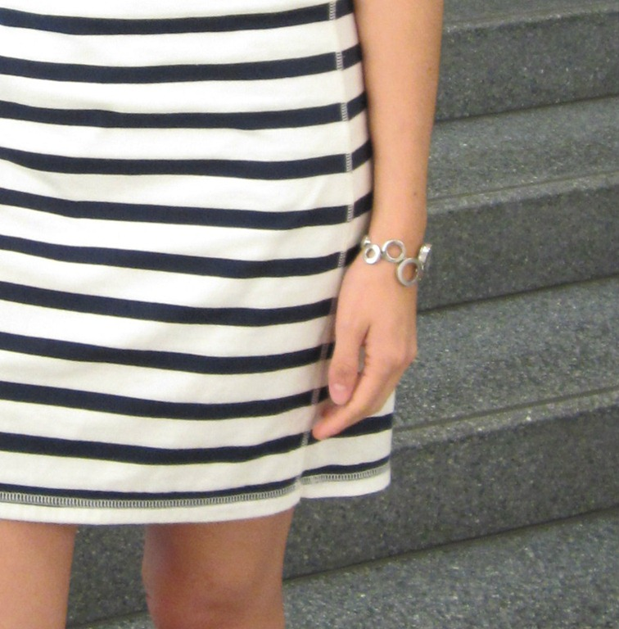
Fingertip Rule
All skirts, dresses, and shorts must be to at least fingertip length when standing upright, meaning that no fingertip may extend below the hem of the dress, skirt, or shorts.

Slide 4
Spirit Wear
Males:
Females:
Appropriate pants, jeans, or dress pants
Key Club/DCON related shirts
Casual or dress shoes
Appropriate pants, jeans, dress pants, or skirts
Key Club/DCON related shirts
Casual or dress shoes
Compliance with fingertip rule
Do not wear: Pajamas, sweatpants, short skirts or dresses, cleavage bearing tops, shirts that do not cover the midriff, or any other revealing clothing.

Slide 5
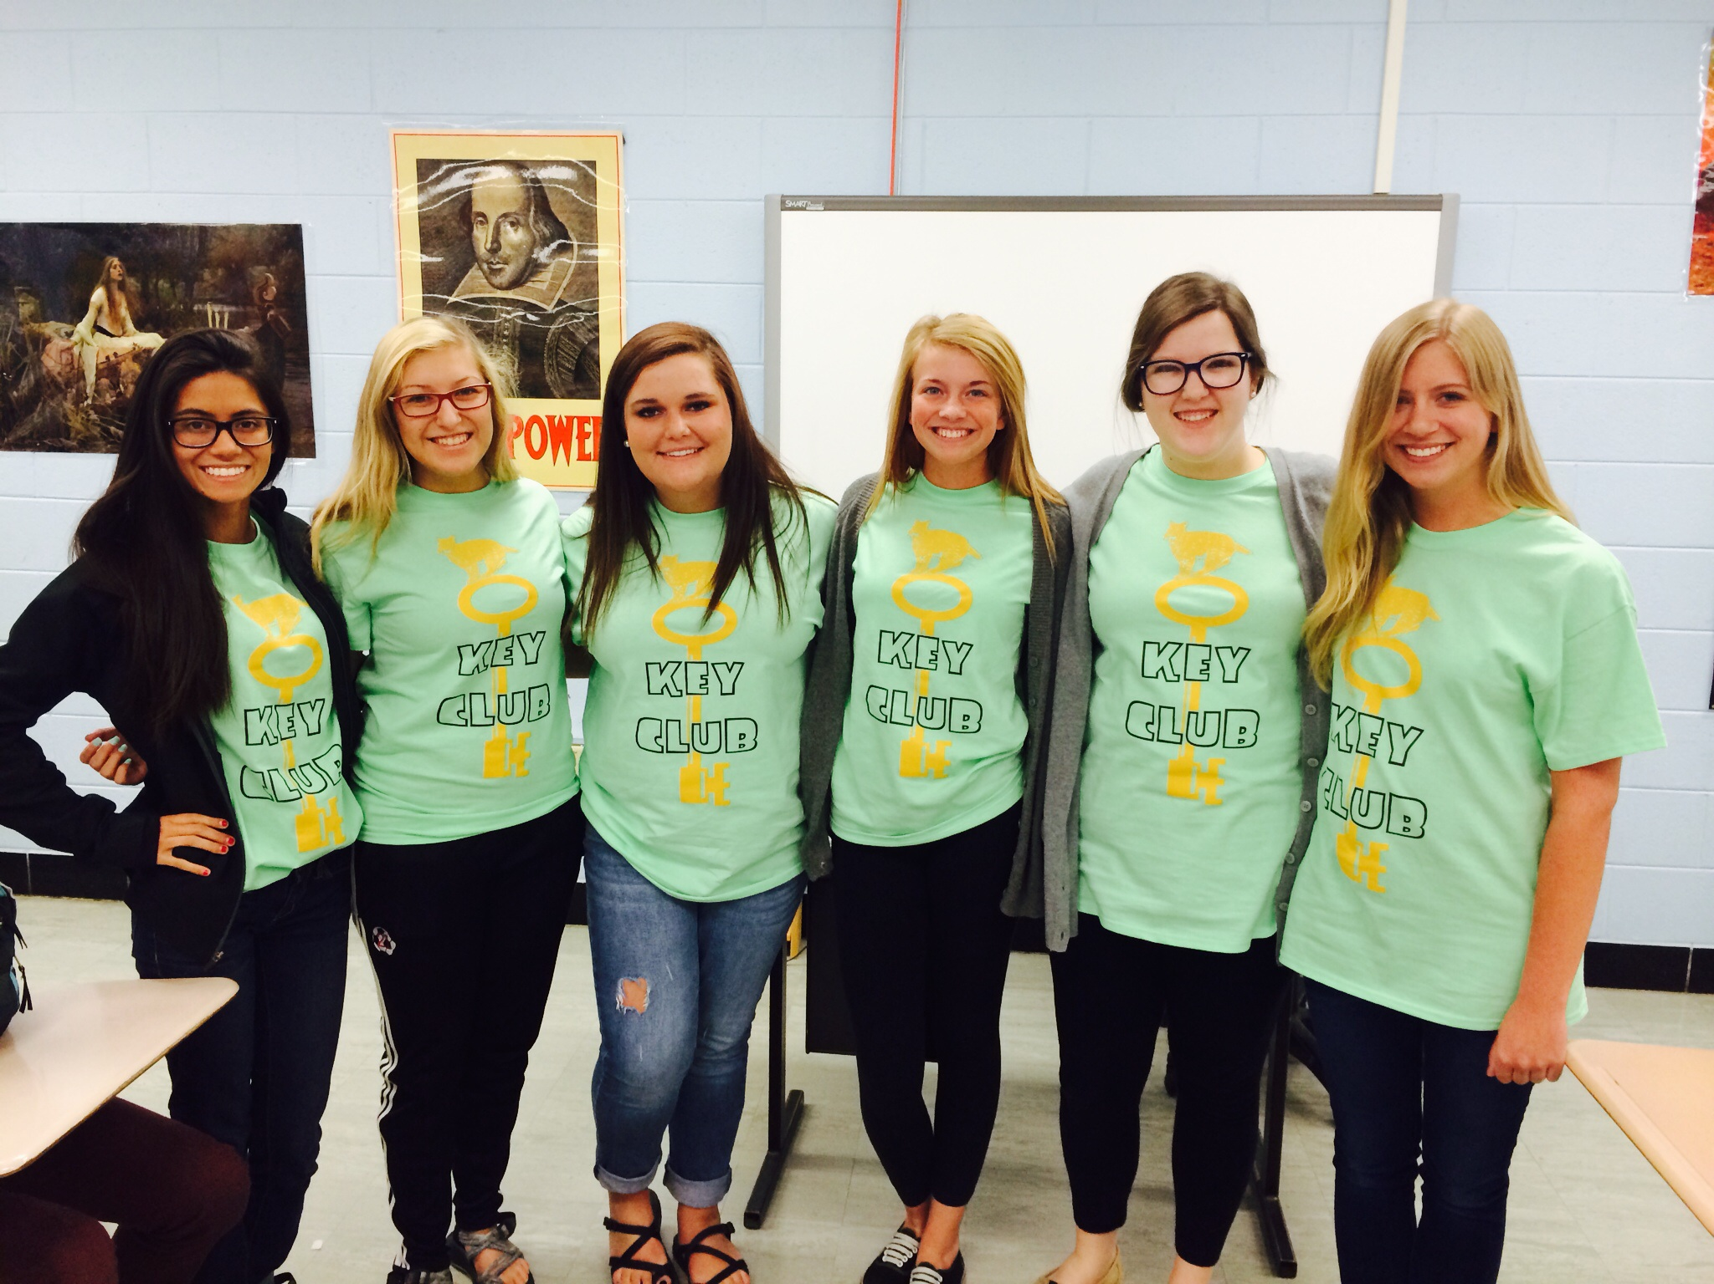
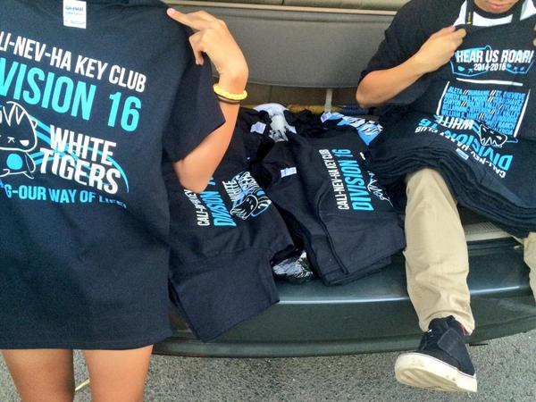
Spirit Wear: Examples

Slide 6
Classy Casual
Males:
Females:
Shorts or jeans
Collared shirts, sweatshirts, or other appropriate t-shirts
Casual footwear
Shorts, skirts, skorts, or jeans
Collared shirts, sweatshirts, or other appropriate t-shirts
Casual footwear
Do Not Wear: pajamas, short shorts, short skirts, shirts that do not cover the midriff, or any other revealing clothing.

Slide 7
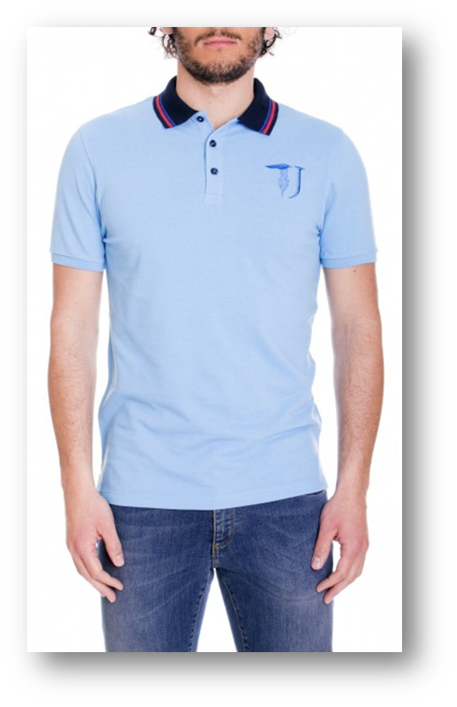
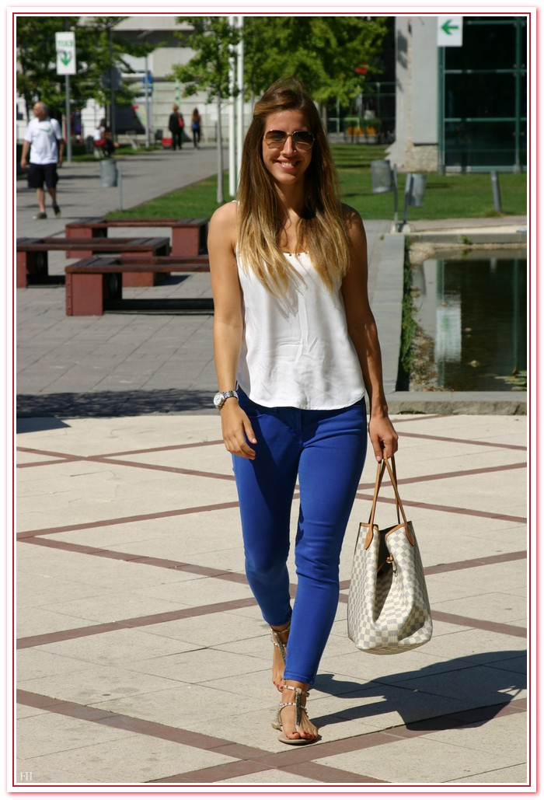
Classy Casual: Examples
For females

Slide 8
Business Casual
Males:
Females:
Dress pants
Button down dress shirt or polo
Dress shoes
Appropriate dress, skirt, or slacks
Blouse or collared shirt
Dress shoes including pumps, heels, wedges, or flats
Shoulders and bust covered
Compliance with fingertip rule
Do not wear: Flip-flops/sandals, short skirts or dresses, shorts, jeans, sweatpants, t-shirts, sneakers, or tennis shoes.

Slide 9
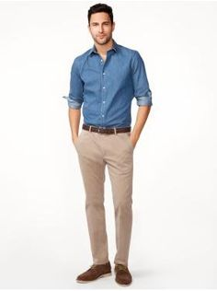
Business Casual: Examples
For males

Slide 10
Business Professional
Males:
Females:
Suit including dress pants, dress shirt, and jacket
Bow tie or neck tie
Dress shoes
Business dress or business suit
Dress shoes including pumps, heels, wedges, or flats
Compliance with fingertip rule
Shoulders and bust covered
Do not wear: Flip-flops/sandals, short skirts or dresses, shorts, jeans, sweatpants, t-shirts, sneakers, or tennis shoes.

Slide 11
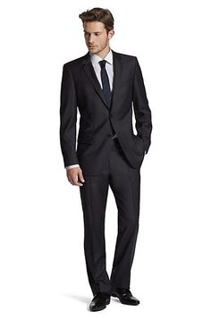
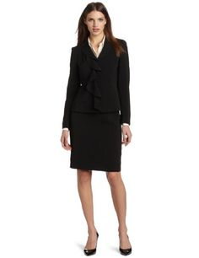
Business Professional: Examples

Slide 12
Formal Wear
Males:
Females:
Suit including dress pants, dress shirt, and jacket OR tuxedo
Bow tie or neck tie
Dress shoes
Business/formal dress or Sunday dress (prom/homecoming style)
Dress shoes including nice heels or flats
Shoulders may be revealed
Compliance with fingertip rule
Do not wear: Flip-flops/sandals, short skirts or dresses, shorts, jeans, sweatpants, t-shirts, sneakers, or tennis shoes.

Slide 13
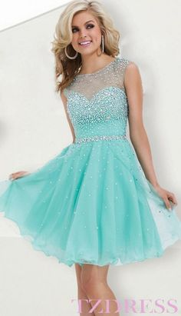
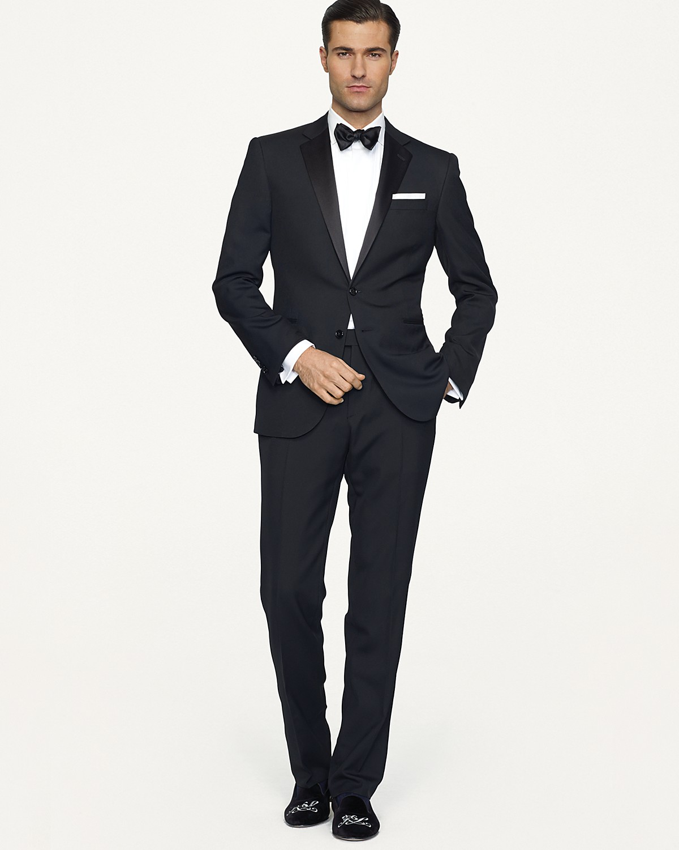
Formal Wear: Examples

Slide 14
Part II: Etiquette
Basic table manners:
Place your napkin in your lap.
If you leave the table during the meal, place your napkin on the table, to the left of your fork.
Work from the outside in with utensils.
When you’re taking a break, rest your fork and knife entirely on the plate. When you’re finished, place them diagonally on the plate, side by side, with the handles at four o’clock.

Slide 15
Basic Table manners: Continued
Never use your hands to eat if utensils are available.
Try not to be too loud while at the table.
If you drop something, pretend that it didn’t happen, but if a drop or spill is too major, discreetly call a server.

Slide 16
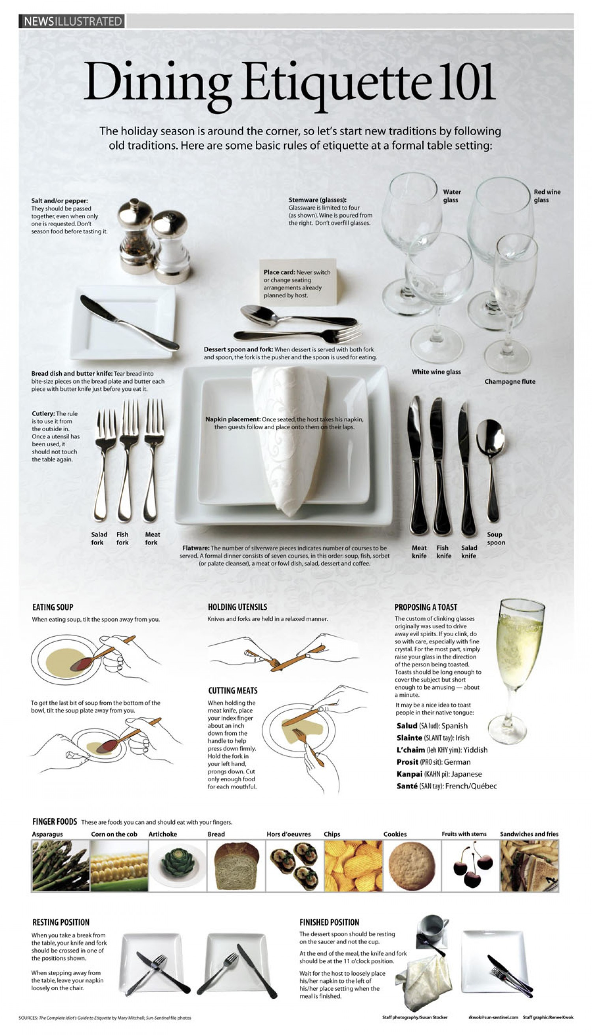

Slide 18
Just remember these simple rules, and you’ll always Key-p it classy!

