Slide 1
Key Club Trivia
Do You know All There is to Know About Key Club?

Slide 2
Kiwanis Family | History | International | District | Misc.
10 | 10 | 10 | 10 | 10
20 | 20 | 20 | 20 | 20
30 | 30 | 30 | 30 | 30
40 | 40 | 40 | 40 | 40
50 | 50 | 50 | 50 | 50

Slide 3
KIWANIS FAMILY: 10
The three Kiwanis-sponsored clubs for elementary children

Slide 4
KIWANIS FAMILY: 10
K-Kids
Bring Up Grades (BUG)
Terrific Kids
Notes:
Aktion club is the only branch of Kiwanis (besides Kiwanis itself!) that is for adults.

Slide 5
KIWANIS FAMILY: 20
The collegiate branch of Kiwanis that is always mistaken for a chain of gas stations

Slide 6
KIWANIS FAMILY: 20
Circle K International
(CKI)
Notes:
CKI’s motto is” Live to Serve, Love to Serve”
Today, CKI is the largest collegiate service organization, with a membership of more than 12,600 collegians on more than 500 campuses worldwide.

Slide 7
KIWANIS FAMILY: 30
Date when Key Club was founded

Slide 8
KIWANIS FAMILY: 30
1925
Notes:
Key Club is the oldest and largest service program for high school students. It is a student-led organization that teaches leadership through service to others. We have approximately 260,000 members in approximately 5,000 clubs

Slide 9
KIWANIS FAMILY: 40
Location of the Kiwanis International Office

Slide 10
KIWANIS FAMILY: 40
Indianapolis, IN
Notes:
This is where last years International Convention was held! This is also where Key Club International Board members go to have board meetings.

Slide 11
KIWANIS FAMILY: 50
The Kiwanis Governor of the Florida District this year (2016-2017)

Slide 12
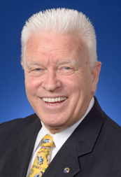
KIWANIS FAMILY: 50
Governor Gary Frechette
Notes:
Her Governors project, Christmas in July, is to provide personalized necessities for homeless children who she refers to as the “invisible homeless”.

Slide 13
HISTORY: 10
Year Kiwanis was founded

Slide 14
HISTORY: 10
1915
Notes:
Key club was born 10 years later!
This past year (2015) was Kiwanis’ 100th anniversity

Slide 15
HISTORY: 20
Year in which the Florida District became the first district of Key Club International

Slide 16
HISTORY: 20
1939
Notes:
The Florida District was actually the first district to be formed in Key Club International

Slide 17
HISTORY: 30
Year when females were admitted into Key Club

Slide 18
HISTORY: 30
1977
Notes:
Kiwanis began admitting females ten years later in 1987

Slide 19
HISTORY: 40
Year when Key Club reached International status

Slide 20
HISTORY: 40
1943
Notes:
This year was also when we chose our first International President, Malcolm Lewis from the Florida District.

Slide 21
HISTORY: 50
Year when the 1,000th Key Club was chartered

Slide 22
HISTORY: 50
1952
Notes:
Just 27 years after Key Club was founded. That’s an average of almost 40 clubs per year!

Slide 23
INTERNATIONAL: 10
Name of the current Key Club International President
(2016-2017)

Slide 24
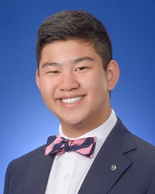
INTERNATIONAL: 10
Devin Sun
Notes:
Rip was an International Trustee before he ran for his position as international President. He is from the Alabama district.

Slide 25
INTERNATIONAL: 20
Name of the International Trustee that looks over the Florida District

Slide 26
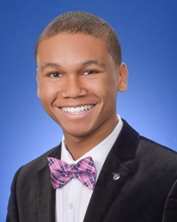
INTERNATIONAL: 20
Clifford Young
Notes:
Amy is from the Texas-Oklahoma District and was a Lieutenant Governor before she ran for her current position as International Trustee

Slide 27
INTERNATIONAL: 30
Name of the first Key Club International President

Slide 28
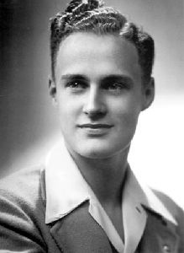
INTERNATIONAL: 30
Malcolm Lewis
Notes:
He was from the Florida District!

Slide 29
INTERNATIONAL: 40
Number of nations in Key Club International

Slide 30
INTERNATIONAL: 40
37
Notes:
Japan is the most recent nation to join the Key Club family

Slide 31
INTERNATIONAL: 50
Number of clubs and members in Key Club International

Slide 32
INTERNATIONAL: 50
Approximately 260,000 members in about 5,000 clubs
Notes:
Our sister Districts for this year are Illinois Eastern Iowa, and Eastern Canada

Slide 33
District: 10
Florida District Governor for the 2016-2016 year

Slide 34
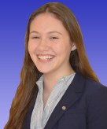
District: 10
Governor Martha Grace Hagan
Notes:
DCON is planned and put on by a DCON chair and multiple committees of Lieutenant Governors such as the Membership Education and Development Committee, Sargent-At-Arms committee, Registration Committee, and many more.

Slide 35
District: 20
Year that the Florida District was established

Slide 36
District: 20
1939
Notes:
Spring Zone Rally is where members go to elect their Lieutenant Governor and hear candidate speeches from those seeking a District position.
KCKC is where new officers and members go to get trained about Key Club and their responsibilities.

Slide 37
District: 30
2016-2017 Governor’s Project

Slide 38
District: 30
Feeding Our Future
Notes:
Lieutenant Governor duties consist of making newsletters, holding divisional council meetings, visiting their clubs, attending board meetings, and much more.

Slide 39
District: 40
Name of the Florida District’s online forum

Slide 40
District: 40
Key-nnect
Notes:
Each District Governor must choose a Governor’s Project. Our District Governor this year is Shane Meagher and his Governor’s Project is Key Goes Green

Slide 41
District: 50
Name of Florida District’s official magazine

Slide 42
District: 50
The Sunshine Source
Notes:
These are Key Clubs preferred charities.

Slide 43
MISCELLANEOUS: 10
The four Key Club core values

Slide 44
MISCELLANEOUS: 10
Leadership
Character Building
Caring
Inclusiveness

Slide 45
MISCELLANEOUS: 20
Location of International Convention in 2017

Slide 46
MISCELLANEOUS: 20
San Antonio, Texas
Notes:
The Florida District is taking a bus tour to ICON this year! More information can be found at floridakeyclub.org

Slide 47
MISCELLANEOUS: 30
Last nine words of the Key Club pledge

Slide 48
MISCELLANEOUS: 30
… combat all forces which tend to undermine these institutions.
Notes:
November is also Kiwanis Family Month

Slide 49
MISCELLANEOUS: 40
U.S. Senators that were Key Clubbers

Slide 50
MISCELLANEOUS: 40
Bill Nelson – Florida
Richard Burr – North Carolina
Trent Lott - Mississippi
Notes:
Every Kiwanis Family branch has a vision statement.
Kiwanis: We will be the world's premier organization engaging adult and youth volunteers to improve the quality of life worldwide.
K-kids, Builders Club, and Aktion Club: To develop competent, capable, caring leaders through the vehicle of service.
CKI: To be the leading global community-service organization on college and university campuses that enriches the world one member, one child and one community at a time

Slide 51
MISCELLANEOUS: 50
Two male actors who were past Key Clubbers

Slide 52
MISCELLANEOUS: 50
Tom Cruise
Brad Pitt
Notes:
The first Key Club was chartered in 1925 in Sacramento California.

Slide 53
Bonus!
Name of the unofficial Key Club International mascot

Slide 54
Bonus!
Paco the Penguin

