Slide 1
Key Club Graphic Standards
By Florida District Editor Jada Mohammed

Slide 2
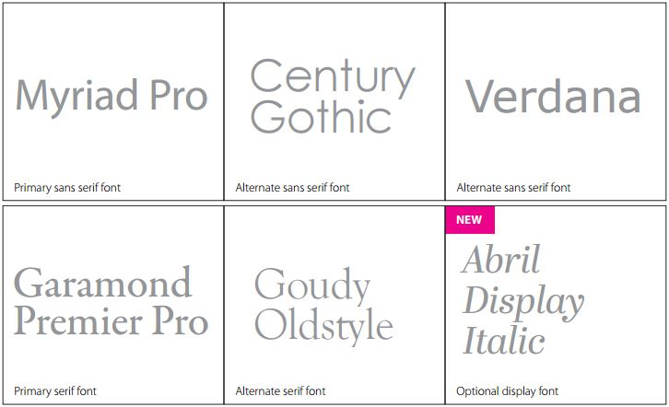
Key Club Fonts

Slide 3
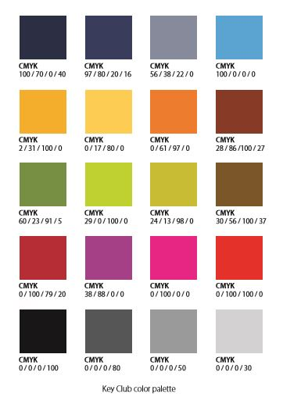
Key Club Colors
You can copy and paste this into the program you are using and utilize the eyedropper tool in the color menu to use these colors.

Slide 4
Pencils

Slide 5
Pencils

Slide 6
Pencils

Slide 7
Pencils

Slide 8
Pencils

Slide 9
Blue Doodles

Slide 10
Regular Doodles

Slide 11
Blue Logos

Slide 12
White Logos

Slide 13
Black Logos

Slide 14
Key Club Emblems

Slide 15
Florida Logos

Slide 16
The Eliminate Project Logos

Slide 17
Eliminate Graphics

Slide 18
Eliminate Backgrounds

Slide 19
Graphics

Slide 20
Headers

Slide 21
Headers

Slide 22
Headers

Slide 23
Headers

Slide 24
Headers

Slide 25
Headers

Slide 26
Backgrounds

Slide 27
Backgrounds

Slide 28
Click here to view the 2015 brand guide.

