Slide 1



Governor Martha Grace Hagan’s
Governor’s Project

Slide 2
Purpose
  To bring food, water, resources, and love to the hungry and homeless of Florida and the Cayman Islands through the growth of food, service, and literacy
  Increase awareness of homelessness in the Florida District
  Increase Kiwanis Family relations through all- age projects
Notes:
What is the purpose of Feeding Our Future?

Slide 3

Ways to get involved
Research
  Learn about your community
  See what is already being done in the community
  Find out how to be apart of those service organizations
Notes:
The first step to getting involved with Feeding Our Future is researching.
Look into already existing programs or organizations that help out the homeless, the hungry, or the literacy of children. Contact these entities and find out how your club can help out as well.

Slide 4
Ways to get involved
Serve
  Design your own system and implement it!
  Create informative messages for your school and communities
Notes:
Your clubs can also choose to design your own ways of working towards the Governor’s Project. Hold food or clothes drives. Design a tutoring system for the children in your community.
(Ask Audience): What are other ways your club can get involved with Feeding Our Future?
As clubs you can (and should) promote the purpose of Feeding Our Future to your schools and communities.
(Example): Have posters around school that inform students of why your club is holding a food/clothes/material drive?

Slide 5
Organizations
Harry Chapin Food Bank of Southwest Florida
Lord’s Place
Community Improvement Organization
Harvest Time Int.
UNICEF
The Children's Hunger Project
Dosomething.org
Notes:
This is a list of certain organizations that have the same purpose of Feeding Our Future.
It would be a good idea to research these and look into partnering with them.
*(Add notes on ex projects with some of these organizations.)

Slide 6
Organizations
America’s Second Harvest of the Big Bend
Feeding North East Florida
Second Harvest Food Bank of Central Florida
Feeding South Florida
Feeding Tampa Bay
Treasure Coast Food Bank
All Faiths Food Bank
Notes:
*(Add notes on ex projects with some of these organizations.)
*(Ask Audience): Are there any other organizations or community programs that your club have/can partner with?

Slide 7
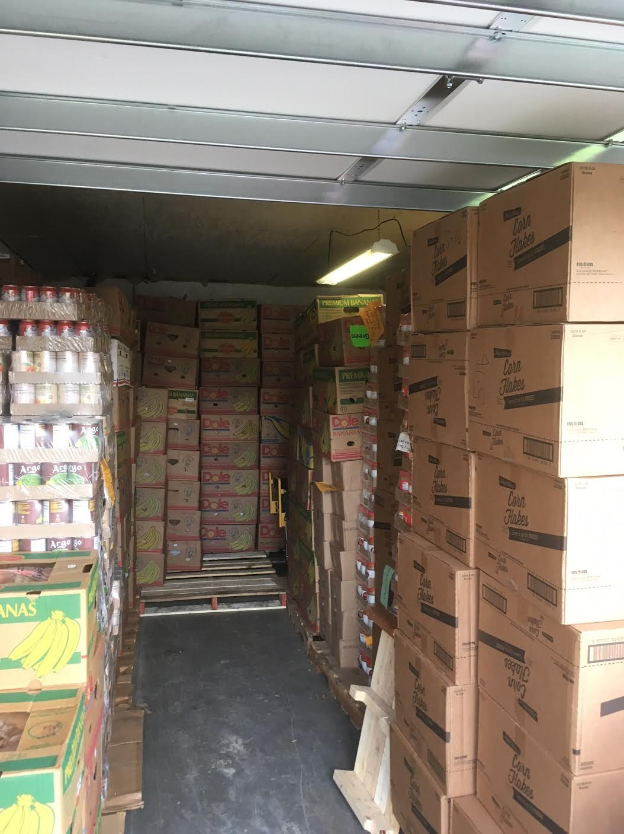

Project Ideas
  PB&J-athon
  The Key to STEM
  Canned Food Drive
  Have your members bring a canned food to every meeting for a month
  Volunteer at a soup kitchen
  Start a Garden
Notes:
(Ask Audience): What are some ways that your club has contributed to Feeding Our Future?
*Provide some examples of what your own division or club has done in the past (summer).

Slide 8

Kiwanis Family Relations
  Aktion Club: Team up with your local Aktion club and start a garden
  Kiwanis Kids: Educate K-Kids on the importance of Feeding Our Future and do food drives at the elementary school.
Notes:
One of the goals of Feeding Our Future is to unite the Kiwanis Family.

Slide 9
Kiwanis Family Relations
Builders Club: Teach them what Feeding Our Future is about & help them plan and execute a school-wide clothing drive
Circle K: Talk to your local CKI Club, they are doing the same thing!

Slide 10
Kiwanis Family Relations
Kiwanis: ALWAYS reach out to your Kiwanis club. Regularly invite them to your service events. If they did not attend, make sure to give them a recap.
Ex. Project
  Preparing a meal for the homeless
Notes:
(Ask Audience): What are some other ideas of service projects that go along with Feeding Our Future and promote working with your local Kiwanis?

Slide 11
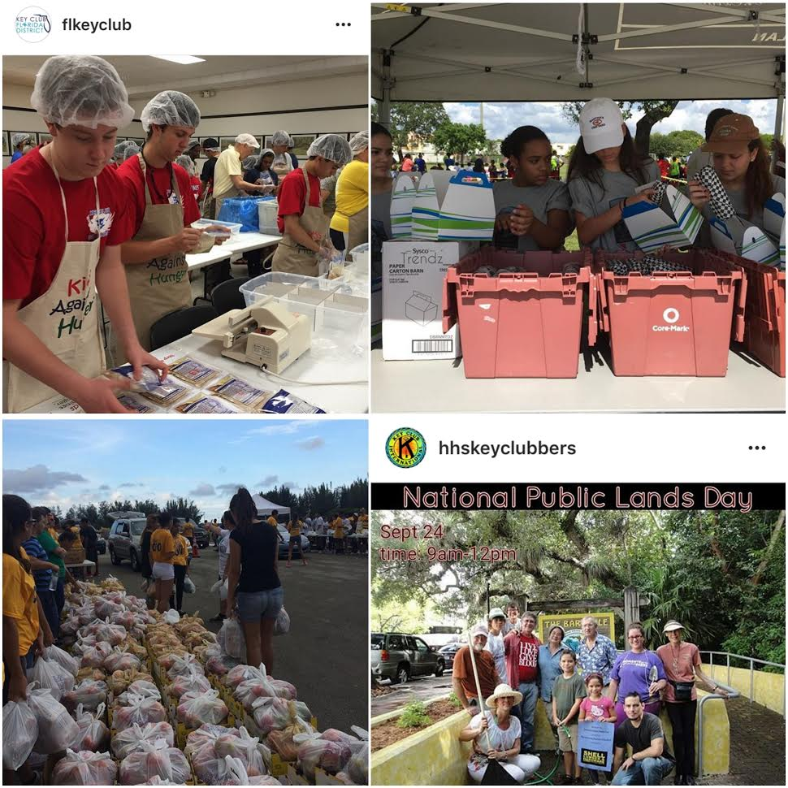
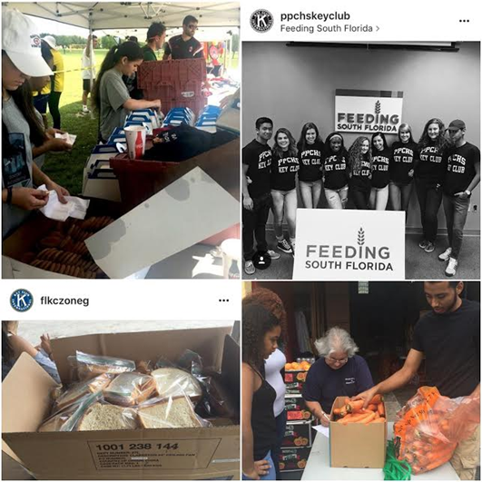
#FeedingOurFuture
Use this hashtag so you can be our club spotlight!
Notes:
Share your Key Goes Green projects on social
media using the hashtag: KeyGoesGreen
When using #KeyGoesGreen you have the
chance of being featured in The Sunshine
Source

Slide 12
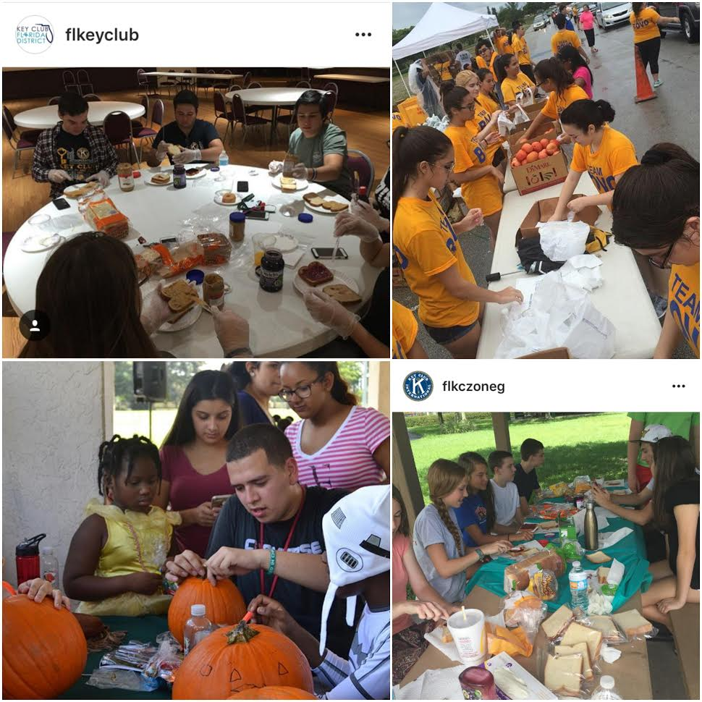
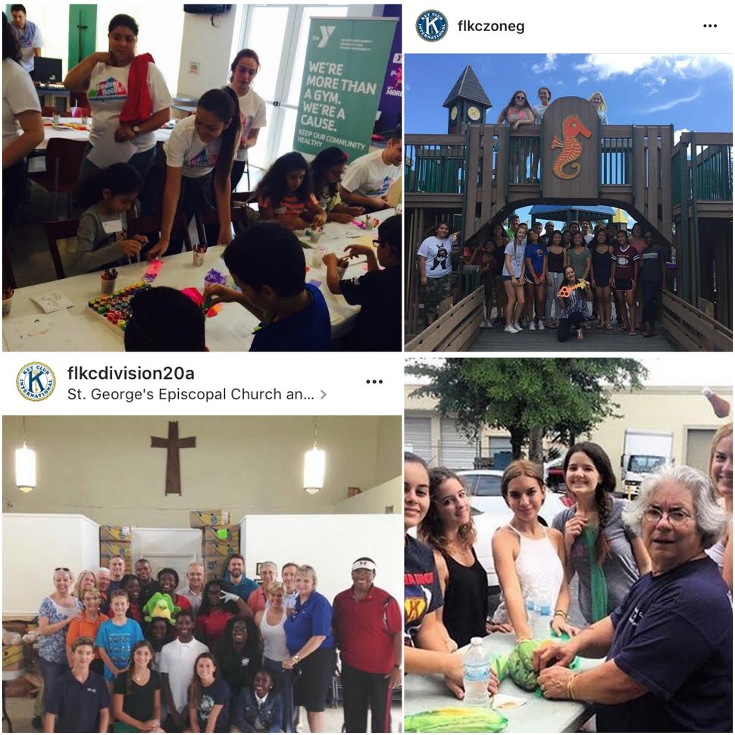
#FeedingOurFuture
Use this hashtag so you can be our club spotlight!
Notes:
Share your Key Goes Green projects on social
media using the hashtag: KeyGoesGreen
When using #KeyGoesGreen you have the
chance of being featured in The Sunshine
Source.

Slide 13
Have questions?
Need assistance planning?
Contact the Governor’s Project Committee Chair:
division20a@floridakeyclub.org

