Slide 1
FLOF and YOF

Slide 2
THE YOUTH OPPORTUNITIES FUND (YOF)

Slide 3
The Youth Opportunities Fund
Key Club International’s grant program
Funding for projects between $100 to $2,000 once a year
Due Date – Please submit the application prior to October 15th
Decision Announcement in mid-January
Notes:
Application must be postmarked by October 15th of the school year
You’ll be informed of International’s decision by mid-January

Slide 4
How to Apply for YOF
Applications can be found at http://www.keyclub.org
Print out Application
Fill out
Mail, fax, or email to Kiwanis International Foundation
Received by October 15

Slide 5
How to Apply for YOF
Need an adult involved
Submit final report within two weeks of project completion
Money is disbursed with an invoice OR after project completion
Keep accurate financial records, include in final report
KEEP ALL RECEIPTS
Notes:
Adult can be Faculty/Kiwanis Advisor, or School administrator

Slide 6
Tips for YOF
It looks better if:
You work with other organizations
You fund part of the project cost
Notes:
Especially one of Key Club’s Preferred Charities
- March for Dimes
- Children’s Miracle Network
- UNICEF
- The Eliminate Project

Slide 7
THE FLORIDA OPPORTUNITY FUND (FLOF)

Slide 8
What is FLOF?
Grant for service projects
Specifically in Florida District
Up to 2/3 the cost of a project
$100 to $1000 per grant
Club may receive grants for multiple projects, total cannot exceed $1,000
Only clubs in good standing can apply
Notes:
You have to provide 1/3 the cost.
Money can come from your club, your Kiwanis club, sponsors or partners, etc
You can get 5 grants in a single year, but they can’t add to more than $1000 all together
Good standing is based on:
- Attendance
- Pride Reports
- Projects
- Dues paid
- Complete OIF

Slide 9
How to Apply
Go to www.FloridaKeyClub.org/FLOF
Click on the FLOF Application button
Follow instructions and fill out application
Apply at least SIX WEEKS before project
Applications submitted after June 1st must be for projects after October 1st; Check issued after October 1st
Applications must be received by April 30th for projects being held between May 1st and October 1st
Notes:
That means you can get a grant for a summer service project, but you have to request it by April 30th
Emphasize that LTGs need to fill out a portion of the application

Slide 10
How to Apply for FLOF: The Conclusion and Follow-up
For projects before March 1, clubs must submit their Part VIII “Follow-Up” report by earliest option:
3 weeks after completion
Start of ongoing project
Or March 5th
Notes:
Which ever option comes the earliest is your deadline

Slide 11
How to Apply for FLOF: The Conclusion and Follow-up
Consequences if a club does not turn in their follow up report or account for money:
Return all FLOF funds to district
Ineligible for awards at DCON
Ineligible for FLOF this year or next year
Notes:
I’d recommend just filling out the form……

Slide 12
Tips for FLOF
Make sure project is not a fundraiser
Make it strengthen your club
Plan a project that can be continued in years to come
Try to find outside sponsorship to cover the remaining one-third of the total costs
Notes:
You wouldn’t believe how common a problem that is
- Money is going strictly to a service project
- Money is not donated straight to a cause

Slide 13
Further Information
For information, contact:
Your Lieutenant Governor
Your Zone Administrator
Your District Treasurer
More information is always available at:
Keyclub.org
Floridakeyclub.org

Slide 14
Successful Projects
Habitat for Humanity
Jesuit High School
Notes:
Donated to Habitat and worked to build house with them

Slide 15
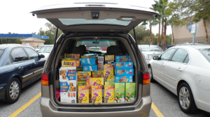
Successful Projects
CHOW-NOW
Bradenton Christian School
Notes:
Children Hungry on Weekends, Not on Our Watch
Ongoing project
Food Bank

Slide 16
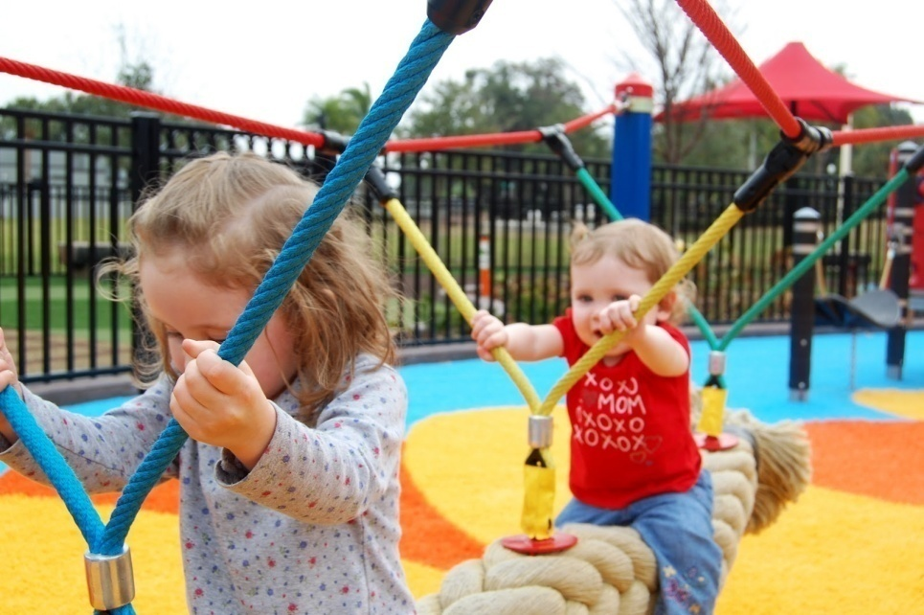
Successful Projects
Playground Construction
Brockton Key Club, MA
Notes:
Built a playground for Elementary School
Raised funds over three year period
Had corporate sponsors in addition to YOF Grant

Slide 17
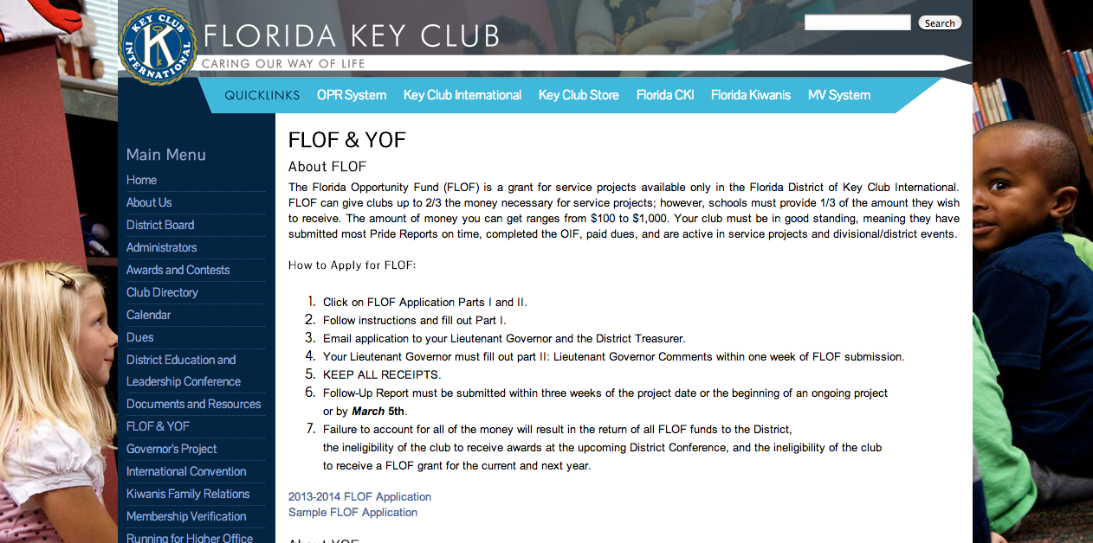
How to Apply
In order to apply, go to www.floridakeyclub.org
Under the “FLOF/YOF” tab, you will find all the information necessary to apply.

Slide 18
Go apply for funds!
Interested in applying for a grant? Contact the District Treasurer Palak Shah at treasurer@floridakeyclub.org or FLOF Committee Chair Sarah Paust at division16@floridakeyclub.org
Notes:
Summary (closing slide)

