Slide 1
Editors

Slide 2
Monthly Responsibilities
Attend meetings
Produce a newsletter
Keep information up to date on published works
Attend board meetings
Save newsletters made by your Lieutenant Governor
Update your club’s social media
Notes:
These are the general monthly responsibilities of the Editor.
However, each club is different and may have different standards for the important job of editor.

Slide 3
Annual Responsibilities
Train your successor
Document and photograph memorable service projects
Suggested: Create a scrapbook for your club that can be entered in District Contests
Design a club T-shirt
Create club advertisements such as videos and flyers to promote your club!
Notes:
Along with collecting pictures and documentation of service projects, it is recommended to keep all photos and creative works for competition at DCON.

Slide 4
The Editor’s Voice
As editor you should act as the voice of your club
Your goal is to spread the word about Key Club and your club’s latest achievements
You should contact:
Local newspapers
Your school newspaper
School TV or morning shows
Notes:
Advertising your club and the impact key club makes is a great way of getting prospective members as well.

Slide 5
The Sunshine Source
All editors should be familiar with The Sunshine Source
The Sunshine Source is a District wide online magazine created by our District Editor, Carly Berthiaume.
You can always view The Sunshine Source on floridakeyclub.com under the left tab “Main Menu” labeled “Sunshine Source.”
Notes:
Each editor should be informed when the Sunshine Source has been released to then inform club members.
Even though this is a newsletter for the entire District , it still gives an idea of the kind of information a club newsletter should contain.

Slide 6
How to make a Newsletter

Slide 7
Why do we need newsletters?
Newsletters are a valuable tool for club communication
Members will look forward to seeing what your club has accomplished and is planning to do in the future.
Newsletters are a great way to advertise your own projects and Divisional Council Meetings.
Notes:
Newsletters can help take your club to the next level!
Some clubs may already produce newsletters, but others are new to the concept. Either way, newsletters are a great addition to any club to keep members informed and motivated.

Slide 8
Do
DO include pictures from past events
DO adhere to Key Club graphic standards
DO include a message from your president
DO add information for future events
DO send out by email
DO create catchy title
DO include Key Club logos
Notes:
-Pictures will make members feel appreciated and included
-A president’s message should be brief and is a great way to connect with members and can be changed occasionally.
-Newsletters can be used to advertise for Divisional Council Meetings (DCMs), Spring Zone Rally, and District Conference (DCON)
-Sending out newsletters by email will save paper. You can also upload these to club Facebook pages or your club’s website.

Slide 9
Don’t
Don’t make your newsletter excessively long.
Don’t leave it to the last minute to complete.
Don’t make the pages too cluttered
Don’t alter the Key Club logo or graphics
Don’t stress, just do your best!
Notes:
-Long newsletters may be harder to read and may hinder members from overlooking important information. Keep them brief but don’t omit information
-Newsletters shouldn’t be overwhelming when done correctly.

Slide 10
General Tips
Ask your Lieutenant Governor for help or advice when needed.
Stick to a schedule when it comes to publishing newsletters. For example, try to have a set date to send the out.
Share your newsletter with your school, it will highlight all the great work your club has done.
Notes:
Newsletters do not need to be produced every month.
For example, producing a newsletter every other month may work best for a club.
The club president and editor should work together to decide on this schedule.

Slide 11
More Tips
Before you begin, take a look at your Divisional Newsletters for inspiration.
Make your newsletter fun with pictures! You want your members to enjoy reading it
Try to make your newsletter seasonally themed. For example, for October you may want to choose a darker color scheme.

Slide 12
How
There are multiple ways to produce a newsletter:
Microsoft Publisher
Microsoft Word
PowerPoint
Any program you feel comfortable using should work fine.

Slide 13
How
Save your Newsletters as a PDF
This will make it more accessible to members.
Your Lieutenant Governor can provide templates or you can make your own.

Slide 14
Graphic Standards
Key Club graphic standards can be found on floridakeyclub.org under the tab “Documents and Resources” labeled as “Club Editors”.
Also take note of the newly updated 2015 Brand Guide which can be found on keyclub.org under the tab “Resources.”
Notes:
Key Club graphics should not be altered as shown above.
Nor should they be combined or altered to create new graphics.
Graphics can be found online and further explained by your LTG

Slide 15
Social Media

Slide 16
Social Media
Social Media is a great way to reach many members
If your club already has social media make sure to keep it updated so members don’t lose interest.
Post events and service projects and create hash tags.
Notes:
Of course, make sure the information on these accounts is appropriate and reflects your clubs well.

Slide 17
Examples of Social Media
Examples of effective social media:
A Facebook page or group open to members.
Twitter or Instagram account that posts about upcoming events.
If your club does not have social media, you should bring the idea up to your other officers

Slide 18
Club Websites

Slide 19
Websites
Club websites can be a great way to have a central location for information.
You are not required to have a club website, however it is helpful and makes it easy to find upcoming events.
Of course, if you choose to create a club website it should be updated regularly and include links to the district website.
Notes:
Examples of making a website can be a weebly site.

Slide 20
How to Become a Distinguished Editor

Slide 21
Distinguished Editors
A Distinguished Club Editor exhibits leadership and places Key Club as a top priority.
Distinguished Editors are recognized for their hard work at District Conference (DCON).
This is a great guideline to set for yourself as club editor.

Slide 22
Distinguished Editors
These are the qualities of a Distinguished Editor:
A Minimum of 75 service hours
Produces regular newsletters
Creates a club scrapbook
Attends KCKC
Attends SZR
Attends past District Conference
Attends upcoming District Conference
Attends club meetings and board meetings
Submits articles to visual media and The Sunshine Source

Slide 23
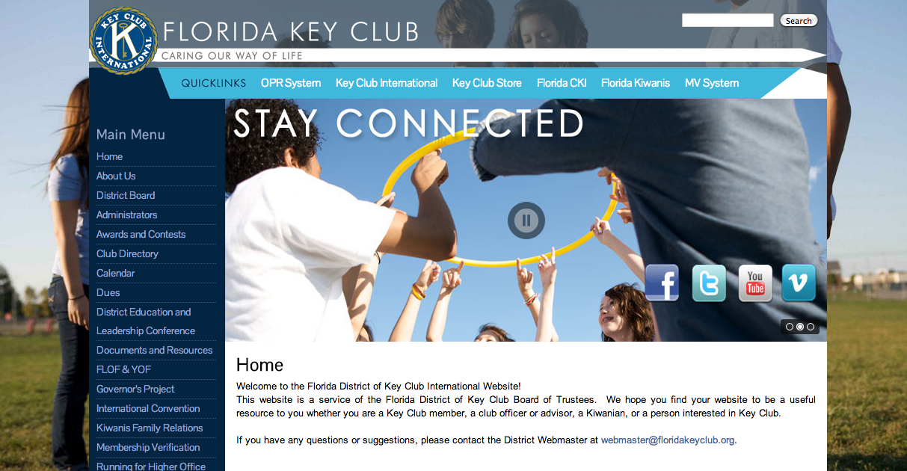
How to Apply
Before the awards deadline, head to Floridakeyclub.org and look under the awards and contests tab

Slide 24
How to Apply
Search for the Distinguished Editor Application and make sure all of the necessary information is filled out prior to the due date.
Once your application is complete, you will submit your application to the awards committee chair.
Keep in mind- your faculty advisor will need to verify that all the information on your application is accurate.

Slide 25
Governor’s Project
Key Goes Green
Project created by Governor Shane
Involves everything environmental
Notes:
The Governor’s Project this year is called Key Goes Green.
It was started by Governor Shane
The environment is all around us, so it is easy to get involved.
Does not include volunteering at animal shelters
- You can do “upcycling” by making dog toys out of old t-shirts and donating them to animal shelters
*ask audience* What are some projects you could do to get involved?

Slide 26
Governor’s Project
How does this apply to your position?
Show off the Governor’s Projects you do in your newsletters
Submit what you did to The Sunshine Source
Use the hashtag #KeyGoesGreen on social media
Notes:
In your newsletters, write stories about the Governor’s Projects you did. That way, members who weren’t able to go to the projects can see what you’ve done
Show off to the entire district! Submit articles to TSS and brag about what your club did to help the environment and participate in the Governor’s Project
Promote Key Goes Green on social media by using the hashtag. Your photos may end up in TSS or other district publications.

Slide 27
Questions?

