Slide 1
Dues in Detail
Florida District of Key Club International, Inc.
Presented by:
Alyssa Frank
District Treasurer, 2016-2017

Slide 2
Why do clubs pay dues?

Slide 3
District vs. International
District Dues
Training board members
Travel (board meetings)
Services to clubs
Florida Opportunity Fund (FLOF)
General expenses
Endowment Fund
International Dues
Promotional materials
Key Club Magazine
Pin/member card
Awards
Youth Opportunity Fund (YOF)
ICON

Slide 4
How much are dues?

Slide 5
Dues Breakdown
Individual clubs can increase their dues in the club bylaws with a ⅔ vote from its members.
District $5.50
International $7.00
$12.50

Slide 6
Used to input/update paid members
Treasurer & Secretary can work together on the MUC
Once member updates are complete:
Print invoice and give to school bookkeeper
Or Pay online at that time only
Opens on September 6th
Membership Update Center
(MUC)
If you have problems:
memberservices@kiwanis.org
treasurer@floridakeyclub.org

Slide 7
How to pay dues?

Slide 8
Go to http://floridakeyclub.org/dues/
Click on “CLICK HERE TO PAY DUES”

Slide 9
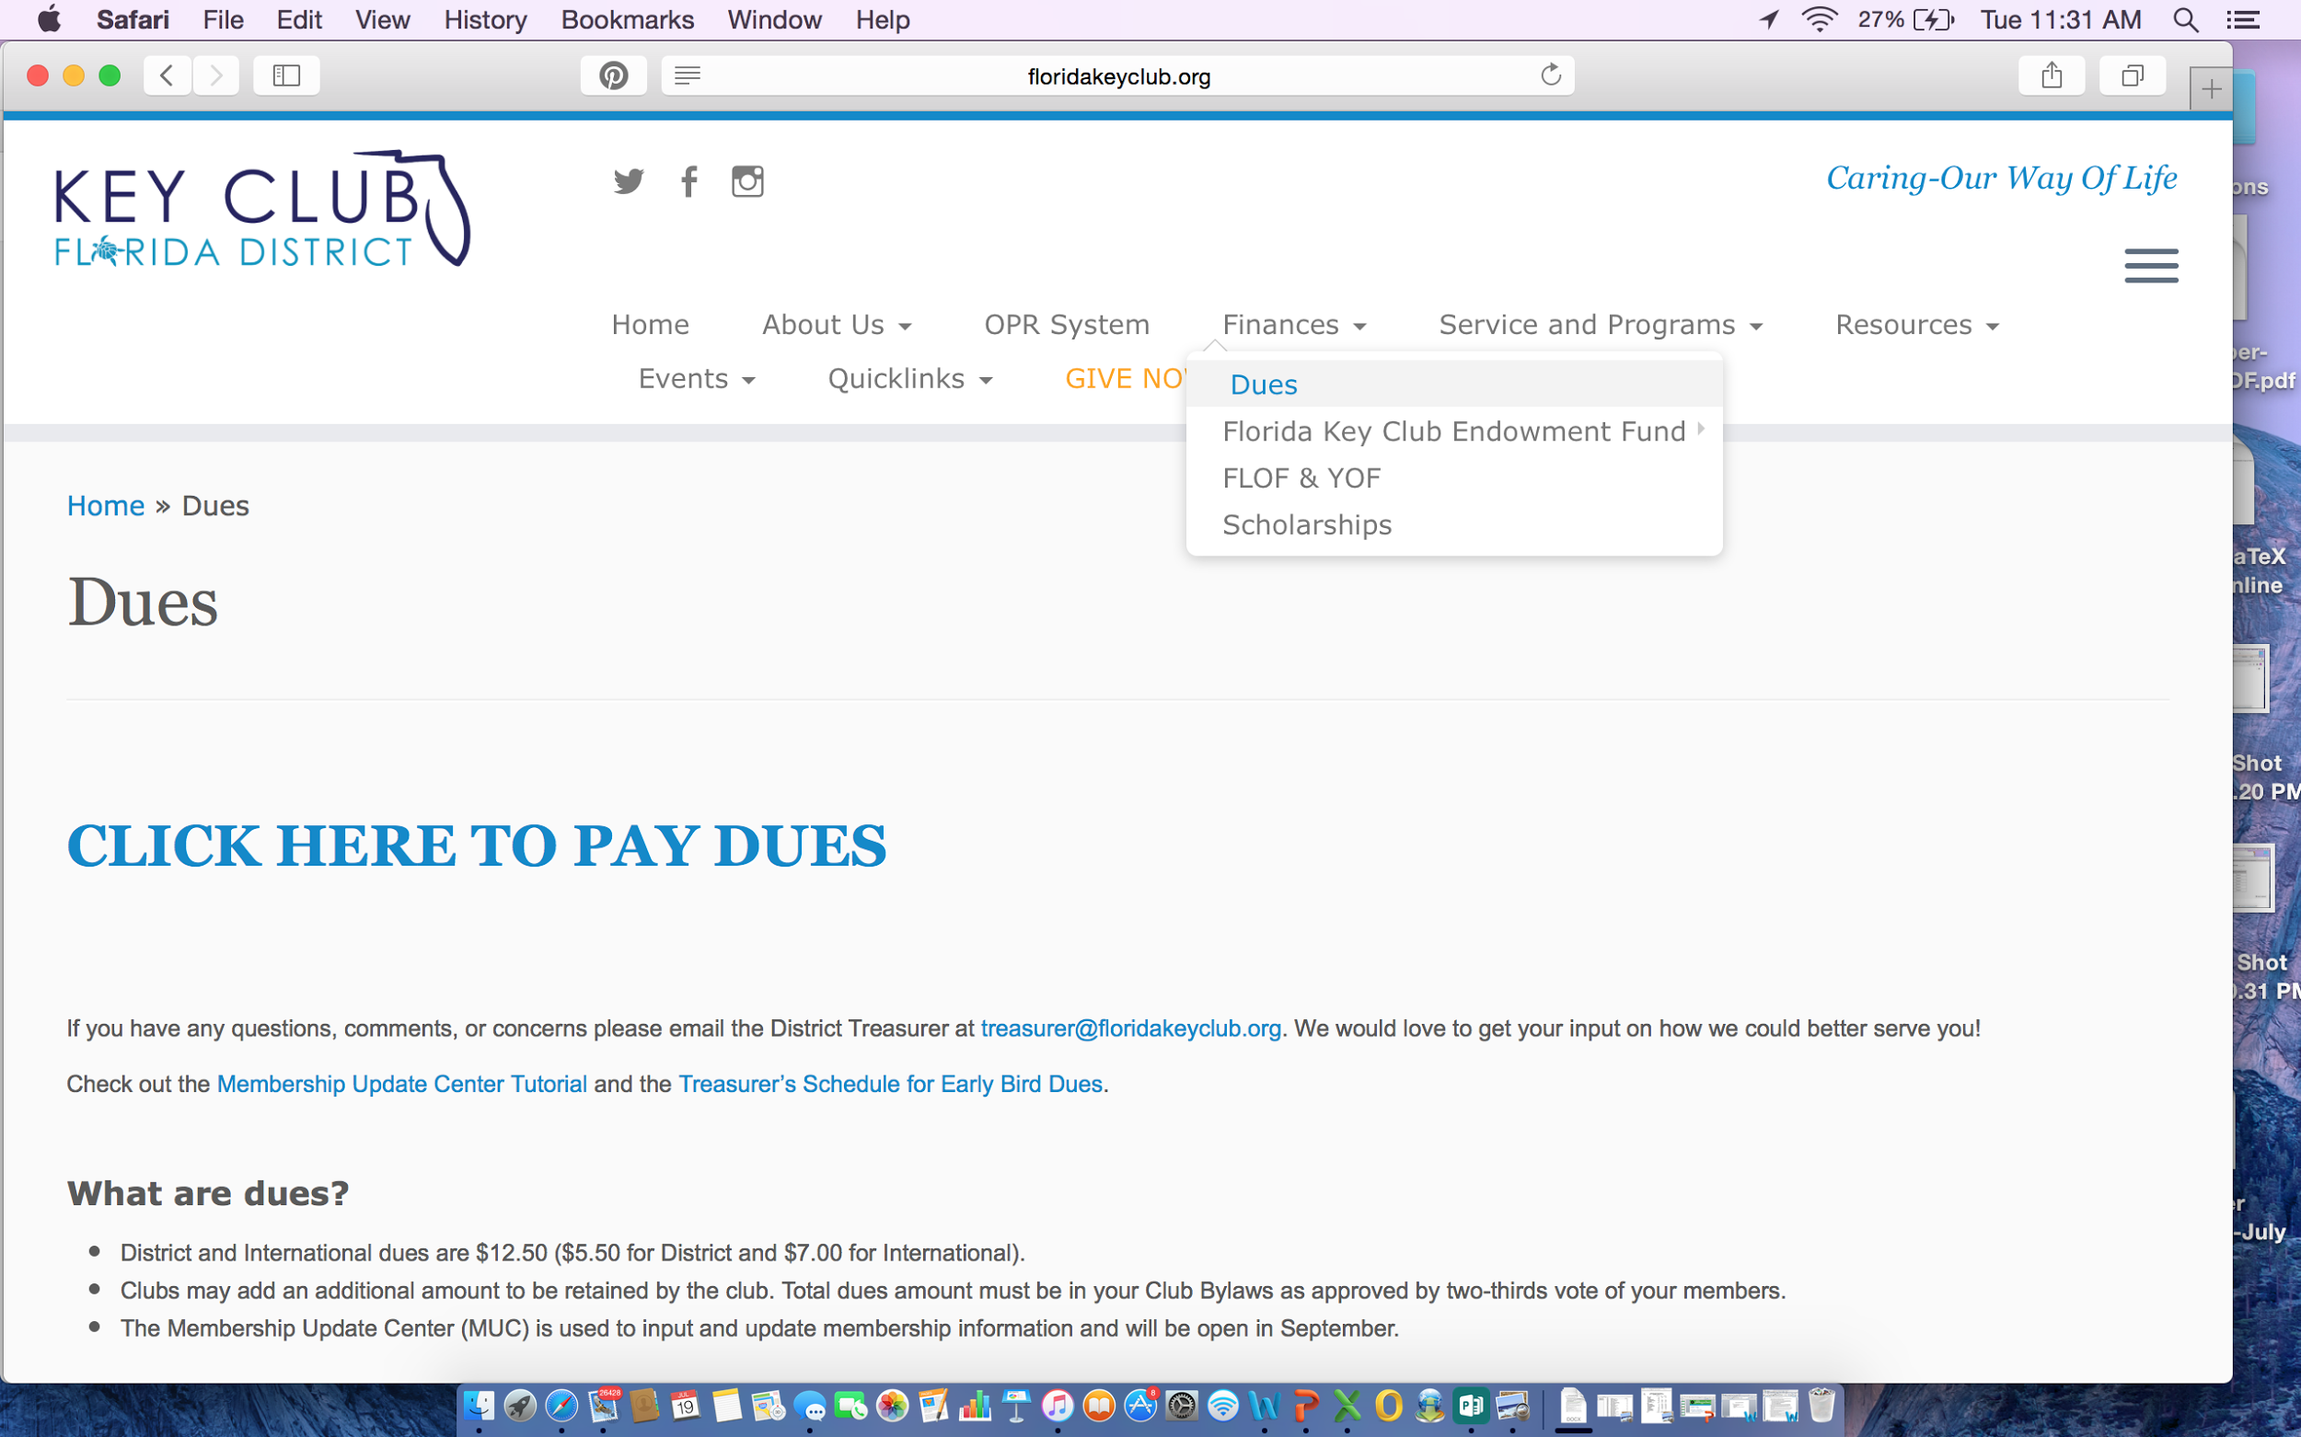
Second point

Slide 10
3. To login, use last year’s advisors email & password
F.Y.I. - Your advisor set it up, so ask him/her for the information.
4. If your club did not pay dues last year, then click on “register/reset password” button below the login

Slide 11
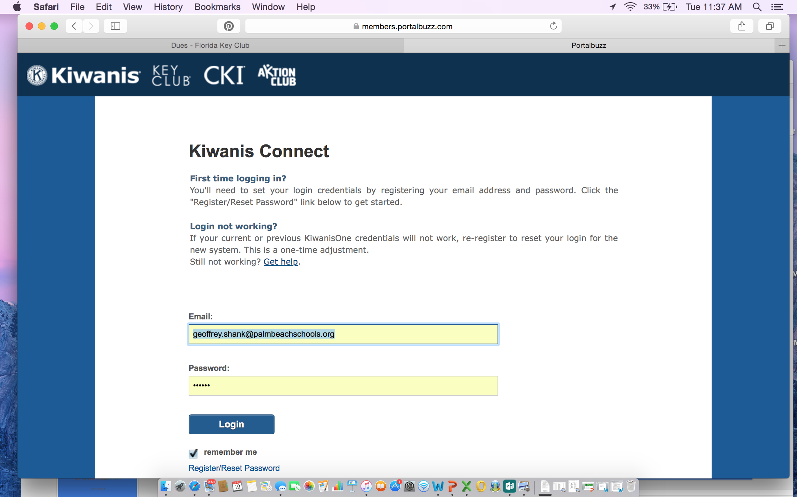

Slide 12
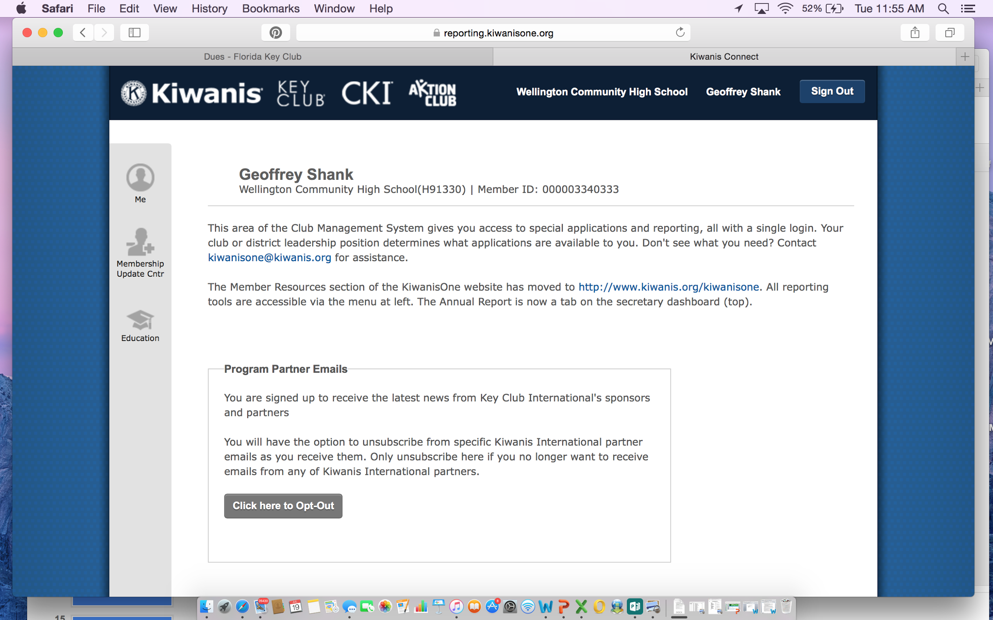
Final point
SCHOOL Advisor
Advisor Name
SCHOOL NAME HERE
A one-line description of it

Slide 13
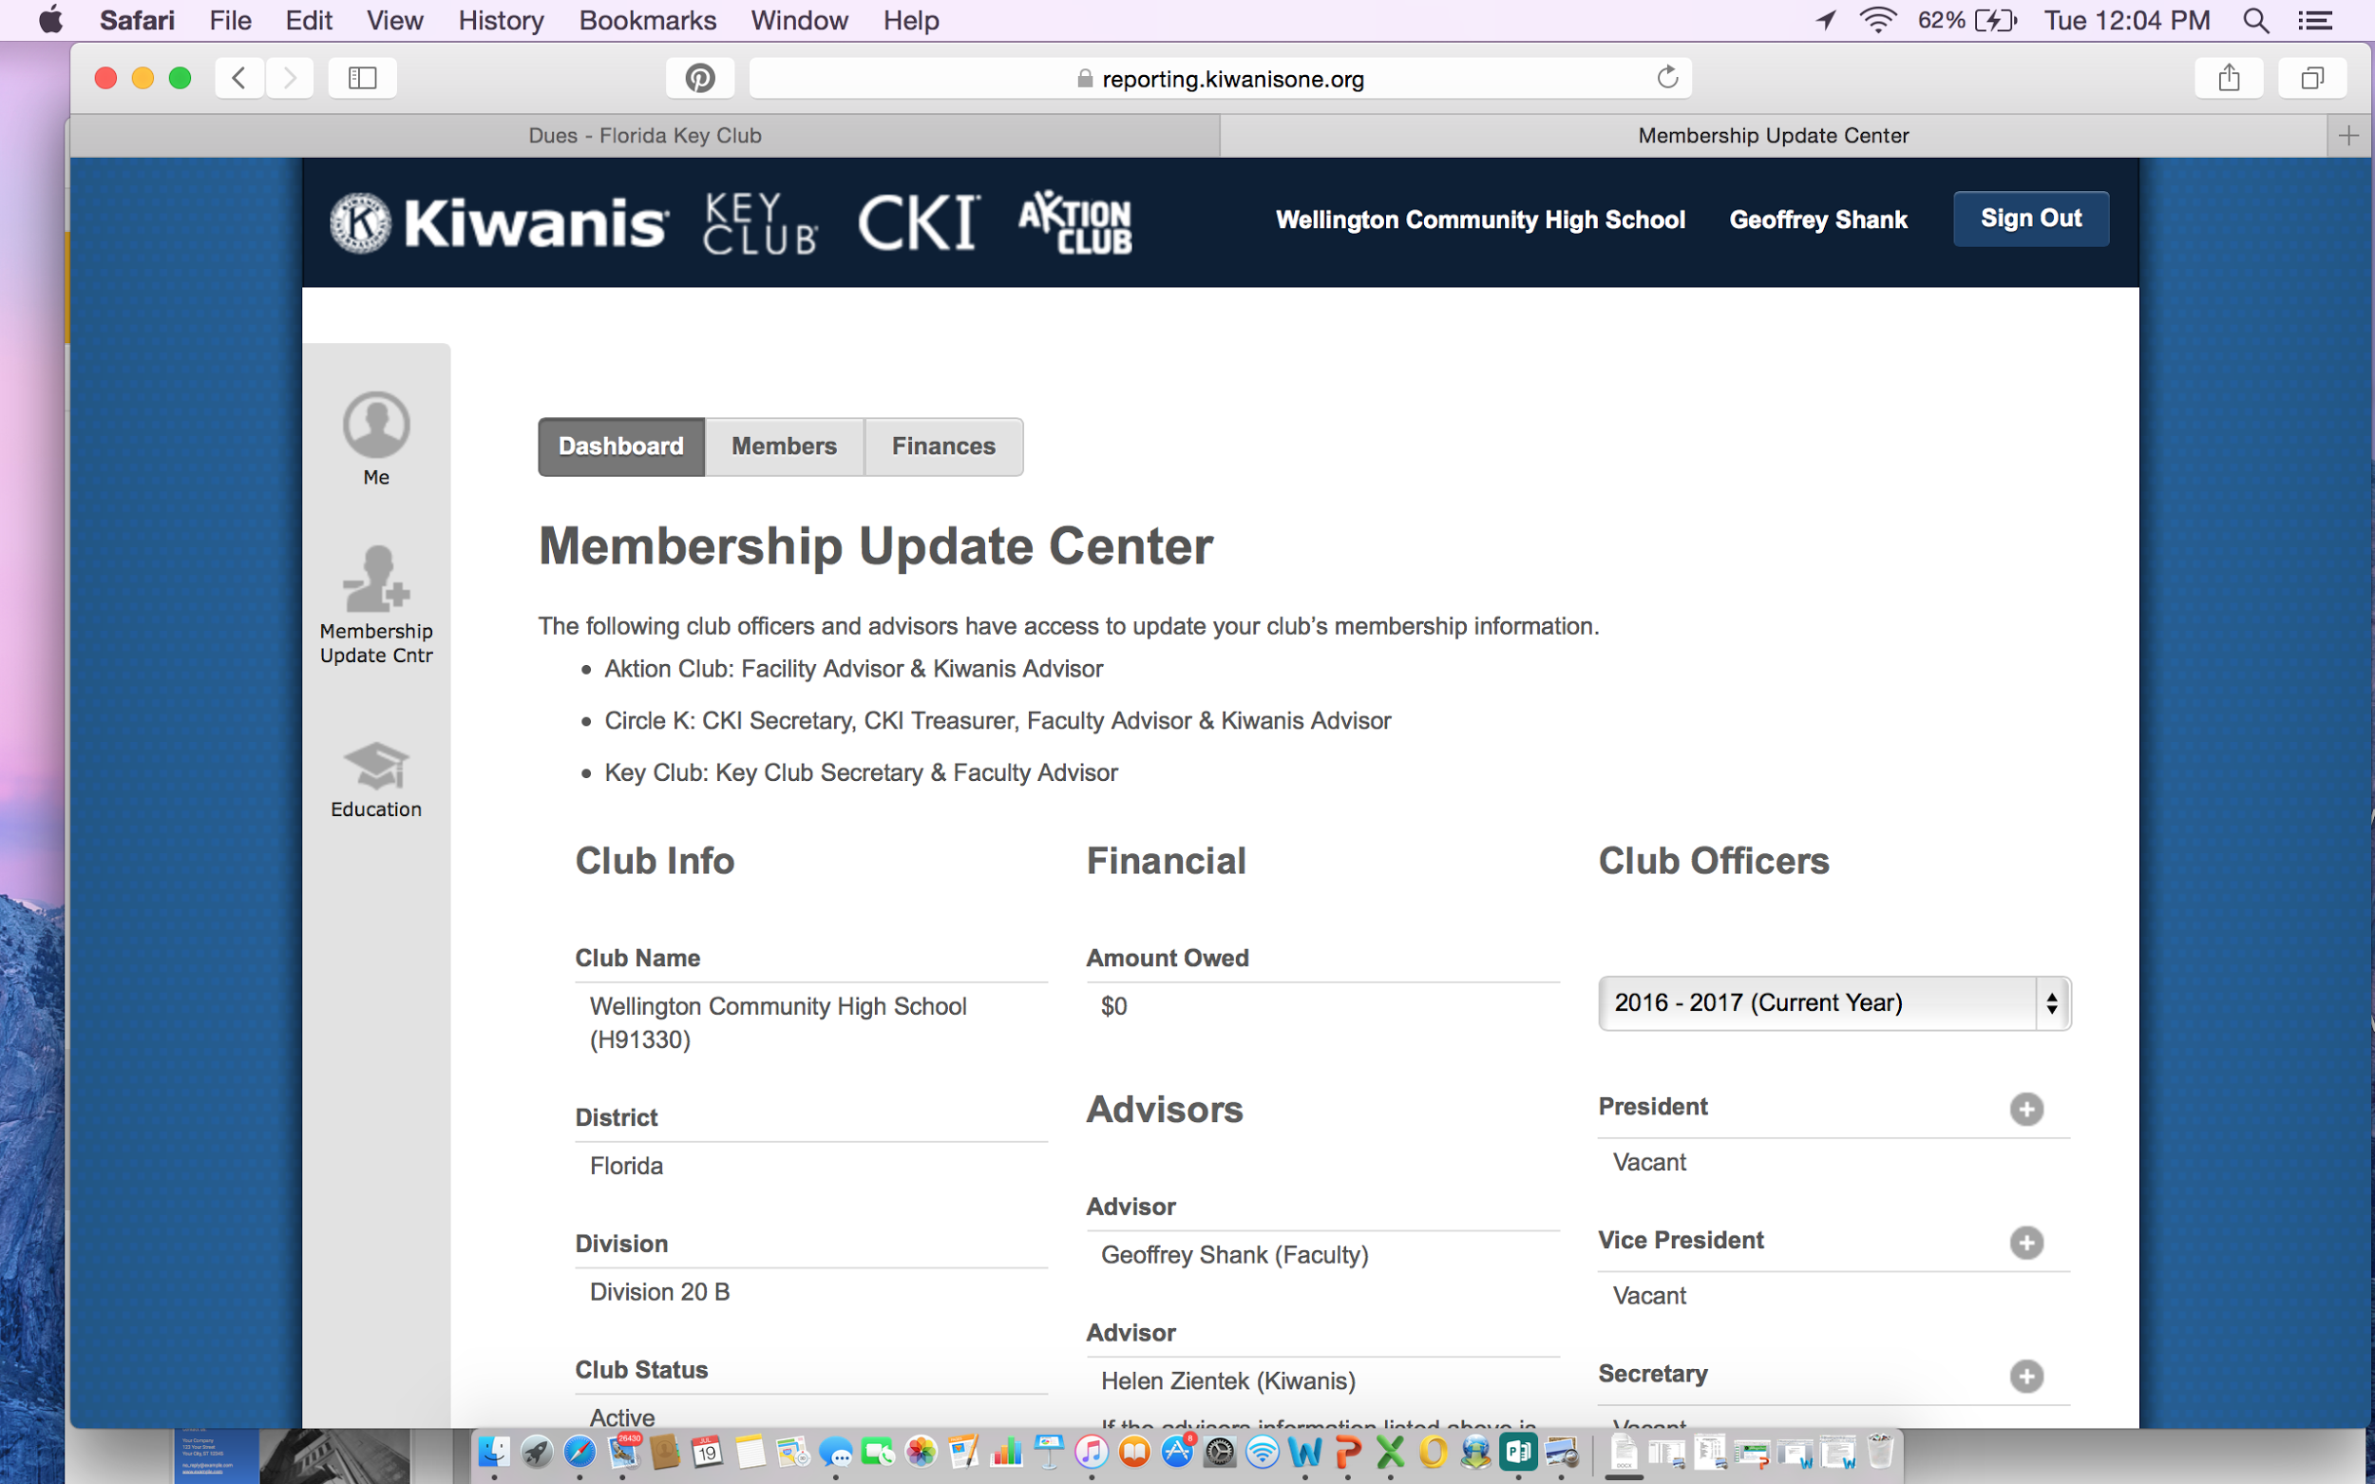

Slide 14
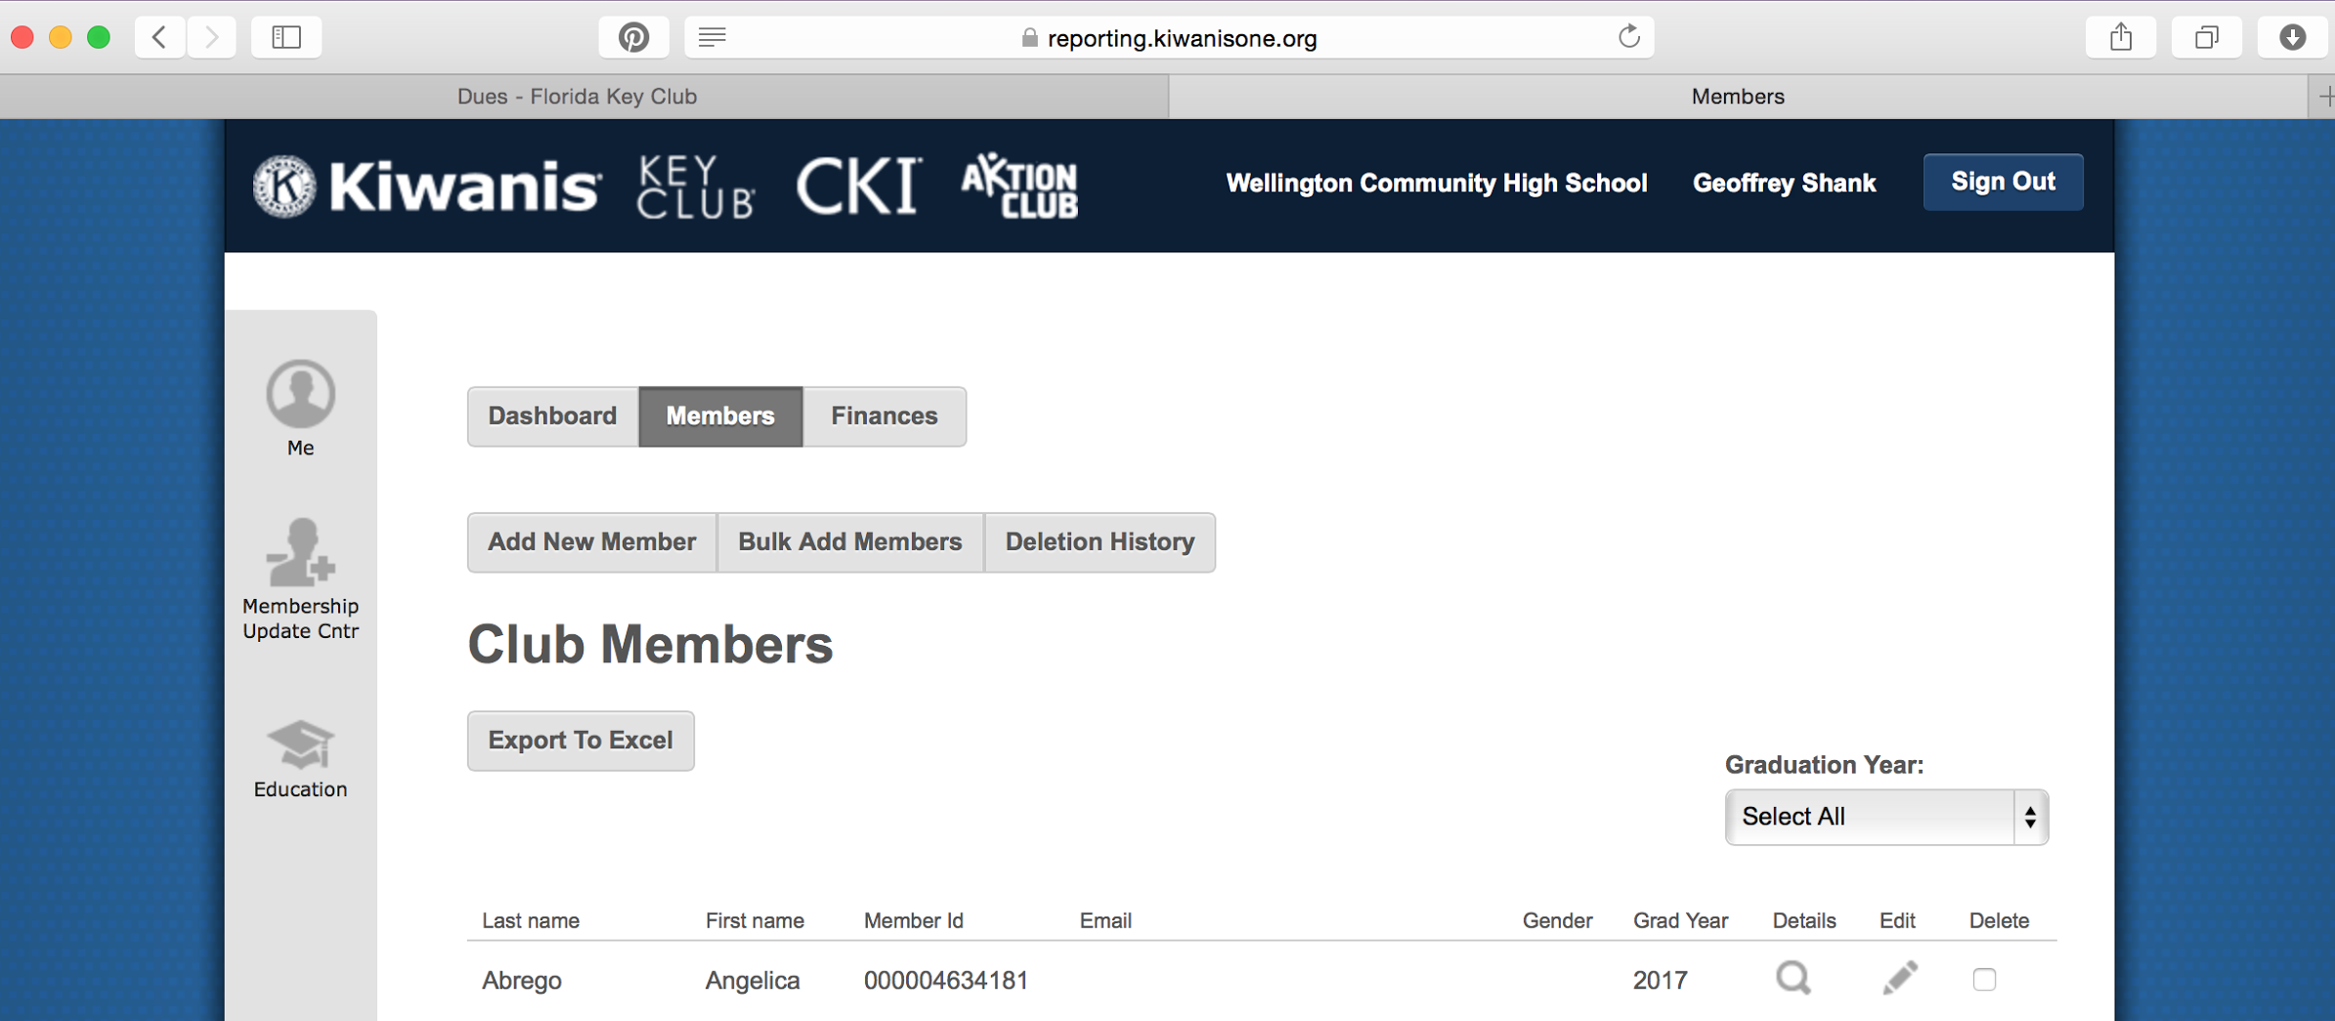
This is where the club secretary can add/delete/revise members. Remember to DELETE Seniors from the previous year.
You can use the “graduation year” dropdown box to delete the seniors.

Slide 15
When ready, clubs can either:
Pay by credit card
Only available immediately after you get the invoice
Pay by check
Send it to the Key Club International office at
3636 Woodview Trace, Indianapolis, IN 46206-6069
PO Box 6069 Dept. 123
Submit the invoice to the bookkeeper or school treasurer in order to get the check written

Slide 16
Early Bird Dues
When: November 1st
Pros:
You don’t have to worry about it during fall/winter break.
You don’t have to worry if the check will arrive before it’s too late.
Your club will receive a banner patch.
Dues Final Deadline
When: December 1st
Cons:
If it does NOT arrive in time your club will be considered inactive.
You have to worry during fall break if the check will arrive.
You will NOT receive a banner patch.

Slide 17
Important Reminders about Dues
You can always add & pay for new members throughout the school year.
To be considered in “good-standings” your club must have at least 20 paid members.
Early Bird Dues is what we want to see!

Slide 18
Early Bird Dues Timeline
Gives 20 days for the check to arrive by
NOVEMBER 1st

Slide 19
September
1st Week:
Hold 1st Meeting and inform members of dues and requirements
During the month:
Remind potential members about application deadline
3rd Week:
Hold Second meeting and collect application and dues
4th Week:
Finalize club roster

Slide 20
October
October 1st:
Update the the Membership Update Center (MUC)
October 4th:
Generate Membership Update Center Invoice
October 6th:
Contact the bookkeeper
October 10th: Send the check!
October 15th:
Check with the bookkeeper to see if the check cleared.

Slide 21
Youth Opportunities Fund (YOF)
Application available at http://www.keyclub.org/service/fund/yof.aspx
Reviewr (create account)
Due: October 15 at 11:59 PM EST
Key Clubs and/or club members may accept $100 to $2,000
Requesting a portion of the funding & working with other organizations
Notified in January
Fill out current YOF application
Key Club Guidebook - Board Policies

Slide 22
Florida Opportunity Fund (FLOF)
Up to ⅔ in amount (school gives ⅓)
Receive amount for $100 to $1,000
Fill out application (Reviewed from October 1st - June 1st)
Club needs to be in “good standing” to receive grant
Grants for clubs, divisions, and/or LSSP’s

Slide 23
Thanks for Listening!
For questions contact:
Alyssa Frank- District Treasurer
treasurer@floridakeyclub.org
Kiwanis Organization
memberservices@kiwanis.org
1-800-549-2647 - Ext. 411 (US and Canada)
For more information go to:
http://www.kiwanis.org/docs/default-source/service-leadership-programs/advisor-resources/toolkit-slp-sponsorship-5-dues-and-fees-key-club-pdf.pdf?sfvrsn=13
http://floridakeyclub.org/dues/
http://floridakeyclub.org/resources/

