Slide 1
District Education & Leadership Conference
DCON

Slide 2
What is DCON?
DCON = “District Education and Leadership Conference”
2,000+ Key Clubbers and Chaperons
Leadership, education, fun

Slide 3
Notes:
Click on video to play

Slide 4
Why should I go?
Valuable workshops
Make Key Club friends
District Officer elections
Better Understanding of Key Club
Contests and awards

Slide 5
DCON Special Events
Talent Show
Leadership Workshops
Governor’s Ball
CKI Pool Party
Club Awards Ceremony
House of Delegates

Slide 6
DCON Awards/Contests
Club contests and awards
Individual Officer Awards
Talent Show
Oratorical Contest
Scholarships

Slide 7
House of Delegates
Vote on District Officers
Discuss amendments
Vote on the proposed amendments

Slide 8
Who should attend?
All Key Clubbers should attend!

Slide 9
And the theme is…

Slide 10
When is DCON?
March 30th- April 2nd

Slide 11
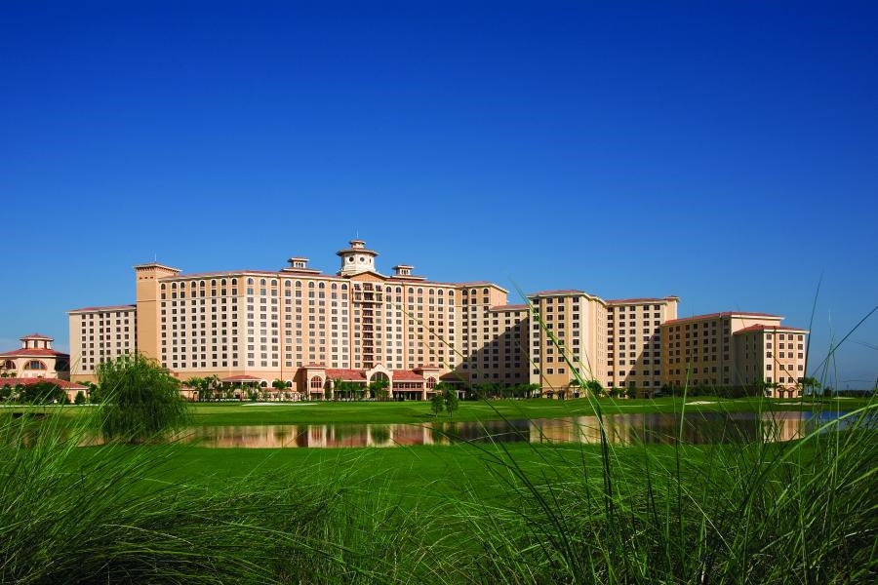
Rosen Shingle Creek Hotel
Notes:
DCON occurs annually in the spring. The next DCON will be March 30 to April 2 in the spring of 2017.
And DCON is located at the Rosen Shingle Creek Hotel in Orlando.

Slide 12
How do I register?
Go to floridakeyclub.org,
Under District Education and Leadership Conference.
All forms, FAQs, and Registration information is on the website.

Slide 13
Prices
– Quad (4 to a room) $275
– Triple (3 to a room): $330
– Double (2 to a room): $370
– Single (1 to a room, adults only): $575

Slide 14
Questions?
Email
DCONChair@floridakeyclub.org
Or
ADADavid@floridakeyclub.org
Notes:
Be prepared to answer questions.
Questions?
If you want more information, you can email the DCON chair Hannah Rosenbaum at DCONChair@floridakeyclub.org
Or email you can email the DCON Administrator David McCampbell at ADADavid@floridakeyclub.org

