Slide 1
Monthly Communications
Presented by Carly Berthiaume
2015-16 District Editor

Slide 2
Service Agreement
7. Publish and distribute a monthly communication to all club officers in the Division, all club advisors, the Key Club District Board, the Kiwanis Lt. Governor, the International Trustee, the Zone Administrator, and the District Administrator by the seventh of each month including summer months.

Slide 3
The Guidelines
Required to have a minimum of 6 newsletters
Other months can either be a newsletter or informational email
Approved by
your Zone Administrator (every month)
District Editor (until told otherwise)
District Administrator (unless told otherwise)

Slide 4
Mark Your Calendars
Read the Editor’s newsletter checklist on the 22nd
Read the executive newsletter on the 25th
Send/receive blurbs by the 25th
Send first draft for editing by the 1st
Make revisions and send newsletter in PDF by the 7th

Slide 5
Monthly Newsletters Q&A
How long should my newsletter be?
Aim for 3-6 pages.
How long should it take to make my newsletters?
The first one will take longest, but the rest should take less than two hours.
What information should I include?
Topics mentioned in Editor’s monthly newsletter checklist, Key Club graphic standards, Required Sections, divisional news, blurbs, etc.

Slide 6
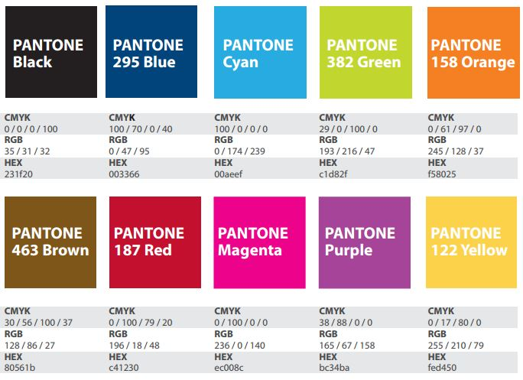
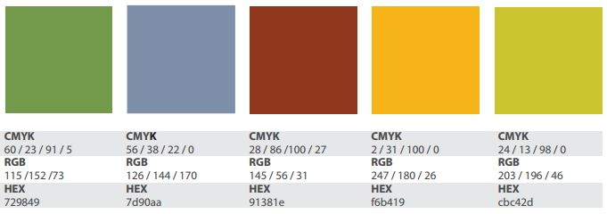
Graphic Standards
Colors

Slide 7
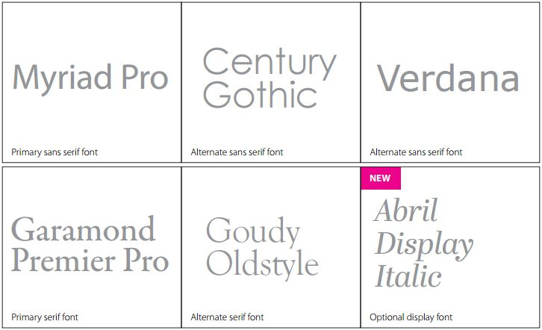
Graphic Standards
Fonts

Slide 8
Newsletters Q&A Continued
Which programs can I use to make my newsletters?
Publisher, InDesign, PowerPoint, or Word; other programs are allowed.
Should I include pictures/graphics?
Definitely! They should be clear, bright, and proportional: no stretching or compressing them.
To whom should I send my finished newsletters?
Club officers, Kiwanis & Faculty Advisors, Kiwanis LTG & Kiwanis Presidents, your ZA, newsletters@floridakeyclub.org, others who request it

Slide 9
Newsletter Contents
Month and year
Table of contents
Welcome message/introduction
Clubs in your division and sponsoring Kiwanis Clubs
Florida Key Club and KCI logos, graphic standards
Editor’s monthly checklist topics
Blurbs- not stretched or compressed
Pictures/graphics/color
Contact Information (yours, ZA’s, DA’s, Executive Committee’s)
Catchy titles, concise information

Slide 10
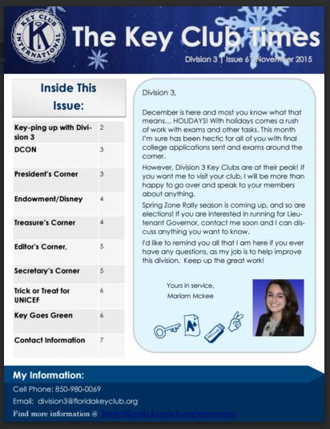
Newsletter Contents
Key Club logo
Newsletter title
Date and Division
Table of contents
Welcome
message
Board picture
LTG contact info
Graphic Standards

Slide 11
Blurbs
Keep in mind graphic standards, fonts, colors
Short, concise, contains only pertinent information
Font size and color must be legible
Graphics, creative backgrounds that don’t distract from text
Need to be sent in JPEG or PNG format; never in PDF
Blurbs should not need to be cropped
PowerPoint recommended for creating blurbs
Must be sent by the 25th of the month

Slide 12
Good Blurbs Why?

Slide 13
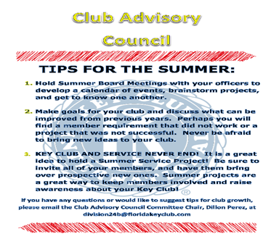
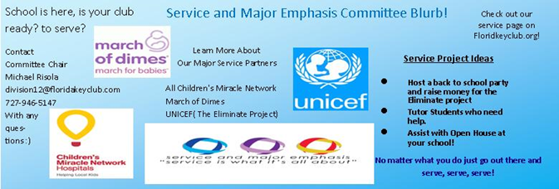
Bad Blurbs Why?

Slide 14
Informational Emails
Should contain same information/distribution list as newsletters (except for pictures, graphics, Executive Committee contact information, etc.)
Topics should be separated by an extra space and a bolded/underlined title
Must also be reviewed by Editor, ZA, DA before sending
Should include blurb information
6 required newsletters; all others can be informational emails

Slide 15
Common Mistakes
Capitalization
Key Club, Division 21, Zone G, Florida District, September Pride Report, Lieutenant Governor Bob Smith
pride report, divisions, districts, lieutenant governor
Grammar
Your v. you’re, were v. we’re, to v. too, Im v. I’m
Punctuation
Plural of OIF: OIFs, plural of pride report: pride reports
Acronyms
Write out full name/words before using acronyms
Newsletters should be sent out ONLY in PDF format!

Slide 16
Other Resources
District Editor
Zone Administrators (ZAs) and your fellow LTGs
District Officer Binder Tab 7, newsletter checklist
Floridakeyclub.org
Keyclub.org (newsletter templates available here)
Graphic Standards PowerPoint
Newsletter examples
Syntax Key

