Slide 1

The Key to College
?
$
$
?
$
?
$
?
?
$
Notes:
Here’s where you introduce yourself and maybe include a neat ice breaker if you have the time!

Slide 2
Why do I even need College?
Other than furthering your education, attending a college or university helps you…
      Get a better job
      Increase your marketability
      Learn a skill or trade
      Meet new friends

Slide 3

Types of Schools
Yep, there’s more than what you think!
2-year community/state colleges
4-year private institution
4-year public university
Satellite campuses
Things to take into account:
    Costs, class size & programs and majors on campus!
      Show interest by taking a tour
      Grab brochures where you can
Notes:
Pro of taking a tour: It actually helps students’ chances! The more interest shown translates to a committed student.
Public colleges are funded by local and state governments and usually offer lower tuition rates than private colleges, especially for students who are residents of the state where a college is located.
Private colleges rely mainly on tuition, fees and private sources of funding. Private donations can sometimes provide generous financial aid packages for students.
For-Profit: businesses that offer a variety of degree programs which typically prepare students for a specific career. They tend to have higher costs, which could mean graduating with more debt. Credits earned may not transfer to other colleges, so be sure to check with the admission office at each college.
Four-year colleges offer four-year programs that lead to a bachelor's degree. These include universities and liberal arts colleges.
Two-year colleges offer programs that last up to two years that lead to a certificate or an associate degree. These include community colleges, vocational-technical colleges and career colleges.
Satellite: campus of a college or university that is physically at a distance from the original university or college area. This branch campus may be located in a different city, state, or country, and is often smaller than the main campus of an institution.

Slide 4
Where to live if you’re leaving home?
Dorm
(On-Campus)
Pros:
    Easier access to campus
    Great way to meet people
Things to keep in mind:
    Figure out your meal plan
    Get to know your roommate BEFORE moving in!
Apartment
(Off Campus/Campus affiliated)
Pros:
  A bit more independence
  Sharing an apartment with friends/roommates
Things to keep in mind:
    Shop around for the best price!
Notes:
Note: It may end up costing more to live on campus than to live off, however some schools do require you to live on campus for your first year.
On Campus:
-Its easier to access campus and get to your classes.
-Its also easier to make new friends, since the people at your school are near you.
-Choosing a roommate: You can either let the campus randomly pick, or sign up for a social media like site provided by your school where you can meet people looking for roommates at your school
-Your college may not allow freshmen to have cars on campus, so its important that you know the rules if you do have a car
Off Campus:
-More independence from school
-You will have to buy your own food and make meals
-Share an apartment with friends, even if they're not going to your school
-Slightly more difficult to commute to school, especially if you live in a high traffic area.
Tip for off campus: Before signing a contract, have it reviewed by a licensed lawyer or a professional to ensure there are no ‘catches’

Slide 5
How do I pay for all of this?!
There is money EVERYWHERE!
#1: Financial Aid!!!
  Grants
  $cholarships
    Complete FAFSA EVERY YEAR!
    Try www.fastweb.com for scholarships!
Student Loans
Finding a job
    (On or Off-Campus)
Notes:
Note: Students no longer need to complete the FAFSA in order to receive the Florida Bright Futures. Scholarship
Tip: Students should see what types of loans are available. Some loans have lower interest rates and others one just shouldn’t touch unless they have too.
What's the difference?!
Grants: Are need based and come from government and private organiations
Scholarships: Are mostly merit based (GPA, Academic/Athletic standings)
-Scholarship Search Engines to try:
-Fastwebs
-Niche
-Chegg
Student Loans: A loan is a form of student aid that must be applied for and paid back to the provider with interest and is based on income, taxes and the school desired.

Slide 6
The Application Process
Start and Submit EARLIER rather than LATER!
Mail/Online Applications
Tip: Make copies of information sent in, just in case something gets lost in translation!
Notes:
Go on to the colleges website over the summer before your senior year and begin to fill out their applications and write the essays. Even if you don’t submit them until you start school, it will be helpful to not have all that work once school begins.
Have either digital copies or printed copied of everything that you send in, just in case something goes missing, so you can send it in again as soon as possible.

Slide 7
What are colleges looking at?
Resume!
    (extracurricular activities, part-time jobs, leadership roles, awards)
      Aka, what you’ve done OUTSIDE of the classroom
High school transcript
Personal Statement/College Essay
    The more personal you make it, the better!
    Remember to always relay it back to why that school is a good fit for you.
SAT/ACT scores
Letters of Recommendation
Shown interest in school
Notes:
Note: Many universities are now switching from looking at academics to checking out what the student does outside of school. Encourage them to talk about what they have done in their community as schools are looking at what a student can bring to the student population.
What to include in resume:
-Extra-curriculars: Key Club, NHS, Student Government, Art Club, Best Buddies, etc.
-Any Part time jobs
-Volunteer hours or experience
-Leadership Roles: Club officer, LTG, Class President, etc.
-Any awards received: Academic, artistic, Distinguished Officer, etc.
Essay: The admissions office not only want some one unique and well rounded, but they also what someone who will be a good fit for that school. Be sure to incorporate how that specific school will help you and how you will benefit to the school. For example, what programs do they offer that will help with your major or what you would like to do with your life.
Letters of recommendation: When you ask someone to write you a letter of recommendation, make sure they know all the things you have done and are able to highlight them and make you stand out. It might be beneficial to give them a copy of your resume and all other things that you want to have in your letter.
-If you don’t give them this stuff,

Slide 8

Don’t forget about CKI!
Contact the colleges’ Circle K club
Ask for a personal tour
Looking over your essays
Deciding your major
    CKI members are in a complete range of majors so can give you an idea or two!
Use your Kiwanis Family resources and get that inside scoop!
Notes:
In terms of deciding majors, student should also talk to their Orientation Leader or advisor because requirements for majors are constantly changing.
College tours: Its best to take a tour before deciding if a school is the right fit for you. It will help to determine if you are comfortable with the size and atmosphere of the campus, the distance from home, and the dorms.
-If possible, schedule a tour with someone who actually goes to the school. They will be able to provide a more accurate depiction of what it will be like if you were to attend that school.
-Best if you schedule a tour when you are looking a colleges, but you could also take one before the beginning of your freshman year.
Essays: Be sure to get a second and third opinion on your essays! The more people revise it, the more mistakes they will catch and the better it will be
-CKI Members have written a few essays, and I’m sure they wouldn't’t mind taking a look at yours. Feel free to ask them!

Slide 9
Do’s and Don’t’s of College Life
Do always go to class.
Do take classes that pertain to your major
Do go to your professor’s Office Hours!
DO NOT lose your syllabus
Don’t always trust Rate my professor.
Notes:
Rate My Professor:
-It can be a handy tool when deciding which professor to take, but sometimes it can be wrong!
Take everything you read on that site with a grain of salt.
Do’s:
-Always go to class: The one class you decide to skip will (almost) ALWAYS be the class where you have a pop quiz, the professor gives extra credit, or there’s a test review.
-Stick to your major: Don’t end up taking another year to graduate just because you took too many filler classes! Remember, more classes mean more money, especially if they wont help you to graduate!
-Go to your professors officer hours: The more your professors see you care about your grade, the more they will be willing to help you out or give you extra credit when you need it.
Do Not:
-Lose your syllabus:
-Trust rate my Professor: Many schools actually have their own version of Rate my Professor that is always more accurate in evaluating a teacher.

Slide 10
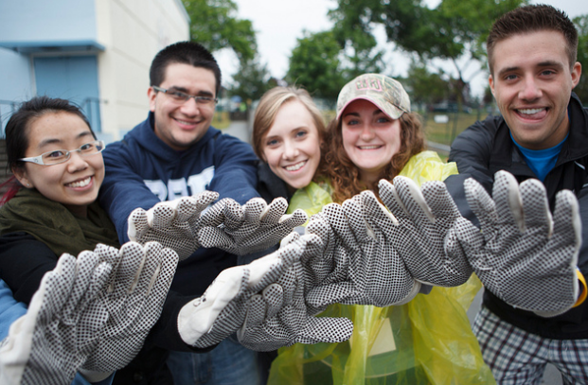
Ending Remarks
Your college life is only what YOU make of it.
Take advantage of opportunities that come your way.
Most of all – have FUN!

Slide 11

Questions?

