Slide 1
Club Webmaster

Slide 2
Club Webmaster
During House of Delegates at ICON last year, delegates voted to add a Club Webmaster
They are now internationally recognized and eligible for awards
Notes:
The club webmaster has many duties, some larger annual tasks, and some frequent weekly duties.

Slide 3
Annual Responsibilities
Create a schedule of posts
Create a list of all usernames and passwords
Update lists of officers on website and their contact information
Renew website service, if needed
Update any resources provided on your club's website
Train the webmaster-elect

Slide 4
Monthly Responsibilities
Review data/analytics about posts
Adjust social media and website posts based on data
Review nearby club's social posts for other ideas
Publish monthly blog on website

Slide 5
Weekly Responsibilities
Follow events up with posts
Update calendar on website
Plan week's social media posts
Follow up on posts that need attention
Post agendas and minutes to the website

Slide 6
Websites should include…
Calendars
Agendas
Meeting minutes
Newsletters
Photos from events
Contact information of officers

Slide 7
Creating a Website
Web-based programs: Wix, Weebly, Squarespace
Software-based programs: Dreamweaver, FrontPage
Notes:
Web based programs do not require any sort of coding knowledge or experience. Less freedom in design, but still a lot of options.

Slide 8
Social Media
Notes:
Another key component to the position of Webmaster is social media. Social media can be very helpful in promoting your club and keeping members informed.

Slide 9
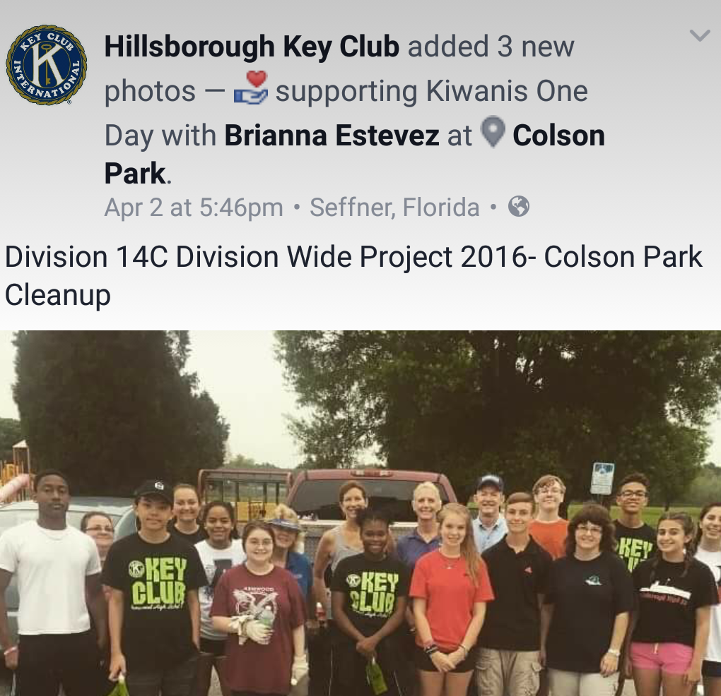
Facebook
Highlight members
Create events and invite friends
Share photos, text, and videos
Create a private group for board members to talk
Don't share irrelevant information

Slide 10
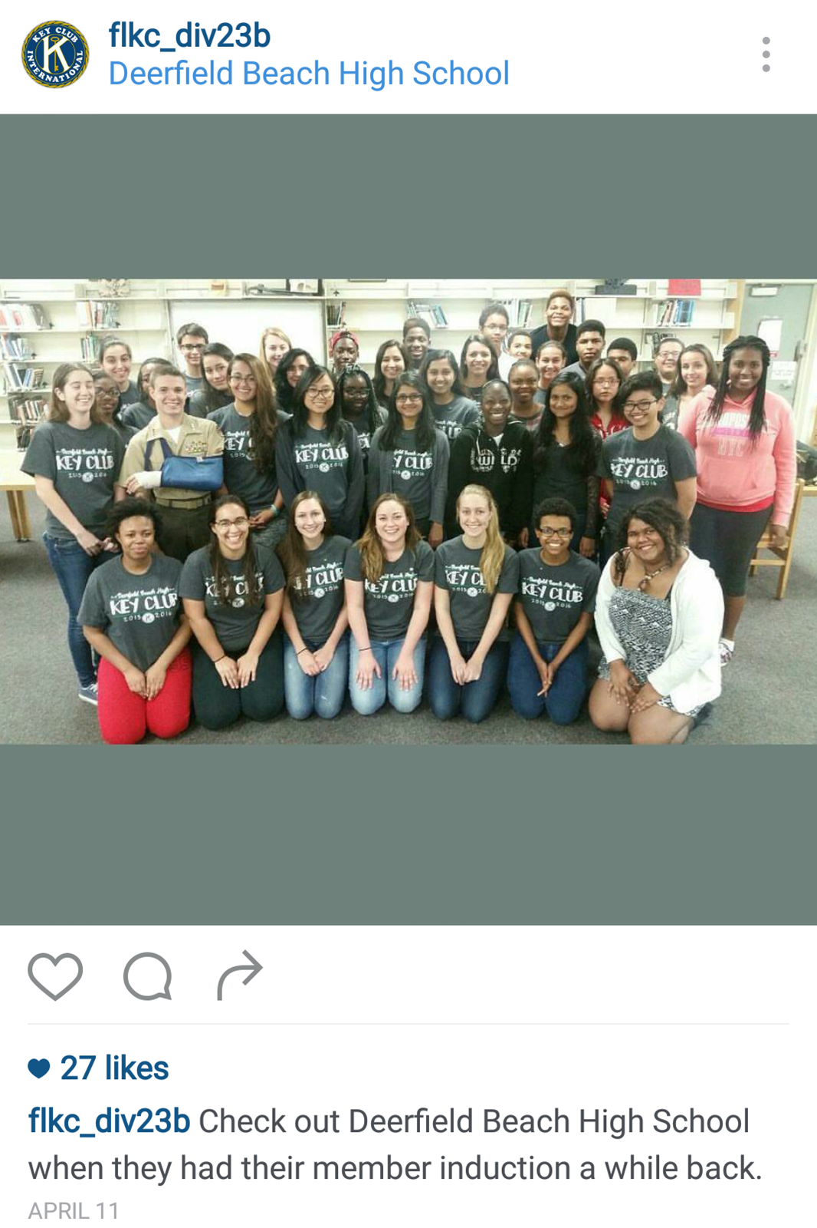
Instagram
Post meeting and event reminders
Use your club's hashtag
Showcase members and service projects
Don't post questionable photos

Slide 11
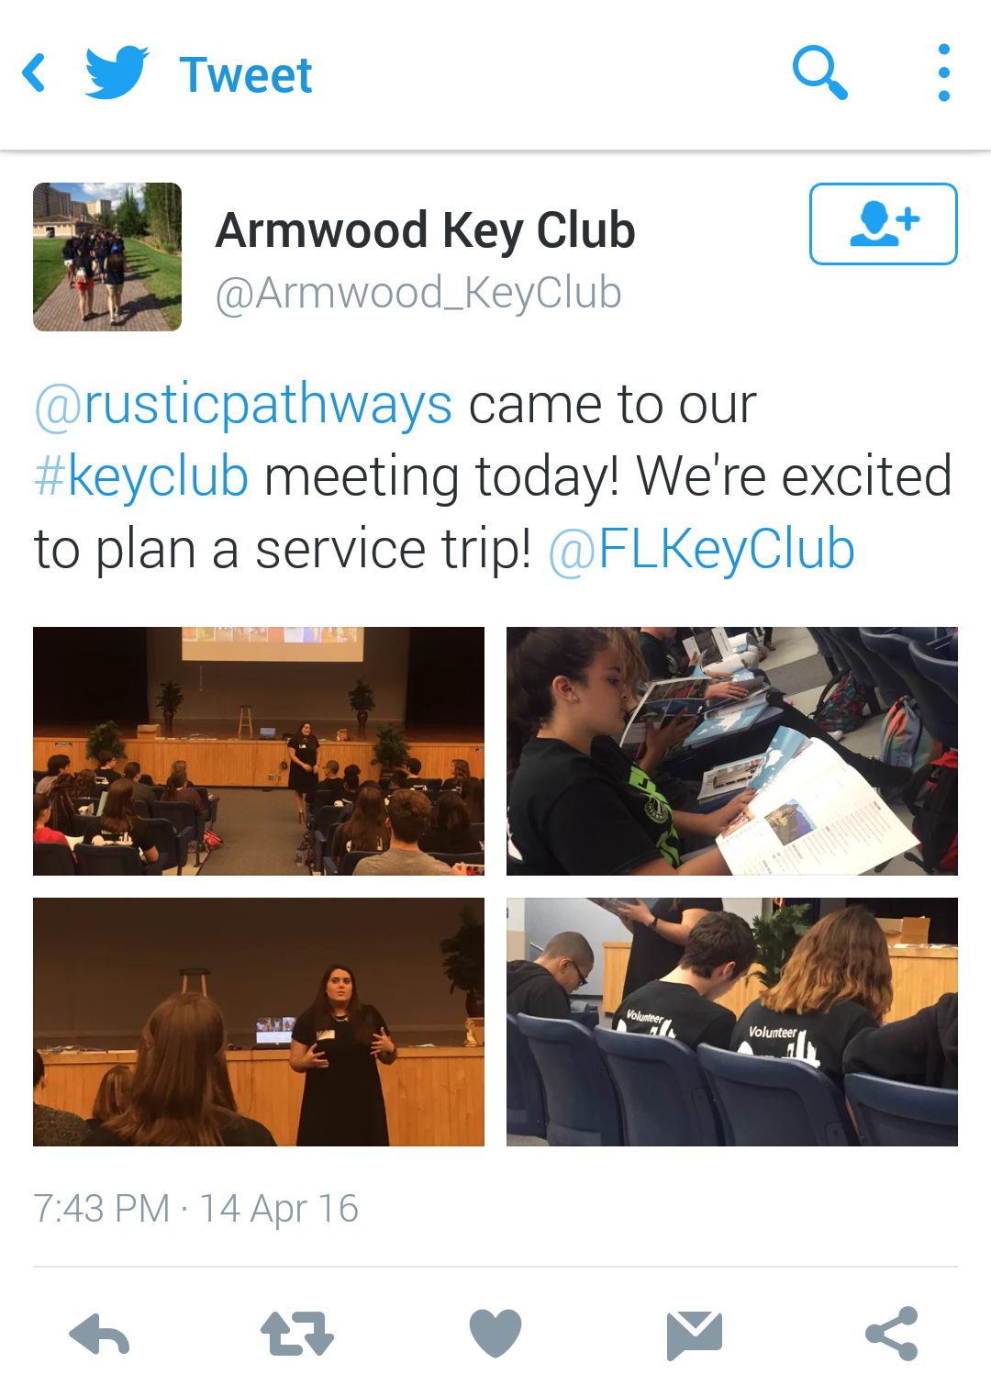
Twitter
Create a hashtag specific for club members to use
Share event reminders, since they can be retweeted
Connect directly with members
Don't tweet about inside jokes—keep it inclusive

Slide 12
Tips
It doesn't matter who you follow, but engage in Key Club activities
If your school permits it, keep your account public
Get your member's parents to sign a photo release at the beginning of every year

Slide 13
Tips (continued)
Use proper grammar, spelling, and punctuation when possible
Don't rely completely on social media for announcements
Tag people in posts
Schedule posts in advance

Slide 14
T.H.I.N.K.
Before you post, use this acronym to decide if it is appropriate.
T- truthful
H- helpful
I- inspiring
N- nice or necessary
K- kind or Key Club related
Notes:
THINK before you post.

Slide 15
Key Club Hashtags
Trick-or-Treat for UNICEF
#TOT4UNICEF
Key Club Week
#KeyClubWeek
Kiwanis Family Month
#KFamilyMonth
Kiwanis One Day
#KiwanisOneDay
Feeding Our Future
#FeedingOurFuture
Be The Key
#BeTheKey
Notes:
Use these hashtags within your club’s posts.

Slide 16
Brand Guide
Specific fonts, colors, and other visual elements
Unites Key Club International and makes it recognizable around the world
keyclub.org/brandguide
Notes:
Brand Guide helps keep Key Club information uniform. Try to use these standards if possible. Visit the link for more information and specifics.

Slide 17
Distinguish Club Webmaster Award
Florida District Award for outstanding club webmasters
Requires creation of club website and attendance to club and divisional events
Full list of requirements on Florida District Website under Awards and Contests
Notes:
Distinguish Club Webmaster Award given at DCON

Slide 18
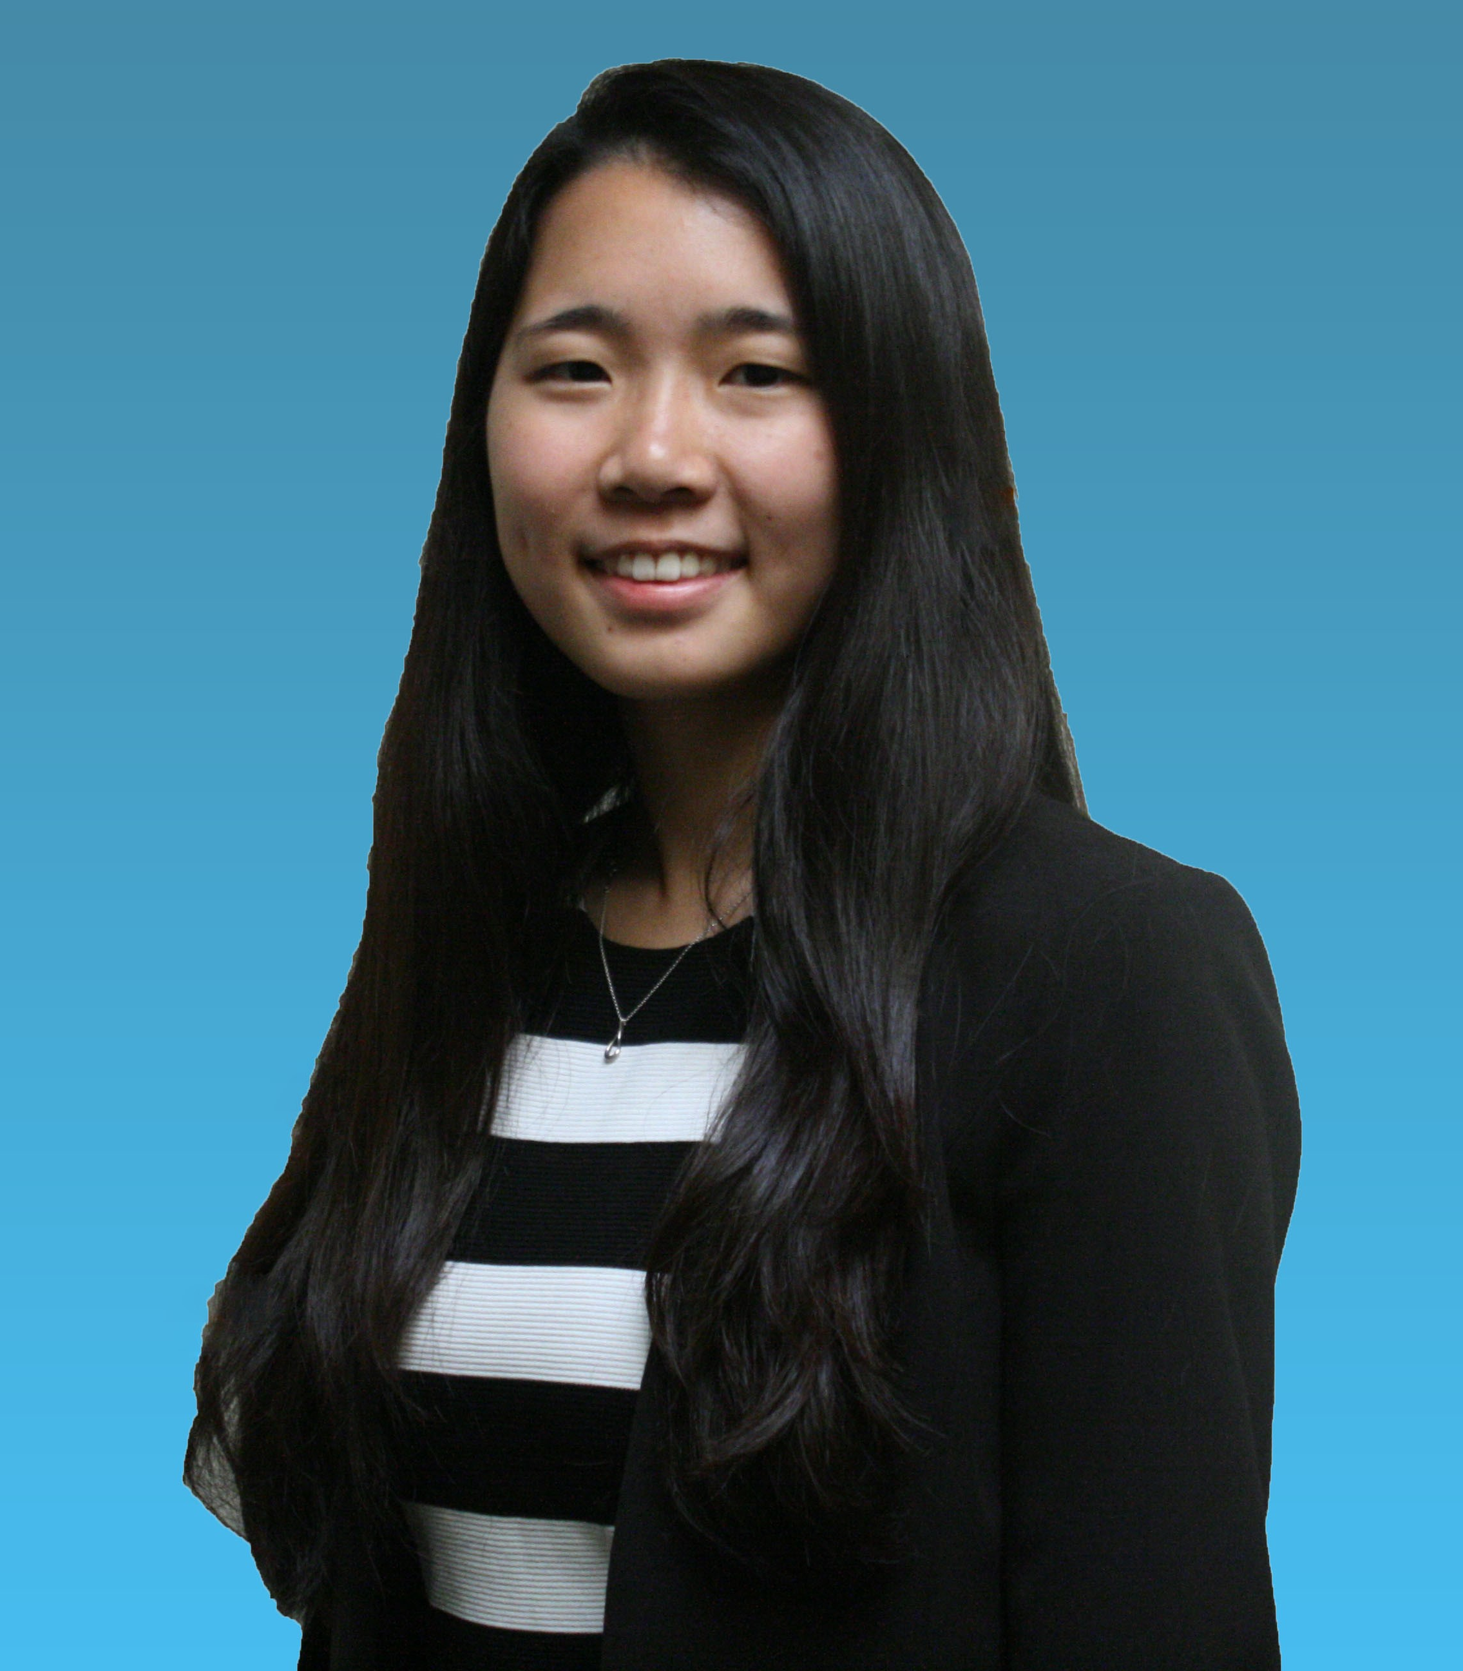
Resources
District Webmaster: Yuria Utsumi
webmaster@floridakeyclub.org

Slide 19
Resources/Questions
For more information visit www.floridakeyclub.org
Questions and/or Comments?

