Slide 1
Club Vice President

Slide 2
General Duties
Assist the president
Be prepared to administer the club in absence of president
Lead the other officers and assist them in their duties. Be the “executor”
- Ensure that attendance is taken at meetings
- Ensure that a newsletter is produced
- Ensure that dues are paid
Notes:
In general, the Vice President is responsible for helping the president in whatever ways possible.

Slide 3
General Duties
Attend all meetings
Help plan events and fundraisers
Serve as a messenger to the members

Slide 4
Communication
Help the president communicate with the members through email or Facebook
Inform members about upcoming service events and fundraisers
Communicate with the Lt. Governor
Communicate with Faculty and Kiwanis advisors
Notes:
Communication is a key part of the role of Vice President.

Slide 5
Communication
MEMBERS
- Greet the members at the door. Acknowledge everyone. If there is any trouble, be sure to address it. Be a messenger to the members about what they missed at meetings, etc.
BOARD OFFICERS
- Help the president assign tasks to other officers, including yourself. Remember that you are there to help and assist.

Slide 6
Communication
ADVISORS
- Keep them informed and be willing to listen to their advice.
LIEUTENANT GOVERNOR
- Your Lt. Governor has valuable information about district events and opportunities and is there to SERVE YOU!

Slide 7
Attend
Represent the club at Kiwanis meetings
Represent the club at Division Council Meetings (DCMs)
Attend service projects, fundraisers, and club/division events
Attend events such as KCKC, Spring Zone Rally, and DCON
Notes:
Make sure to attend as many events as possible and represent your club positively.

Slide 8
Host Meetings
When the president is absent, you will host club or officer meetings.
Help the club president create effective meeting agendas
Host special meetings to plan for and organize projects and activities
Notes:
When the President is gone, you are in charge.

Slide 9
Additional Duties
Monitor all other officer work to ensure that it is completed on time
- Pride Reports, Dues, Newsletters, etc.
Have exceptional knowledge of Key Club on the District and International levels
Educate new members
Transition the vice president-elect
Notes:
Make sure to keep up to date with the activities of the club. Monitor club activities to ensure everything is running smoothly. Whenever you find out who the Vice President Elect for your club is be sure to train them on the duties of the vice-president.

Slide 10
Set Goals
With the rest of the club board, set attainable and measurable goals for your club.
- SERVICE HOURS
Our club will achieve __ hours per member
- MEMBERSHIP
Our club will raise membership by __ members
- FUNDRAISING
Our club will contribute $__ to the Eliminate Project
Notes:
Setting goals is so important to the success of the club. Help the president and the rest of the club board set these goals. In addition to these goals, each club is different and may want to have goals for their unique situations.

Slide 11
Committees
Notes:
A Vice-President is the main advisor to all club committees. Therefore, it is important for Vice Presidents to have knowledge about the basics of a club committee and what its purpose is.

Slide 12
What Is a Committee?
Committee - group of people who work together for a common purpose.
Led by committee chair who should be appointed by the President.
Vice-President oversees committee system

Slide 13
Why Use Committees?
Delegate the officers’ workload
Give members leadership opportunities
Work towards club goals and ensure that projects/events are carried out in the most effective manner
Notes:
Committees are the basis of organization in a club. Perhaps the most important function of committees is that they provides leadership opportunities to members.
Remember that Key Club is all about developing leaders! Also, perhaps these members will be the ones to take over after you are gone. Giving them these leadership opportunities will prep them for later.

Slide 14
Who Makes Up A Committee?
Every member!
As Vice-Presidents, it is your job to…
- survey members to ask which ones they want to be on
- encourage each member to be active on a committee

Slide 15
Committee Chairs
Committee Chairs are member that head a committee.
Duties:
Ensure committee goals are accomplished
Report committee progress, news, happening to club officers, especially Vice-President
Hold monthly meetings
Delegate duties to committee members
Notes:
As Vice President, it is important to know the roles of committee chairs so that you can better assist them and the committee.
A committee chair is chosen to oversee the committee and delegate task to its members.
These specific duties form the gist of what a committee chair does. Refer to resources such as KeyClub.org to learn more,

Slide 16
Examples of Committees
Relay for Life Committee
Kiwanis Family Committee
Fundraising Committee
Member Growth Committee
Scrapbook Committee
Notes:
These are examples of Committees. Every club has its own unique set of goals and special projects that could be carried our more effectively with committees. Some more general committee ideas include; membership committees, service committees, fundraising committees, etc.

Slide 17
Vice President & Committees
The Vice President is in charge of managing the committees system; they advise committees.
- Attend monthly committee meetings
- Ensure work is completed and committees progress towards their goals
- Help committee chairs and members with any problems they may have.
Notes:
Vice President is in charge of committees. These are main tasks that a Vice President should do to effectively manage the committee system.
For a more detailed list of the Vice-President’s responsibilities with committees, visit KeyClub.org and search for vice president.

Slide 18
Distinguished Club Vice President
Notes:
At DCON, the Distinguished Club Vice- President Award is given to vice-presidents that have gone above and beyond their call of duty.

Slide 19
Requirements
Exhibits constructive leadership at all times
Supports Club President
Actively participates in club service projects
* At least 75 service hours
Notes:
According to last year’s Distinguished Vice President Application, these are some of the qualities that a Vice-president must have to be able to apply or this award. These requirements are subject to change; however, they are a good guideline for you all to follow.

Slide 20
Requirements
Works to raise awareness of Governor’s Project & Major Emphasis Project
Encourages all committees
One letter of recommendation (Faculty Advisor)
Notes:
*Continuation of requirements

Slide 21
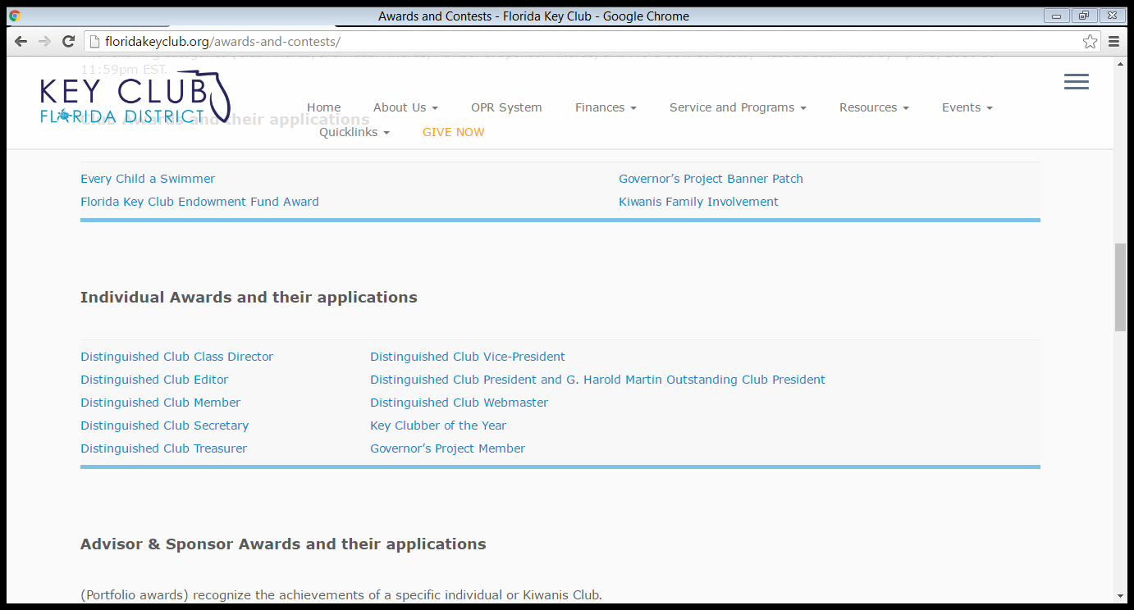
Notes:
For more details on this award, including application deadline, other requirements, etc. visit the floridakeyclub.org website. Go to the Service & Programs tab and click on the the Awards/Contests tab.

Slide 22
Resources
Lieutenant Governor
Zone Administrator
http://www.floridakeyclub.org
Key Club Vice-President Guide
Notes:
If you have more questions or concerns about your position, contact either your Lieutenant Governor or Zone Administrator. You can also access additional resources on the Florida key club website.

Slide 23
Notes:
*Give audience time for questions.

