Slide 1
Club Treasurer

Slide 2
Annual and Monthly Responsibilities
Go to meetings
Financial reports
Manage the club’s bank account
Update and Prepare a budget for the new year
Coordinate and collect dues
Communicate with the school bookkeeper or financial administrator
Notes:
Go to meetings - Attend all meetings
Financial Reports - give financial updates as requested by officers and Kiwanis. A report should include a comparison of what is budgeted with the actual income and expenses.
Manage the club’s bank account – crediting and depositing money, Collect all leftover monies from club projects.
Update and Prepare Budget- Record the club’s income and expenditures on a weekly basis, as well as see what money will be spent and how much money you will fundraise
Collect dues from new members, update them through the Membership Update Center, and submit the dues to International. Also, coordinate dues, because dues can be a complicated process. Start early to allow for dues to be taken care of properly
Develop an in-depth financial report for Board of Directors Meetings.

Slide 3
Bylaws
The Bylaws contain important information on what a club can and cannot do i.e. dues amount, committee assignments, appointed positions, elections process
A Standard Form can be found on floridakeyclub.org under Documents and Resources
Notes:
IF the bylaws are violated, a club can face serious consequences.
Amendments to the Bylaws can be made through a club vote. The amendment must be proposed prior to a meeting then voted on at a normal club meeting.

Slide 4
Paying Dues
Notes:
Before going to the next slide (How Much Are Dues?), ask those in the workshop.
How much is the minimum amount for dues? A: $12.50
How much goes to International? A: $7.00
How much goes to the District? A:$5.50

Slide 5
How Much Are Dues?
International: $7.00
District: + $5.50
Club dues $12.50 at least
A typical club charges anywhere from $20-$25, which includes a T-shirt.
Notes:
Your club can add additional fees, but each member must pay at least $12.50

Slide 6
What Are Dues Used For?
International
- Club and District resources
- Key Club Magazine
District
- District Board expenses
- General Administration
- Florida Opportunity Fund
Notes:
Internationally, dues are used to provide club and district resources and to print the Key Club Magazine.
Within the district, dues are used to help with district board expenses, general administration, and the Florida Opportunity Fund

Slide 7
When Are Dues Due?
Early Bird Dues: November 1st
Send your invoice by October 10th
Regular dues deadline: December 1st
Notes:
By doing this, you can improve your club’s chance of receiving District Awards including the Early Bird Patch and improves your club’s officer’s chances at being distinguished.
For the best chance of receiving this, send your club’s invoice on Oct. 15th. (More on this later)
The final date for dues to be received is Dec. 1st.
After this point, clubs are marked as delinquent, and the club and its members are no longer in good standing.

Slide 8
Schedule for Early Bird Dues
1st Week of Sept. – Hold 1st Meeting and inform members of dues and requirements
Month of Sept. – Remind potential members about application deadline
3rd Week of Sept. – Hold Second meeting and collect application and dues
4th Week of Sept. – Finalize club roster
October 1st – Update the Membership Update Center
Notes:
Early Bird Dues can qualify you for banner patches.
The schedule is quite easy to follow
During the first week of September, hold your first meeting and inform members of dues and requirements
Remind potential members about the application deadline throughout the month of September
In the third month of September, hold a second meeting and collect application and dues
In the fourth week of September, finalize the club roster
On October 1st, update the Membership Update Center with the help of the secretary

Slide 9
Schedule for Early Bird Dues
October 4th – Generate Membership Update Center Invoice
October 6th – contact the bookkeeper
October 10th – Send the check!
October 15th – Check with the bookkeeper to see if the check cleared.
November 1st – Final deadline for early bird dues
This gives you roughly 20 days for the check to get to Key Club International.
Notes:
(continued from last slide),
-- On October 4th, Generate Membership Update Center Invoice
On October 6th, contact the bookkeeper
October 10th, send the check
October 15th, check with the bookkeeper to ensure the check cleared
The final deadline for early bird dues is November 1st
This gives roughly 20 days for the check to get to Key Club International.

Slide 10
Using the Membership Update Center
Opens September 14th
Visit www.FloridaKeyClub.org/Dues
Access the Membership Update Center by logging on with your Advisor’s information
Update the membership list with the new members
Print out the invoice and give it to your bookkeeper or pay with a credit card.
Notes:
-The Membership Update Center (MUC) is where you and your secretary will go to update your clubs roster and register them through Key Club International
-It opens on September 14th.
-Go onto this link to access the MUC and ask your advisor for the information to log on
Update the membership list with the new members who have payed their dues
Print out the invoice and give it to your bookkeeper or pay with a credit card

Slide 11
Developing a Club Budget

Slide 12
What is a budget?
What is a budget?
Why plan?
What are the components of a budget?
Notes:
DISCUSSION SLIDE. Ask the audience to answer these questions
What is a budget? A: A plan for income and expenses.
Why plan for income and expense? A: Know where you are going and how to get there, required for successful meeting objectives, check your progress
What are the components of a budget? A: List sources of income, list of your expenses, net (total) of income and expense

Slide 13
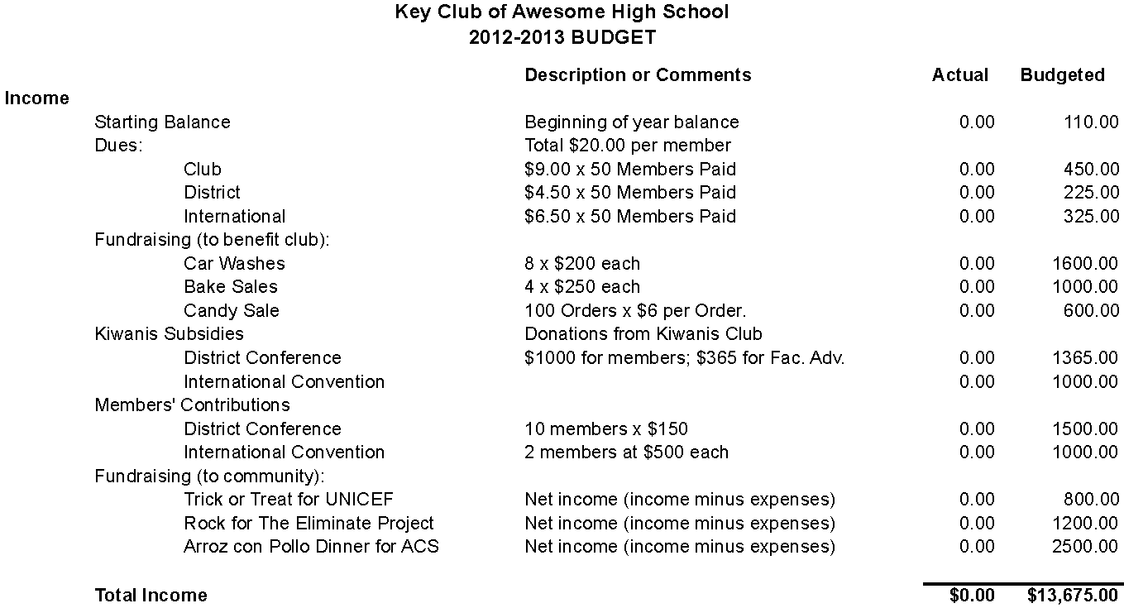
Income Portion of Budget
Notes:
Describe the budget.
First column in the source of income. Second is the description or comments. Third is how much you ACTUALLY made. Fourth is how much your projected you would make.
Starting Balance is how much money you have in your Key Club account at the beginning of the year.
Dues:
In this case for this sample club, the club charges $20 per member.
The club makes $9 per member and they estimate they will have 50 members. 50*9=450
District charges $5.50, so $.50*50=275
International charges $7.00, so $7.00*50=350.
ASK IF ANYONE HAS QUESTIONS ABOUT DUES SECTION
*if they seem to understand ask someone to come up and explain how this sample budgeted for fundraising*
Fundraising
This section is for any type of fundraising activities that benefit the club, such as going to District Conference or their induction ceremony.
Car Washes: this club will have 8 car washes throughout the year and estimate that they will make $200 at each car wash. 8 car washes*$200 made at each car wash=1600
Bake Sales: this club will have 4 bake sales and estimate they will make $250 at each. 4*250=1000
Candy Sale: this club estimates they will have 100 orders that cost $6 for each order. 6*100=600
ASK FOR ONE FUNDRAISER FROM CLUB IN WORKSHOP AND HAVE THEM TELL YOU HOW THEY WOULD PUT IT IN A BUDGET
Questions about fundraising for club portion?
*if everyone seems to understand then move on, so you have enough time*
Kiwanis Subsidies are donations from their sponsoring Kiwanis club
District Conference: how much did your Kiwanis club give to pay for members/officers/faculty advisors to attend DCON. For this club, their Kiwanis Club will hopefully give them $1000 to benefit their members and $365 for their faculty advisor.
International Convention: the club estimates their Kiwanis Club will give them 1000 for whomever to attend ICON.
Members’ Contributions (such as paying for DCON, ICON, or any other activities that require members to pay)
DCON: the club estimates that they will have 10 members attend and each member will need to pay $150. A quad room costs $250 but each member received $100 from their Kiwanis subsidy.
ICON: the club estimates that 2 members will attend and each pay $500 for a total of 1000
ANY QUESTIONS?
Fundraising for the community
Trick or Treat for UNICEF: Net income is the income minus the expenses, so basically what you have left to donate. The club budgets $800.
Rock for The Eliminate Project: Budget $1200
Arroz con Pollo Dinner for ACS: Budget $2500
All fundraising activities may fluctuate each time.
As your club goes through the year and through the activities, have your club treasurer fill in the actual column.
Total income: this club hasn’t started their year yet so their actual is $0, but their budgeted column is $12,675 which is the total of all incomes.

Slide 14
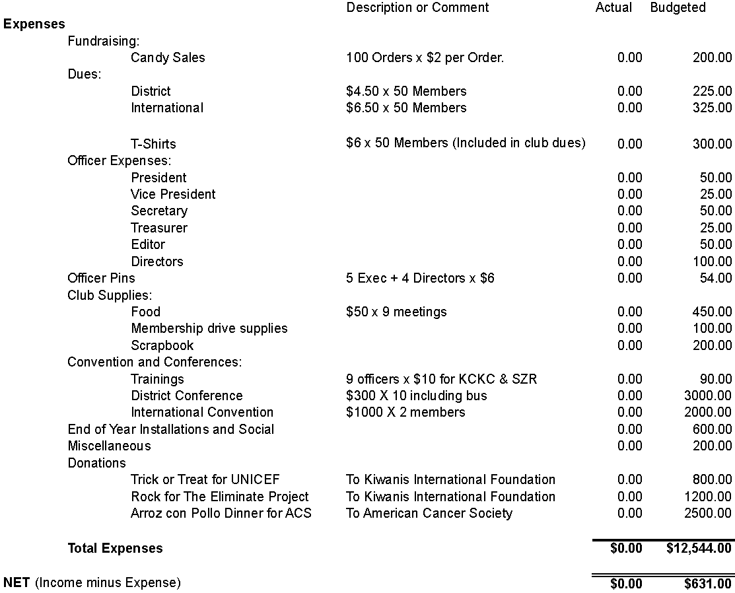
Expense Portion of Budget
Notes:
First column is the source of expense. Second is the description or comments. Third is how much you actually spent. Fourth is how much your projected you would spend.
*generalize the information go through the first topic (fundraising) then ask if they have questions*
Fundraising for your club
Your club budgeted it would cost $2 for each candy to create them. The club budgeted for 100 orders, so 100*$2=200
*if everyone seems to understand ask someone to come up and explain the next topic*
Dues:
The club has to send both district and international dues to International but breaking it down: $4.50 to the district*50 members=225 and $6.50 to international*50=325
The club made tshirts that cost $6 each to make. The club already charged their members with their dues for the tshirt. $6 per tshirt*50 members=300
Officer Expenses could include paper, ink, traveling, food, or any little things that your officers paid for. Each officer has a budget: president $50, Vice President $25, Secretary $50, Treasurer $25, Editor $50, Class Directors $100 (there are 4 class directors so 100/4=25. Each class director is budgeted for $25)
*if they understand stop here, so you have enough time)
Officer Pins: 5 executive officers (president, VP, secretary, treasurer, and editor) plus 4 directors. Each pin costs $6 so 9 pins*$6=54
Club Supplies
Food: some clubs provide food during their meetings. This club budgets that they will have food at 9 of their meetings and it will cost $50 each time. $50*9 meetings=450
Membership Drive Supplies could be brochures, posters, or anything creative to recruit new members. Budgeted $100
Scrapbook for the award at DCON is budgeted for $200 (which is the maximum that a club can spend on a scrapbook to be judged at DCON).
Convention and Conferences
Trainings such as KCKC and SZR: all 9 officers will attend and the club budgets that KCKC will charge $5 and SZR will charge $5 for each officer. The total for both KCKC and SZR for each officer is $10. 9 officers*$10 each for both KCKC and SZR=90
District Conference: It is budgeted to cost $300 per member to attend DCON ($250 for registration and $50 for a bus). $300*10=3000
International Convention: $1000 each*2 members=$2000
End of Year Installations and Social: budgeted to cost $600. This can include food and other supplies.
Miscellaneous is any type of expense that suddenly comes up during the year.
Donations:
Trick of Treat for UNICEF will go to the Kiwanis International Foundation and is budgeted to net $800. $800 is how much your check will be.
Rock for The Eliminate Project will go to the Kiwanis International Foundation and is budgeted to net $1200. $1200 is how much your check will be.
Arroz con Pollo Dinner for ACS will benefit the American Cancer Society and is budgeted to net $2500. $2500 is how much your check will be.
The club budgeted to spend $12,544 this coming year.
Their net (income minus expense) will be $631.
ANY QUESTIONS?

Slide 15
Fundraising

Slide 16
Why do we Fundraise?
For Key Club activities and nonprofit organizations
District Conference/International Convention
The Eliminate Project
What projects have you done in your clubs?
Notes:
It is important to fundraise because it will raise money for Key Club activities and nonprofit organizations, raises money for trips to District and International Convention, and the Eliminate Project
Hold a discussion with the last question.

Slide 17
Sponsorship Fundraisers
Fundraisers where you seek sponsors:
Bowl-a-thons
Dance-a-thons
Walk-a-thons
Notes:
Also, you can seek corporate sponsors by selling advertisements or by telling them they can make a tax-deductible donation.

Slide 18
Sales Fundraisers
Fundraisers where you sell a product
Key Club International and Kiwanis both have licensed merchandise:
www.keyprofits.com
www.kiwanispeanutday.com

Slide 19
Project and Budget Resources
District Treasurer (treasurer@floridakeyclub.org )
Your sponsoring Kiwanis Club (their club treasurer)
www.FloridaKeyClub.org > The Eliminate Project Idea book
www.KeyClub.org > Fundraising Projects (search)
Advisors, Teachers, Parents
Notes:
Going to DCMs, KCKCs, and SZRs are a great way to get ideas from other clubs about how they fundraise.

Slide 20
The Florida Opportunity Fund
(FLOF)

Slide 21
How to Apply for FLOF
Florida Opportunity Fund (FLOF) is a grant for service projects in the Florida District.
Go to www.FloridaKeyClub.org/FLOF
Download and complete the application
Follow instructions and fill out application
Applications need to be received by June 1, 2016.
Notes:
Applications must be received by June 1, 2016 for all projects. Grants will become available again on October 1.
You may submit an application before October 1; however, you will not receive your grant until after October 1.
For projects before March 1, clubs must submit their Part III “Follow-Up” report by the earlier of within three weeks after project completion or the beginning of an ongoing project or by March 5.
If clubs do not submit their Follow-Up Report or do not account for the money spent, they will need to return all FLOF funds to the District, will be ineligible to receive awards at the upcoming District Conference, and will be ineligible to receive a FLOF grant of the current and next year.

Slide 22
How to Apply for YOF
The Youth Opportunities Fund (YOF) is International’s grant program.
It has another application that can either be completed electronically (Reviewr) or on paper
http://www.keyclub.org/service/fund/yof/yofgrant.aspx
Applications must be postmarked by October 15.
Notes:
This is a paper application that you need to print, fill out, and mail to Kiwanis International Foundation.
Applications can be found at http://www.keyclub.org/service/fund/yof/yofgrant.aspx
Applications must be postmarked by October 15.
You must have an adult advisor to apply (Faculty/Kiwanis advisor or a school administrator).
Submit a final written report within 2 weeks of the completion of the project.
Use all grant money for the purposes detailed in your application.
Keep accurate financial records and include the records in your final report.
KEEP ALL RECEIPTS.

Slide 23
Distinguished Treasurer Award
Complete a minimum of 75 hours of service
Submit Club Dues
Attend Club Meetings and DCMs
Coordinate and participate in all club or district fundraising activities
Attend KCKC, SZR, and DCON
Participate with member recruitment
Notes:
The Distinguished Treasurer Award is a great tool to make sure you are keeping on track throughout the year
- Applications will be available on the Florida Key Club website under awards and contests.

Slide 24
Governor’s Project
Feeding Our Future
Project created by Governor Martha Grace
Includes food banks, food drives, and supplying needs for those homeless or hungry.
Notes:
The Governor’s Project this year is called Feeding Our Future
It was started by Governor Martha Grace
There are many opportunities to help feed those who are hungry or homeless
- You can collect canned foods or other goods and donate them to a local food bank
*ask audience* What are some projects you could do to get involved

Slide 25
Governor’s Project
How does this apply to your position?
Raise money for an organization that supplies food for the homeless
Raise money for supplies needed in a project
Ex. Raise money for canned foods to give to a food bank
Notes:
You can raise money or ask for supplies to be donated for any Governor’s Project your club is doing.

Slide 26
Want More Help?
District Treasurer Alyssa Frank at treasurer@floridakeyclub.org
Your Division’s Lieutenant Governor at www.floridakeyclub.org/district-board
www.floridakeyclub.org/dues
Notes:
If you have any questions or concerns contact your Division’s Lieutenant Governor, your Zone Administrator, or District Treasurer.
More information is always available at floridakeyclub.org/district-board or floridakeyclub.org/dues

