Slide 1
Secretary Duties and OPR Training

Slide 2
Duties of the Club Secretary
Secretaries play integral role in the club
1. Keep Officer Information Form (OIF) and reports up-to-date
2. Be prompt, organized, and efficient
3. Take Roll and Minutes at meetings
4. Handle service hours
5. Maintain roster of dues paid members
6. Assist club president with needed tasks
7. Attend Key Club activities (meetings, KCKC, SZR)
8. Work with OPR System
Notes:
Club secretary is one of the most important officer positions making it one of the most challenging.

Slide 3
Attendance
Record attendance for meetings
Use for membership requirements
Use in Pride Reports
Create sign-in sheet in Membership Update Center
Sign in guests at meetings
Guests = any nonmember
Record number on Pride Report
Notes:
Keep track of paid members that are not complying with their duties as members
Use sign in at meetings to keep record of who attended. Do the same for events to keep track of how many hours each member has.

Slide 4
Taking Minutes at Meetings
Meeting Minutes: brief description of what occurred at a meeting
Helps members/officers catch up
Send to members, advisors, and sponsoring Kiwanis club
Template of sample Meeting minutes: floridakeyclub.org > Documents and Resources > Club Secretaries
Notes:
Don’t forget to send minutes to sponsoring Kiwanis president, secretary, and SLP chair.
Helps give records and examples to future board.

Slide 5
Keeping Track of Hours and Other Duties
Track service hours on Excel spreadsheet
Use sign in sheets at events to record members’ hours
Attend KCKC, SZR, and DCON
Assist with planning of club & board meetings
Keep contact with President, Faculty and Kiwanis Advisors
Notes:
Keeping an excel spreadsheet will help you submit pride reports, the Annual Achievement Report, Distinguished Officers/Members Awards Applications, and club member recognition within the club.
Minutes must include:
Date & time
People present
Each topic discussed
Who spoke & what they said
Any motions or decisions

Slide 6
Reports
Keep up to date:
Pride Reports
Officer Information Form (OIF)
Annual Achievement Report (AAR)
School Related Reports
Notes:
Pride Reports: Monthly reports that are submitted on FloridaKeyClub.Org
Officer Information Form (Oif): form with all your officers, class directors, and advisors
Annual Achievement Report (AAR): An end of year report that is submitted to the Awards Committee. Submission of this report can qualify for Distinguish Club and Club of the Year

Slide 7
OPR Contents

Slide 8
Registration Required for newly chartered/newly reactivated, or never registered

Slide 9
Access Florida Key Club Website
Click “OPR System”

Slide 10
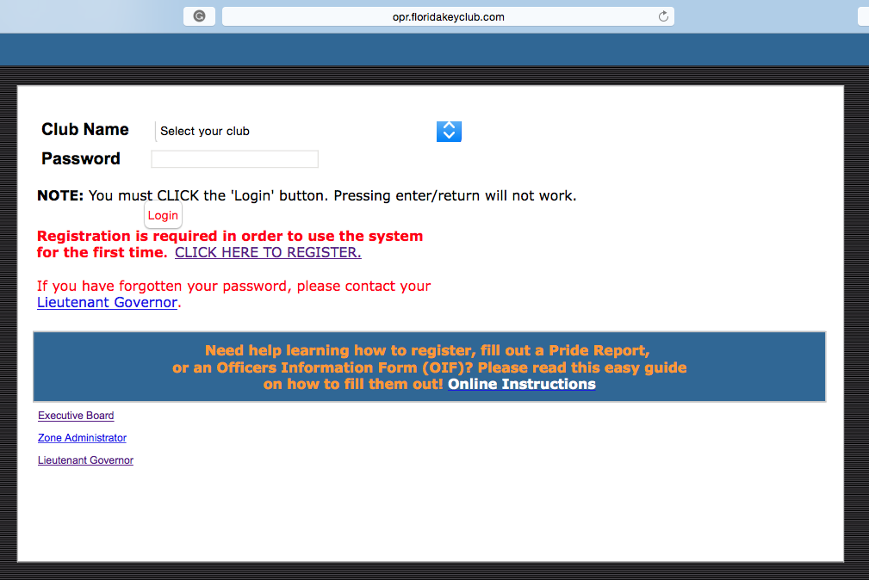
Click registration link

Slide 11
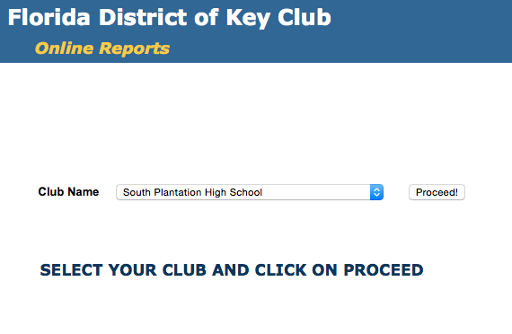
Select your club and click proceed

Slide 12
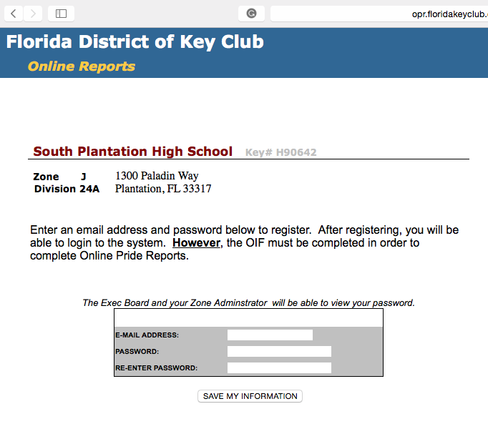
Insert your Faculty Advisor’s email
Create unique password. Secretary, President, and Faculty Advisor needs to know password
Save your information
Once registered, you will be able to login into OPR system
Your Lt. Governor, Zone Administrator, and District Secretary have your password in case you forget it

Slide 13
Officer Information Form (OIF)

Slide 14
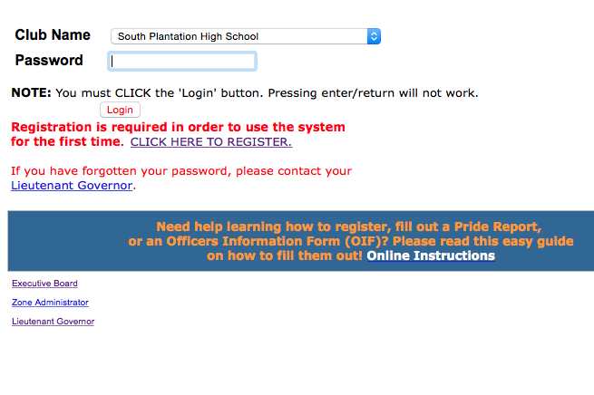
Select your club, enter your password, and click login to enter your club’s account

Slide 15
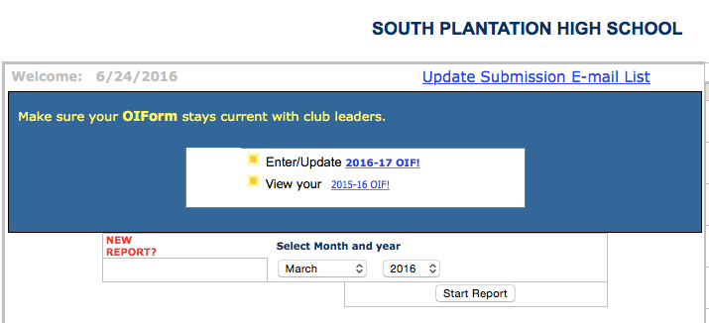
To modify your club’s OIF, press “2016-17 OIF”

Slide 16
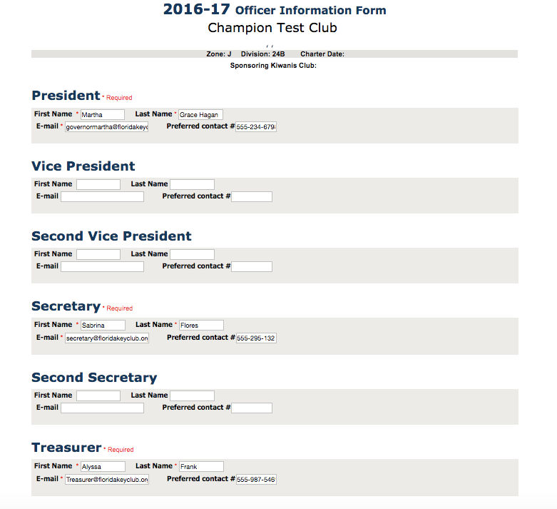
Complete all relevant fields. Note some positions are not required.
Be sure to input all officers’ information as they will then receive updates from their LTG and the District.

Slide 17
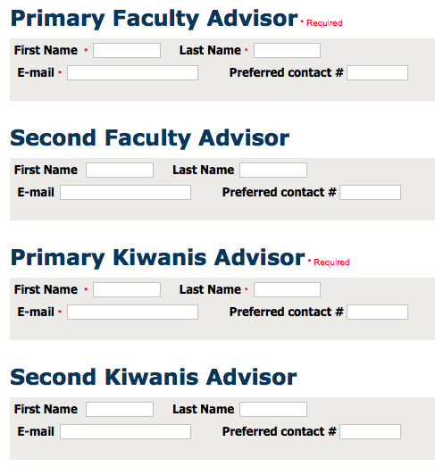
Advisors
To submit OIF, you must enter the names and emails of the Faculty and Kiwanis Advisors
If your club does not have Faculty Advisor, then you can enter your principal’s name and email until Faculty Advisor is chosen
If your club does not have Kiwanis Advisor, then you should enter your sponsoring Kiwanis Club President name and email until Kiwanis Advisor is chosen

Slide 18
Done!
When done, press “Save My Information” then “Send Form Now”
If any information ever changes, please update it on OIF

Slide 19
Pride Reports
Due the 10th of each month

Slide 20
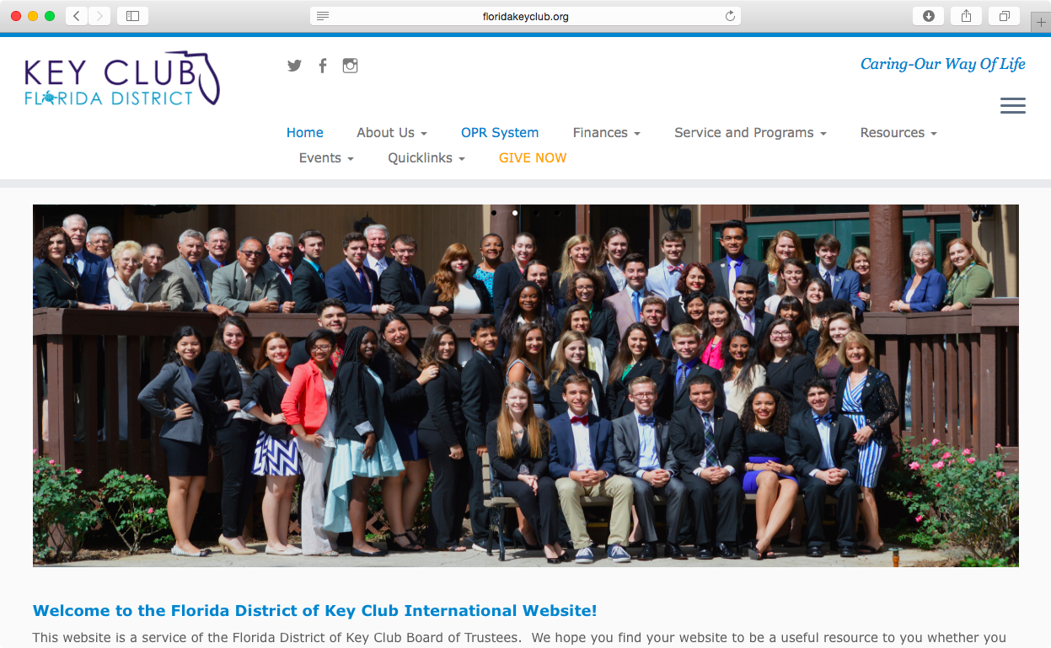
First, access floridakeyclub.org
Then, click on OPR system link

Slide 21
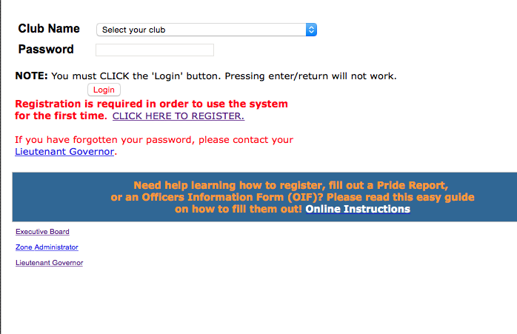
You now need to select your club and then enter your password
If you need help, you can find online instructions here

Slide 22
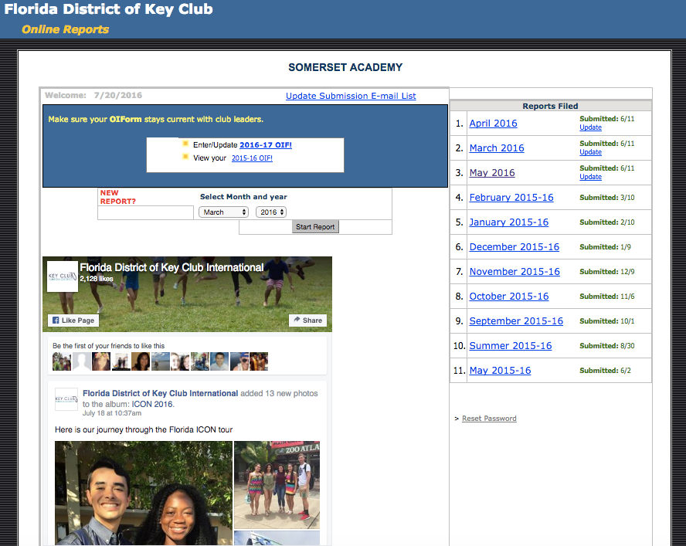
To start Pride Report, select month you wish to fill out, then click “start report”
This is where you can view and update Pride Reports

Slide 23
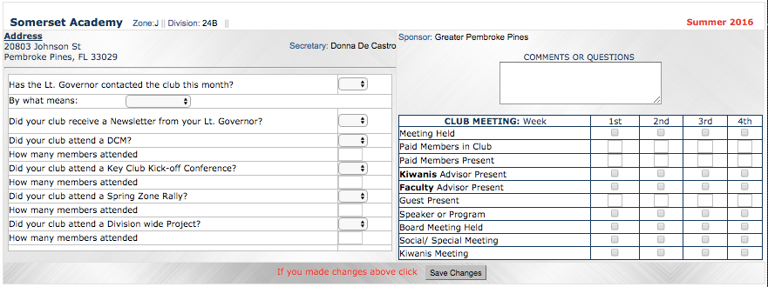
You should see this page once you click “Start report”. From here you can complete report.

Slide 24
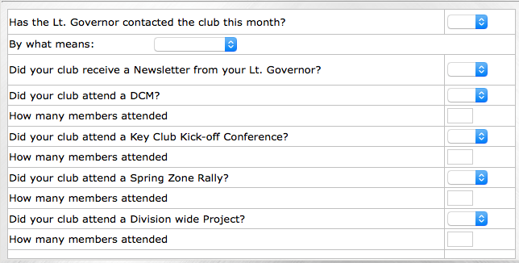
Your Lt. Governor (LTG) can contact you via email, phone, or personal visit
LTGs can either send informational emails as well, so if you received an informational email, put yes for this line
On the left of your pride report, you will find contact and attendance information.
For attendance, please take note:
Clubs will NOT attend Key Club Kick-Off Conference(KCKC) until the Fall. Just leave it blank until your club attends for current year.
Clubs will NOT attend Spring Zone Rally until Spring (SZR) (same as above)
When your club does attend a DCM, Division Wide Project, KCKC, or SZR for that month, click "Yes" and note how many members attended in the line below it.

Slide 25
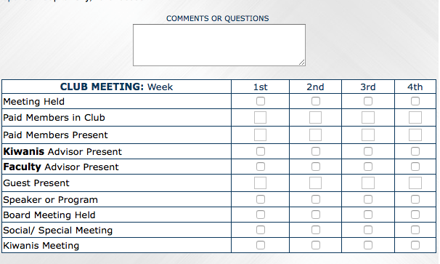
Taking attendance at club meetings will make this box easier to fill out
Be sure “Paid Members in Club” corresponds to number of dues paid members
Meet with your club Treasurer or Faculty Advisor to determine how many paid members are in the club
Above, there is a comments or questions box
If you ever have any questions about Pride Reports, you can enter them here.
You can also clarify certain things. Such as, why your club didn’t do service or have a meeting, and so forth.

Slide 26
After you are done filling out the top portion, press “Save Changes” before moving on

Slide 27
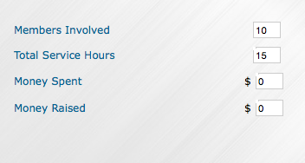
Click “Add Projects” to add service projects. The section below will be opened
In the title section, you will put title of your service project and brief description of the service project
In members involved, you will put number of paid members involved
In total service hours, put the total hours worked by each member, including planning hours
If the club spent any money and/or raised any money you would put the amounts here

Slide 28
Check the applicable boxes for each service project.
Kiwanis Project: Any project that is with Kiwanis Club.
Governor’s Project: Any project that falls under current year’s Governor’s Project
Kiwanis Family Project: Any project involving two or more Kiwanis Family Clubs (Ex. Kiwanis and CKI)
Divisional Project: Any divisional project conducted by your Lt. Governor
Fundraiser: Any fundraiser that is done for a charity or for the club. (Please note fundraisers done for club does not count as service hours.)
District Project: Any project that is conducted district wide.
Major Emphasis Project: Any project that deals with any of three Major Emphasis Partners; March of Dimes, UNICEF, and Children Miracle Network.

Slide 29
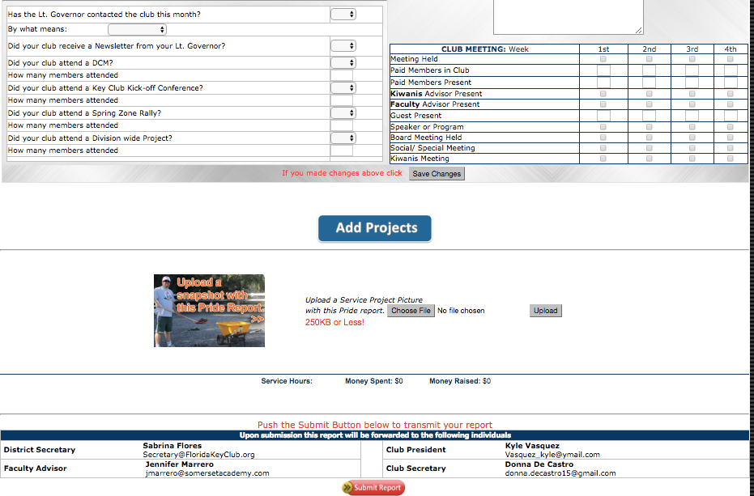
If you have more service projects, press “Add Projects”
If you have pictures of any service projects, upload it! Choose File first, then press “Upload”
When you are finished, “Press Submit Report”
After you are done posting service projects press “Post to My Report”

Slide 30
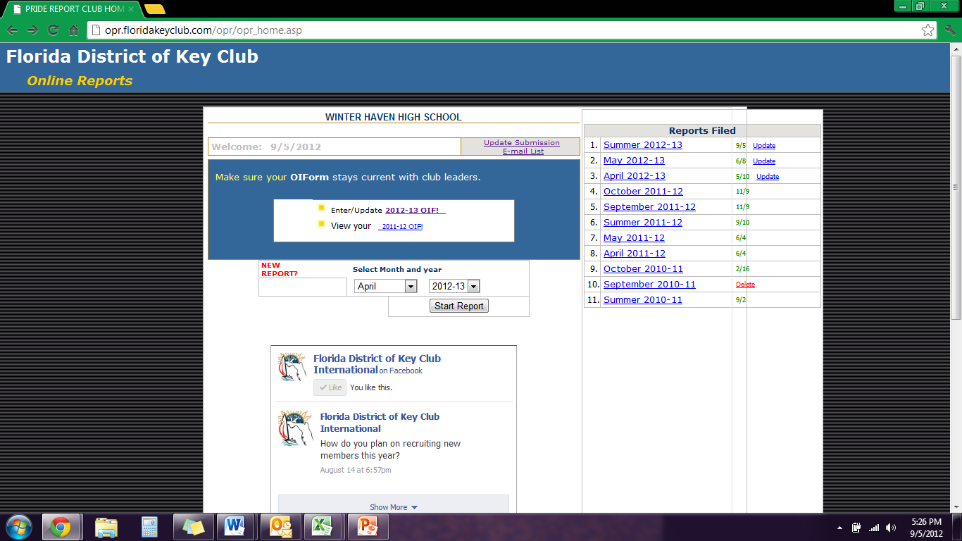
You can add additional people to receive Pride Reports by clicking “Update E-mail Submission List” on right hand side of blue OIF box

Slide 31
You can input club committee chairs, Kiwanians from your sponsoring Kiwanis Clubs, and school officials.
Pride Report is e-mailed to everyone on your club’s OIF, the District Secretary, your Lt. Governor, and your Zone Administrator.
Make sure to click “UPDATE MY INFORMATION” before exiting the page or updated information will not be saved.

Slide 32
Helpful Resources
Your Lt. Governor
http://floridakeyclub.org/contact-information/#Board
District Secretary
secretary@floridakeyclub.org
Notes:
Edit the “your lt. governor” to be the correct email.

