Slide 1
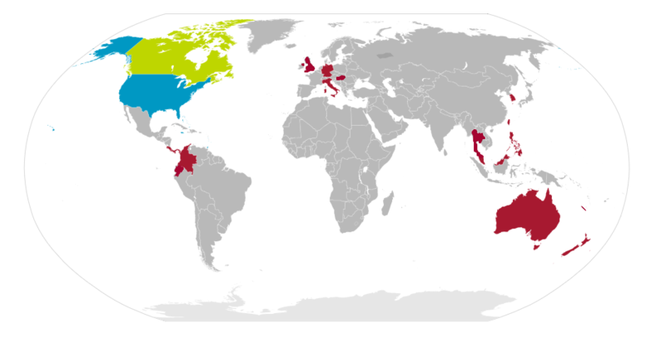
Bigger Than You:
The Impact of
Key Club International
Notes:
If possible, do an icebreaker or team building activity to get everyone more comfortable with each other, for example: Spider Web (http://www.great-at.com/great-games/icebreaker-game-spider-web-game/)
Place emphasis the scale of Key Club
On the map above, the blue denotes fully districted countries, green denotes partially districted countries and/or districts-in-formation, and red denotes countries with non-districted Key Clubs.
As you can see, Key Club is a GLOBAL organization, which means that collectively, we can create a huge impact on the world.

Slide 2
Just the Facts
Key Club is the ______ and ______ service program for high school students, started in _(Year)_.
Key Club was started in what city?
How many clubs are in Key Club International?
Key Club is represented in how many nations?
Notes:
Ask the members if they know the answers to these questions.
Give out small prizes such as candy if they get it right.
(Answers are on the next slide)

Slide 3
Just the Facts
Key Club is the oldest and largest service program for high school students, started in 1925
Key Club was started in Sacramento, California
Key Club has over 260,000 members
There are more than 5,000 clubs
Key Club is represented in 34 nations
Notes:
Ask the members if they know the answers to these quesions
Emphasis the size and age of Key Club international

Slide 4
The Structure

Slide 5
Members
Member
Home Club
Notes:
Member: An individual who pays dues
Club: Your home club is the club you are registered with, usually your school’s name.
Give a short description of each club officer position (See below)
The Home Clubs officers Include:
-President:
-Responsible for setting and monitoring the goals of the club, running club meetings, appointing committee chairs and delegating tasks as necessary, recruiting, training and retaining members
-Responsible for maintaining regular communication with the Lieutenant Governor of his or her division
-Vice President:
-They serve the president, other club officers, committees and the general membership.
-Secretary:
-Responsible for taking minutes, keeping records and maintaining all important files for the club
-Treasurer:
-Controls the club’s money, both its collection and disbursement.
-He or she collects member dues, prepares and monitors the budget and maintains accurate financial records.
-Editor:
-Responsible for keeping the membership informed about important activities, opportunities and deadlines at the club, district and international level.
-Should publish a newsletter
-Class Directors:
-Responsible for transmitting information from their class members to the club officers.
-There is one class representative for every grade in Key Club.

Slide 6
Divisions
Division:
A Division is made up of several clubs and is assisted by a Lieutenant Governor (LTG).
LTG
Club
Club
Club
Club
Club
Club
Notes:
A Lieutenant Governor (LTG) oversees the clubs in his or her assigned division.
Their duties include attending all the trainings and board meetings, sending out monthly newsletters, completing monthly reports about their clubs in the division.
Hold at least 6 Divisional Council Meetings throughout the year
They act as a liaison between the District Board and their assigned clubs.

Slide 7
Zones
Zone:
A zone consists of all divisions within the zone set by Kiwanis.
Zones are assisted by their districts’ respective Lieutenant Governor and are over seen by an Adult Zone Administrator.
Zone
LTG
LTG
LTG
LTG
Notes:
Explain significance of a Zone coming together:
KCKCs- Key Club Kick-off Conference
Held in the Fall
Training for officers to start their year off, and for members to get informed with higher office opportunities and the significance of Key Club.
Usually where the theme of DCON is announced.
SZR- Spring Zone Rally-
Held in the spring.
Where the new Lieutenant Governor is elected.
Where incoming officers are trained for the next year.

Slide 8
Districts
District:
Consists of all zones.
Assisted and lead by Executive Board and, ultimately, by the Governor.
Governor
Executive
Board
Editor
Treasurer
Webmaster
Secretary
Exec. Assistant
Lieutenant Governors
Notes:
Explain rolls of Executive Board:
-Secretary, Treasurer, Editor – Same as in clubs, but on a bigger scale
-Webmaster – all technical help including Website maintenance, Editing Method, etc.
-Executive Assistant – assists the governor and tracks each LTG’s progress
-Governor – Make executive decisions about the district as a whole, Run Board meetings, Lead DCON, etc.

Slide 9
International
International:
Three Sister Districts are assisted by an International Trustee.
All Trustees are lead by the International Vice-President (IVP) and President (IP).
IP
IVP
International Trustees
Governors
Governors
Governors
Notes:
The International Board:
The International Board consists of 11 trustees, one Vice President, and one President
Please ask them if they know who the current IP and IVP are, along with who Florida’s Trustee and Sister District are.
Roles:
-International Trustees: A Trustee is assigned to sister districts, in which he maintains consistent contact with. He or she also interprets the scope and meaning of the bylaws, and carries out committee.
-Florida’s International Trustee is Amy Jiang. Our sister Districts are Illinois Eastern Iowa, and Eastern Canada
-International Vice President: Performs the duties of the president in the event the president is unable to do so. He or she chairs at least one international committee, supports all other committee chairmen and performs duties/attends events as deemed necessary by the International President and/or board of trustees.
-The Key Club international Vice President is Addison Clipffel
-International President: Exercises general supervision over the work and activities of Key Club International. He or she presides over the international convention and all meetings of the Board of Trustees and the International Council. The president is the official representative of Key Club International with Kiwanis-family leadership and external agencies.
-The Key Club International Presidents is Rip Livingston

Slide 10
What does this mean for you?
Notes:
Service
You are part of the LARGEST high school service organization in the world
You are not alone, but instead, part of something much bigger
You. Can. Change. The. Course. Of. History.
With a club this size, every little thing we do, comes together to create something much larger.
(Make this dramatic, emphasize the significance of Key Club)

Slide 11
Leadership
in
Key Club
Notes:
When people hear “Key Club,” they immediately think “service.”
Everyone knows Key Club is a service organization.
-3 out of 4 Core Values are service oriented (Inclusiveness, Character Building, Caring)
-The one that people fail to recall is LEADERSHIP.
-Key club aims to instill leadership to every single one of its members

Slide 12
Higher Office Opportunities
Committee Chairs
Class Directors
Club Executive Board
Higher Office
Notes:
Mention the” Running for Higher Office” workshop.
Why do you need leadership?
looks good for colleges. They aren’t just looking for grades anymore. It’s the trifecta of scholarship, community service, and leadership. Key Club is 2/3 of that!
For future life tasks. Skills are used all the time. Group projects. Planning events. Etc.
Because it keeps you one step above the rest. No group can accomplish anything if there isn’t someone to lead and organize
In Key Club, there are many ways to get involved in higher office, (Whether it is on the club, the district, or international level) and the earlier you start, the better!

Slide 13
Key Club Service
Interact with members from other clubs
Larger Projects
Recognition
Notes:
As a Key Club member, you will come in contact with many different people as you all come together for the same purpose, service. For example, when you meet members from other clubs you will get new service project ideas, be able to participate in joint projects, and maybe even make great new friends
Larger Projects – The Eliminate Project. Make a global impact in many countries
Recognition – Key Club is known by every college because Kiwanis is a world-renowned organization

