Slide 1

Kiwanis and Faculty Advisors

Slide 2



Quiz Time!
Key Club is the ________ and _________ service program for high school students.
It is an international _________-led organization which provides its members with opportunities to provide service, build character, and develop leadership.
3. The role of Faculty Advisors is to _______ the students.
oldest largest
student
coach
Notes:
Key Club
- Open to anyone in the four upper grade level of high school. Exceptions to this are for high schools that last longer than four grades.
- More than ¼ million members
- 5,100+ clubs
- Founded in 1925 in Sacramento, California
- Since 1995: 44% growth

Slide 3

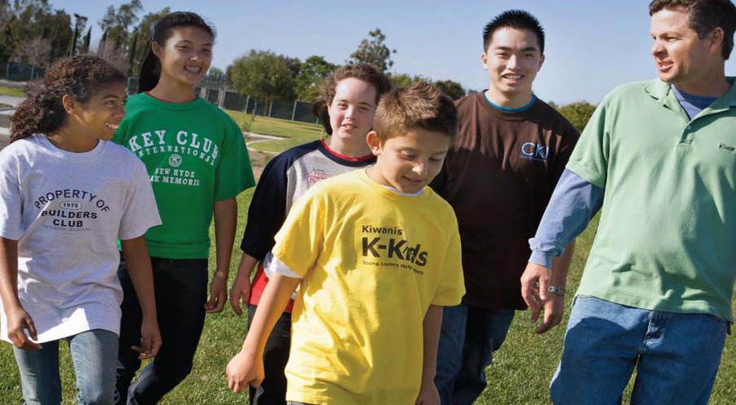






We are
a part of…
Notes:
Historically…
What we’re best known for
- Being a part of the Kiwanis family
- What Kiwanis does best: Service and Leadership
- Working with other branches of the Kiwanis Family
- Let’s learn a little more about the Kiwanis Service Leadership Programs. <change slide>

Slide 4
The structure of Key Club
Although Key Club is a student-led organization, the club officers and members are guided by their Faculty and Kiwanis Advisors.
Kiwanis Advisor
Faculty Advisor
Student Members
Notes:
Key Club is comprised by paid members, who make up club members, club officers, district officers, and international officers
-Although Key Club is a student-led organization, members are then guided by their Faculty and Kiwanis advisors
-Kiwanis family relations are vital to a strong club

Slide 5


Keeping your club strong
To maintain a strong club, the following must have strong relationships in order to flourish
Responsibilities fall on
  The school
  The Kiwanis Club
  The Key Club
Notes:
All 3 need to enter into an agreement and work together
Important all 3 have good relations with one another so that Key Club can flourish
Helpful tips:
-Remind Officers to introduce themselves and Key Club to their school principal
-If the school has morning news, talk to the producer and get Key Club mentioned to advertise meetings
-Have officers set posters up around school
-Have members attend Kiwanis Meetings, they not only learn more about Kiwanis, but also build relationships with the clubs members

Slide 6

Club Operations
Club Bylaws
  Make copies accessible to membership
    These allow members to have a voice in how the club should run, and have the ability to change it if they want to
  Review of sections
  Amendments
Notes:
Club bylaws are a crucial resource for your club to run
-Dictate your club’s dues (on top of international and district dues)
-Allow members to have a voice in how the club should operate
-Make club operations official with Key Club International
If you can’t find your original Bylaws, contact your Zone Administrator or Lt. Governor and they will be glad to find them for you.
You can find their contact information on the Florida Key Club website (floridakeyclub.org) under the tab District Officers
They can be found on the Florida Key Club website, on the Documents and Resources tab under “Club Building and Improvement”

Slide 7


Club Operations
Key Club Board of Directors
  The Board of Directors is comprised of club officers as written in your Bylaws
  Usually the President, Vice President, Secretary, Treasurer, Bulletin Editor, and the four Class Representatives.
  Make sure to hold officers accountable for how the club does
  Make sure you advise your club, and guide them, not take over.
Notes:
The Board of Directors is compromised of the President, Vice President, Secretary, Treasurer, Bulletin Editor, and the four Class Representatives.
Hold officers accountable for how the club is doing. If an officer is not doing his or her job, let them know and explain to them how they can improve. If they still are not doing their duties, ask them politely to step down for the good of the club.
“Co” Officers aren’t bad to have, but it isn’t advised to have them. Under the OIF (Officer Information Form) you can only list
one officer, causing only one officer to get the recognition they deserve. Try to avoid this.
Club officer duties can be found on the Florida Key Club website, under the documents and resources tab.

Slide 8

Club Operations
Club Member Meetings
  Meetings are the President’s responsibility
  Should be held at least twice a month
  Meetings should follow an agenda, to ensure important topics are covered
  Remind your President that meetings should be both productive and fun to keep members coming back!
Notes:
Try to have both officer meetings, and full club meetings.
Meetings should be an appropriate length- not too long not too short
Get members involved! Use ice breakers and get them to know each other, or make it a formal meeting where members can come dressed business professional! They love it.
Always remind your officers to let members play a part in the planning and carrying out of events, it not only gets them more involved, but it takes all of the pressure off of the officers.

Slide 9
Club Operations
Club Board Meetings
  The President’s responsibility
  Should be held at least once a month to:
    Approve projects
    Long range planning
    Next meeting planning (plan next meetings agenda)
    Have Committee Chairs present Committee Reports
Notes:
Should not plan projects at board meetings.
Work with you board to:
Approve budgets
Plan for the year
Create a member encouragement plan
Review performance of Club Officers
They are called board meetings, NOT officer meetings

Slide 10


Club Operations
Committees
  The Vice President is responsible for committees
  Committees serve a useful purpose
    Delegate tasks
    Provide more leadership opportunities
  Role of committees is defined by your Bylaws
  Have your Committee Chairs attend board meetings to present what they have been working on. (Committee Reports)
Notes:
Committees help officers to delegate their duties and relieves them of doing all the work, makes projects run smooth and fast, and gets more members involved in a leadership role.
By giving members leadership and participation opportunities, they can become inspired to become officers
They mimic “real” world committee and positions, which give them good work experience
Not using a committee makes club operations much more difficult, and stagnant
If you have problems with your committees, talk to your Vice President to brainstorm solutions. Contact your lieutenant governor if you still need help.

Slide 11
Club Operations
Budget and Finances
  Primarily the Treasurer’s responsibility
  Follow school policy for accountability
  Create a budget for club expenditures
  Request Kiwanis support if needed (Ex. Sending representatives to DCON)
  The Board should approve of expenditures
Notes:
Faculty advisor should guide the club in creating a budget and providing any rules to the treasurer about handling money, especially regarding school policy
If needed, request financial support from your sponsoring Kiwanis club. However, make sure you establish a relationship before making money a priority
First time contacting your Kiwanis club should not be the first time you ask for money.

Slide 12
Club Operations
Registering members/paying dues
  The Treasurer collects dues
  The Secretary inputs their information into the membership database
  Clubs are required to pay dues on time
  Look for dues mailing from KCI mid-September
  Plan deadlines ahead to get Early Bird Dues award (Received by November 1st)
  Dues process
Notes:
Dues:
Timely dues payment is a life lesson
Treasurer and secretary should work together to collect dues and member information and input them into the membership database
Plan out timeline for dues process and allow some extra time for mailing
Try to make the Early Bird Dues deadline- received by Nov 1
Allow time for school processing (may take more than a few days for school to send out check)

Slide 13
Club Operations
Officer Information Forms (OIF)
  The Secretary’s responsibility to update
  Serves as contact information to keep them informed on both the District and International
  This form is found in the Online Pride Report System (OPR)
  The OPR is found on the Florida Key
  Club site (floridakeyclub.org)
Notes:
Keep OIF updated.
This is the job of the secretary.
If you have trouble accessing OPR system ask your LTG or ZA. Their emails can be found on the Florida Key Club website under “Contact Info”
The district as well as your LTG uses this to get in contact with officers and you.
Make sure OIF is filled out as soon as you elect new officers, preferably before DCON.

Slide 14
Club Operations
Online Pride Reports (Monthly Reports)
  The Secretary’s responsibility
  Pride Reports state:
    Club activities and meetings
    Hours done that month
    Contact from Lt. Governor
  Pride Reports are a part of the OPR, found on the Florida Key Club site
Notes:
Gives measure of club health
Provides information on primary activity of Key Club: Community Service
Gives ideas of projects
Gives a basis for whether or not club secretaries can win certain awards, such as the 100% Submission Award

Slide 15
Club Operations
Methods of Communication
  The Editor has the responsibility of keeping members informed
  Ways to communicate include:
    Agendas at meetings
    Email/Facebook
    Posters
    Newsletters and Calendars
    Phone calls or conference calls
    Announcements at school
Notes:
Use multiple methods of communication tools not just one.
Allows all members to stay in contact with Key Club in some way. Good new resourses could include Remind101, GroupMe,
Spread Key Club message in as many ways as possible

Slide 16

Club Operations
Member selection and recruitment
  The Board’s responsibility
  Clubs should have at least 20 members
  Membership applications are useful
  Membership requirements (required number of hours per month)
  Plan well to provide service opportunities for all members as often as possible
KEY CLUB NEEDS YOU!
Notes:
20 members: Average club membership in Florida is 58.
Small clubs have problems with developing and installing leadership
Risk loss of significant number of members – having to rebuild each year
Lack of project ideas
Lack of frequent volunteers for big events
Cause is usually leadership problems (many reasons for this), overly restrictive advisors, lack of involvement

Slide 17
Kiwanis Advisor
A Kiwanis Advisor is:
A member of your sponsoring Kiwanis Club, which has chosen to assist and guide your Key Club.
They are an amazing resource of knowledge, so keep in contact!
Have officers and members attend Kiwanis Meetings if possible
Notes:
Represents Kiwanis when coming to meetings for Key Club
Show your support and create a connection with the club and officers
You should be a familiar face

Slide 18


Kiwanis Advisor Responsibilities
Train, educate, and encourage officers
Attend and support the attendance of Key Clubbers at club meetings, board meetings, divisional and district events
Invite Key Club members to Kiwanis meetings and Kiwanis projects
Present budget requests to Sponsoring Kiwanis Club board in summer
Assist Faculty Advisor wherever and whenever possible
Notes:
Have a connection with the Key Club you sponsor
Invite Key Clubbers to your projects and go to theirs
It should be a mutual connection, where both sides work together
Reach out to your Key Club if they do not reach out to you. A Key Club may need to be reminded that they should have a strong relationship with their Kiwanis Club

Slide 19
Faculty Advisor
A Faculty Advisor is:
A representative of their Key Club to the school’s administration, and club members.
Assists and guides the club officers with organizing and coordinating club events
Attend and support attendance of Key Clubbers at division and district events
Give individual guidance of members/leaders
Ensure school policies are followed
Notes:
Represents Key Club to the school administration
Helps explain policies of school and guides students through paperwork when planning school activities
Guides officers into success and oversees actions

Slide 20

Beyond the Club Level
Divisional level
  Lieutenant Governor
  Divisional Council Meetings (DCM’s)
  KCKC/SZR
  District level
    District officers
  DCON
International level
  International officers
  ICON
Notes:
Division- run by a LTG. Divisions come together at DCMs as well as KCKC and SZR. Divisional events allow members/officers in a division to be educated on Key Club and understand what is happening on international and district levels.
District- 34 districts total, each district is comprised of LTGs with an executive board. Manages 20,000 members and 360 clubs
International- President, VP, along with trustees. Each trustee has 3 districts. Trustees bring information from the international level to the club level

Slide 21

Beyond the Club Level Specifics…
Roles of the officers above the club level:
Key Club International Board
    Florida District Governor
    Florida District Secretary
    Florida District Treasurer
    Florida District Editor, Webmaster, Executive Assistant
    Division Lieutenant Governors (41)
Notes:
Governor-provides guidance and leadership for the entire district and the district officers and committee chairmen
Secretary- tracks Pride Report Submissions, takes minutes and attendance at all meetings
Treasurer-charged with accurately tracking and reporting the district financial accounts
Webmaster-updates and maintains Florida Key Club website and deals with any technical questions or issues
Editor-charged with sharing news and correspondence from the district board to the clubs in your district and with promoting district events in your community. Edits Lieutenant Governors Newsletters.
Executive Assistant-charged with helping the entire Executive Board in a variety of tasks
LTG:
Is a member of the District Board
Is part of a committee on the district board
Represents clubs that make up a division

Slide 22
Beyond the Club Level
Higher level involvement is important!
Benefits from additional leadership experiences
Expand idea base for projects
Gain motivation from others
Network
More higher officer opportunities for members.
Notes:
Our stronger clubs are involved on higher levels- division and district
Try to get members and officers to DCON and/or ICON
Push officers/members to go to Divisional Council Meetings (DCM’s), Key Club Kick-off Conference (KCKC), and Spring Zone Rally (SZR)

Slide 23
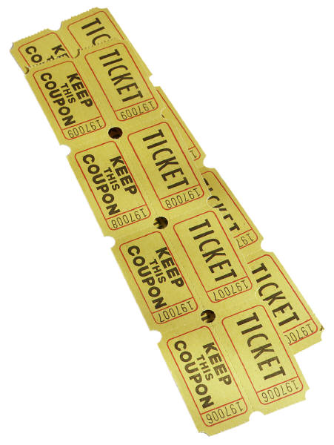
Beyond the Club Level Specifics…
Events to attend
  Division Council Meetings (DCM)
  Division projects
  Key Club Kickoff Conference (KCKC) (The Fall)
  Spring Zone Rally (SZR) (The Spring)
  Florida District Conference (DCON) (Around April)
  Key Club International Convention (ICON) (The Summer)
Notes:
Encourage all officers and members to attend these events, especially Divisional and District events.
These events bring Key Clubbers together and make us a stronger organization
You as well as Key Club officers can learn more about the organization and become more effective leaders.

Slide 24
Beyond the Club Level Specifics…
Club competitions at DCON and ICON
  District contests
  District awards
  District scholarships
  Kiwanis scholarships
  International awards
  International scholarships
Notes:
Apply for awards and scholarships at DCON!
Great way to get members involved as they see the payoff when they receive recognition
Your club can also be entered into international awards and receive recognition on an international level
These can be found on the Florida Key Club website under the Awards and Contests tab

Slide 25


Let students know that Key Club continues…
Into college! Circle K is the premiere university service organization in
the world
Notes:
Circle K International (CKI)
- University students
- 500 campuses
- 13,000 members
- Since 1936
- Dues: US$25 (tiered) *

Slide 26

Resources
Tools you’ll need to build, grow, and lead your club:
  Florida District KC website
  Key Club International website
  Zone Administrator
  Lt. Governor
  Other district officers
  District Administrator
  KCI Office
Notes:
Resources
Gather the tools you’ll need to build, grow and lead your club.
- The basics: club structure and organization.
- PR tools: free posters, brochures and video.
- Advisor tips: Know what to ask—and expect from—advisors.

Slide 27

How do you change the world?
Change a life.
Sow the seeds of service—and a lifelong commitment
to caring. Advise a Key Club.

Slide 28

Discussion Time!

