Slide 1
ADVISOR WORKSHOP

Slide 2
AGENDA
Background information
Structure of Key Club
Club Operations
Global service
Faculty Advisor Responsibilities
TO DO LIST
Club Officers Responsibilities
Service hour
Resources

Slide 3
BACKGROUND INFORMATION

Slide 4

Service Leadership Program
Founded in 1925 in Sacramento, CA.
1939 Florida association forms, becoming the first Key Club district
1977 Female students are admitted into Key Club.
Notes:
Key Club is one of the great organizations Kiwanis sponsors.
These are called the Service Leadership programs.
Service club for high school age students.
Key Club was the first of its kind started in 1925 in Sacramento, California at Sacramento High School

Slide 5
KEY CLUB MISSION AND VISION
Vision: To develop competent, capable, caring leaders through the vehicle of service.
Mission: An international, student-led organization providing its members with opportunities to perform service, build character, and develop leadership.

Slide 6
KEY CLUB CORE VALUES
Caring, Character Building, Inclusiveness, Leadership
Notes:
Members base their leadership and service on these principles.
Values, mission, and vision guide decisions and Key Club strategic planning.

Slide 7
KEY CLUB PLEDGE
I pledge, on my honor, to uphold the Objects of Key Club International; to build my home, school and community; to serve my nation and God; and combat all forces which tend to undermine these institutions.

Slide 8
KEY CLUB OBJECTS
To develop initiative and leadership.
To provide experience in living and working together.
To serve the school and community.
To cooperate with the school principal.
To prepare for useful citizenship.
Notes:
Slide one of two: Key Club pledge references “...to uphold the objects of Key Club International...”
These are similar to those of Kiwanis

Slide 9
KEY CLUB OBJECTS
6. To accept and promote the following ideals:
To give primacy to the human and spiritual, rather than to the material values of life.
To encourage the daily living of the Golden Rule in all human relationships.
Notes:
Slide two: Final object has six parts

Slide 10
KEY CLUB OBJECTS
To promote the adoption and application of higher standards in scholarship, sportsmanship and social contacts.
To develop, by precept and example, a more intelligent, aggressive, and serviceable citizenship.
To provide a practical means to form enduring friendships, to render unselfish service and to build better communities.
To cooperate in creating and maintaining that sound public opinion and high idealism which makes possible the increase of righteousness, justice, patriotism and good will.
Notes:
Slide two: Final object has six parts

Slide 11
KEY CLUB IS REACHING OUT
5,000 Clubs
260,000 members
31 countries
12 million hours of service each year
Notes:
Growth and interest from young people all over the world.
Key Club is unique in many countries and is appealing to make communities.

Slide 12
FLORIDA DISTRICT OF KEY CLUB
370 Clubs
20,000 members
Florida and the Cayman Islands
250,000 hours of service each year
Led by 48 District Board members
Notes:
Florida is the oldest district and second largest behind California-Nevada-Hawaii
Florida District of Key Club, Inc. is a Florida 501(c)(3) corporation

Slide 13
STUDENT-LED ORGANIZATION
Key Club members decide how:
Club will function
Budget will be administered
Issues will be addressed
From the club to the International Board young men and women are leading their organization.
Notes:
Key Club is lead by its members, with the support of Kiwanis.
Young developing leaders have a unique opportunity to lead an enormous organization doing millions of hours of service each year.
Student led makes Key Club different from other youth organizations.

Slide 14
STRUCTURE

Slide 15
KEY CLUB STRUCTURE
Members
Club board of directors
Clubs
Divisions
33 Districts
District boards
International Council:
Board and Governors
International Board of trustees
Notes:
Similar structure to Kiwanis.
How Key Club functions is different at times, because they are a different generation with different needs and interests.

Slide 16
CLUB OPERATIONS

Slide 17
CLUB BYLAWS
Importance of Bylaws
Make copies accessible to membership
Review of sections
Amendments
Notes:
Found on Florida Key Club website

Slide 18

KEY CLUB BOARD OF DIRECTORS
Required board members
Duties of officers
Hold officers accountable
Advise, do not take over
Notes:
Cover issue of “co-” officers.

Slide 19

COMMITTEES
Vice President’s responsibility
Purpose of committees
Role of committees
Problems with committees
Notes:
Committees relieve officers of doing all the work
Committees give other members leadership and participation opportunities
They mimic the “real” world in how things get done
Lack of training in how committees work and not using them is major problem

Slide 20
CLUB MEMBER MEETINGS
President’s responsibility
Held at least twice a month
Agenda
Make them interesting, informative, FUN!

Slide 21
CLUB BOARD MEETINGS
President’s responsibility
At least once a month
Officer vs. Board meetings
Purpose
Project approval
Long range planning
Next meeting planning
Notes:
Should not plan projects at board meetings.

Slide 22
BUDGET AND FINANCES
Treasurer’s responsibility (primarily)
Follow school rules for accountability
Create a budget
Request Kiwanis Support in summer
Board approval of expenditures
Notes:
What should Kiwanis fund: primarily training costs

Slide 23

MEMBER SELECTION AND RECRUITMENT
Board’s responsibility
Minimum 20 members
Membership application
Membership requirements
Plan well to provide service opportunities for all members
KEY CLUB NEEDS YOU!
Notes:
20 members: Average club membership in Florida is 58.
Small clubs have problems with developing and installing leadership
Risk loss of significant number of members – having to rebuild each year
Lack of project ideas
Lack of volunteers
Cause is usually leadership problems (many reasons for this), overly restrictive advisors, lack of involvement beyond local club

Slide 24
REGISTERING MEMBERS
PAYING DUES
Treasurer’s and Secretary’s responsibility
Clubs are required to pay dues on time
Look for dues mailing from KCI mid-September
Plan deadlines ahead to get Early Bird Dues award
Dues process
Notes:
Dues:
Timely dues payment is a life lesson

Slide 25
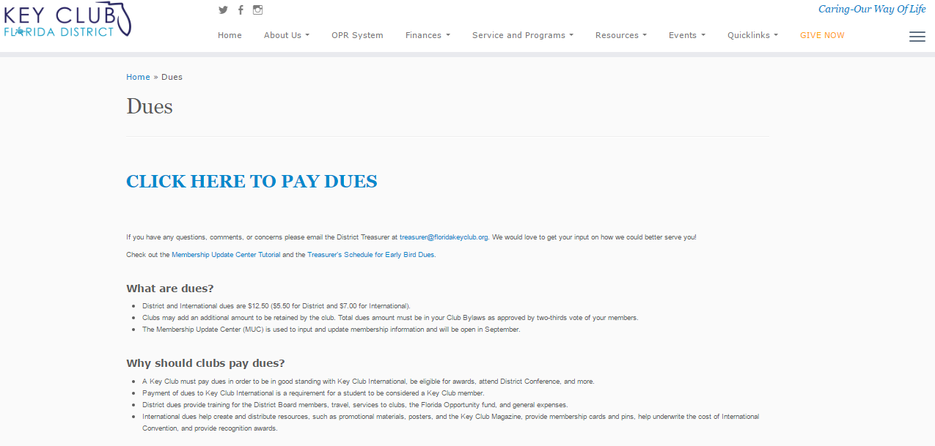
http://floridakeyclub.org/dues/

Slide 26
PRIDE REPORTS
(MONTHLY REPORTS)
Secretary’s responsibility
Report on club meetings
Report on club activities
Filed online at Florida Key Club website www.FloridaKeyClub.org
Notes:
Gives measure of club health
Provides information on primary activity of Key Club: Community Service
Gives ideas of projects

Slide 27
OFFICER INFORMATION FORMS (OIF)
Secretary’s responsibility
District does not receive contact information from International
Our central database
Filed online at Florida Key Club website
www.FloridaKeyClub.org
Notes:
Keep updated.
Go over registration process.

Slide 28
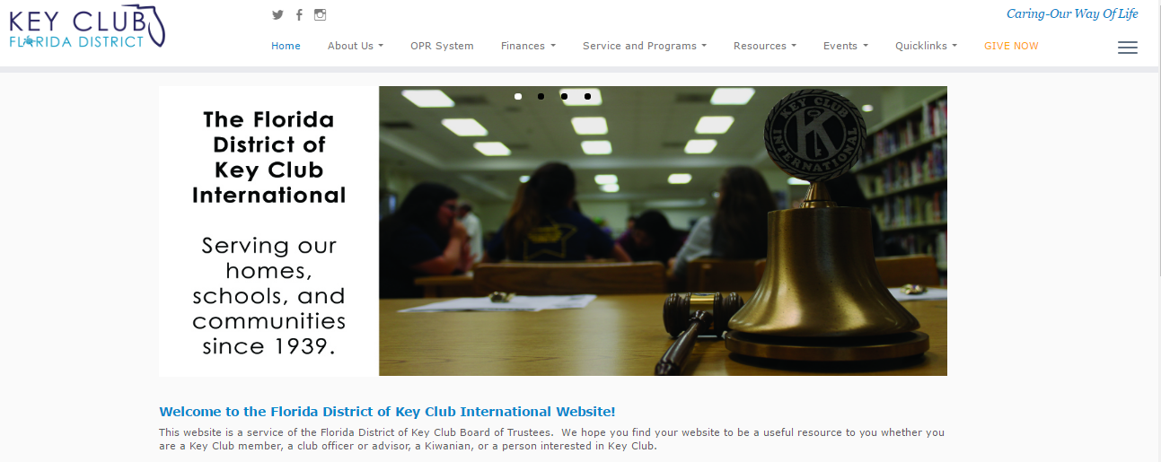
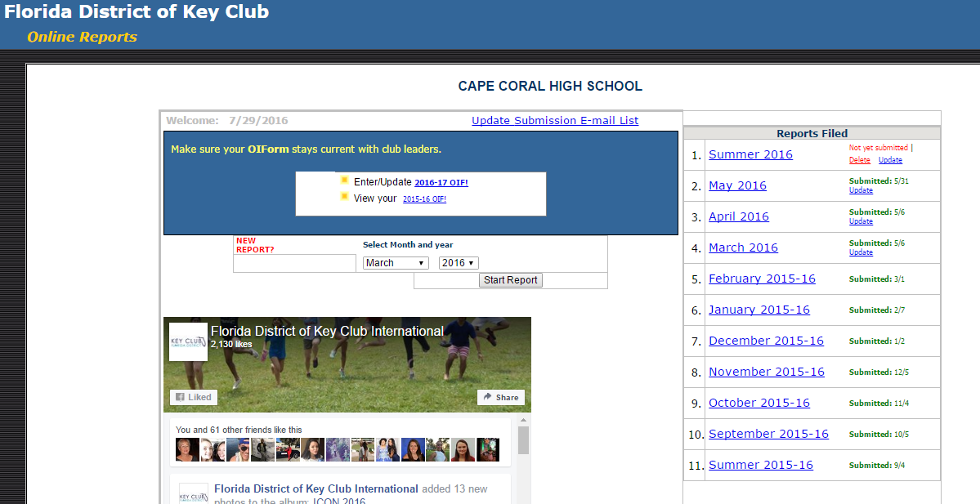
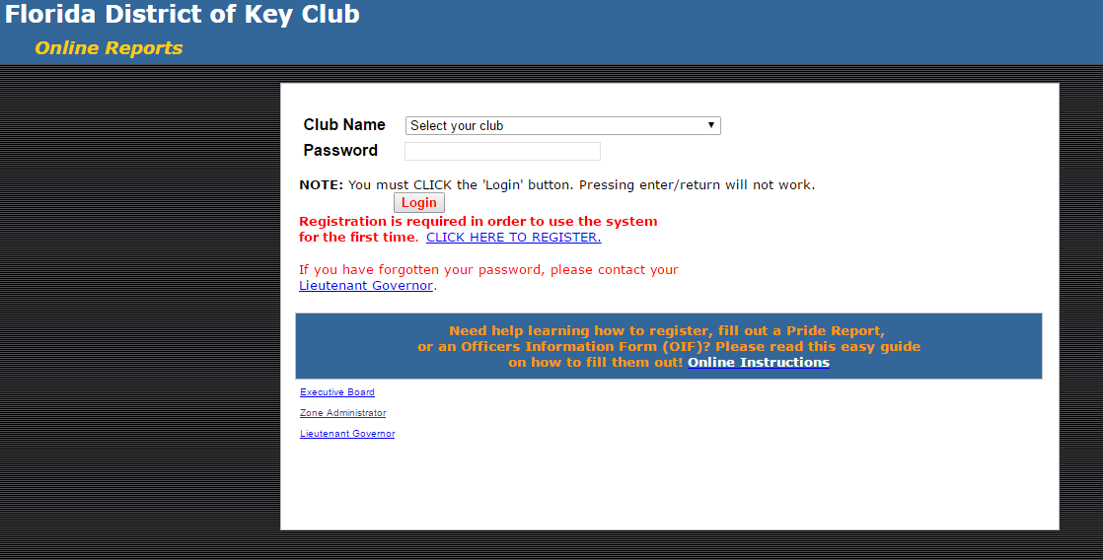

Slide 29
PROJECTS AND SOCIAL ACTIVITIES
Board’s responsibility (including committees)
Approval at board meetings
Planned in committees
Think about:
    Funding needed, Member interest/involvement, School and community, Meaningful/impactful service
Notes:
Consider at least one “meaningful and impactful project”
Funding for both club and community needs

Slide 30
METHODS OF COMMUNICATION
Board responsible to keep members informed
Types
  Agendas at meetings
  Email/Facebook/Twitter
  Notes through school
  Newsletters
  Phone calls or phone tree
  Buddy system
Notes:
Use of Class Directors

Slide 31
GLOBAL SERVICE

Slide 32
WHAT IS THE KEY CLUB MAJOR EMPHASIS?
A service program to bring together all Key Club members to focus energies on making an international impact benefiting children.
Notes:
Started over 50 years ago, the Major Emphasis has changed and reinvented itself.
The commitment to benefiting children has remained constant.

Slide 33
KEY CLUB SERVICE PARTNERS
The Eliminate Project: UNICEF
March of Dimes
Children’s Miracle Network
Notes:
The three service partners have been determined by feedback from members, evaluation, relevance to our Key Clubs mission, and approval by the Key Club International Board.
All three organizations provide outstanding support and resources to members.

Slide 34

THE ELIMINATE PROJECT: UNICEF
To eliminate maternal and neonatal tetanus.
It will take $110 million—and the dedicated work of UNICEF and every member of the Kiwanis family.
www.unicefusa.org/keyclub
Notes:
Kiwanis International and UNICEF have joined forces to eliminate maternal and neonatal tetanus, through the global campaign of The Eliminate Project. This deadly disease steals the lives of nearly 60,000 innocent babies and a significant number of women each year. The effects of the disease are excruciating — tiny newborns suffer repeated, painful convulsions and extreme sensitivity to light and touch.
By helping raise money for The Eliminate Project, you can save a life for just $1.80.

Slide 35

MARCH OF DIMES
Mission is to improve the health of babies.
Key Club members raised over US$90,000 last year: March for Babies and other fundraising.
www.marchofdimes.com/youth
Notes:
Clubs support March of Dimes in the spring typically, which is when March for Babies occurs in many communities.
If clubs do not have access to support the March of Dimes, they should contact their local children's’ hospital to learn how they can improve the health of babies in their community.

Slide 36
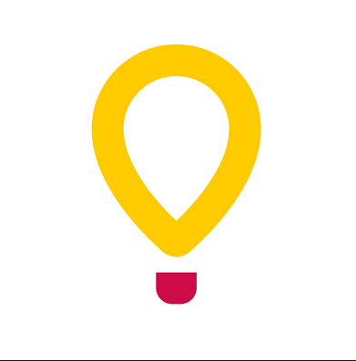
CHILDREN’S MIRACLE NETWORK
Network of hospitals providing healthcare for children whose parents aren’t able to pay.
Dance marathon, telethons, trauma dolls, serve meals at the Ronald McDonald House.
www.cmn.org
Notes:
Dance marathon is new to Key Club. Clubs can participate and host their very own Dance a thon, to raise funds.
If clubs do not have access to support the CMN, they should contact their local children's’ hospital to learn how they can support children's hospital needs in their community.

Slide 37
Faculty Advisor Responsibilities

Slide 38
TO THE SCHOOL AND PRINCIPAL:
Make certain that all Key Club projects and fund-raising activities are acceptable to the school and are in accord with regulations. Also understand the school's policy regarding transportation.

Slide 39
TO THE SCHOOL AND PRINCIPAL:
Ascertain that Key Club Bylaws are always in keeping with school regulations that govern student organizations.
See to it that the financial records of the Key Club are kept in accordance with standard procedure for student groups.

Slide 40
TO THE SCHOOL AND PRINCIPAL:
Work with the advisors of other student groups in forming a possible joint service project to promote a cooperative spirit in the school.
Seek to bring a “Key Club Understanding” to all members of the administration and faculty

Slide 41
TO THE KEY CLUB MEMBERSHIP:
Attend all regular meetings and all Board meetings.
Assist the Key Club in obtaining meeting room space for regularly scheduled club and Board meetings.
Assist in securing additional members for the club through contacts with other faculty members and students.

Slide 42
TO THE KEY CLUB MEMBERSHIP:
Help obtain proper and adequate publicity for Key Club in school publications.
Seek ideas and suggestions for Key Club service projects from the faculty, the administration, and other groups.
Help maintain discipline as needed.
Support & encourage Key Club’s “Student Led” concept

Slide 43
TO THE SPONSORING KIWANIS CLUB:
Discuss Key Club problems with the Kiwanis advisor, perhaps away from Key Club meetings, on a regular basis.
Reach a mutual understanding with the Kiwanis advisor regarding proper sharing of responsibility for guidance, training, and supervision.
Be thoroughly familiar with all available Key Club literature.
Attend Key Club conventions and training conferences whenever possible to share ideas with other faculty members and Kiwanians.

Slide 44
TO THE SPONSORING KIWANIS CLUB:
Do not become overloaded with details. Do not do what the Key Club members should do for themselves. Do not hesitate to make certain that Key Club members are doing what they should be doing.
Become a part of the Kiwanis family. Become interested in Key Club and Kiwanis.

Slide 45
TO DO LIST

Slide 46
DATES TO REMEMBER
Pride Reports due 10th of every month
Attend Division Council Meetings (DCM)
February - hold officer elections and Complete/Update the current year’s Officer Information Form(OIF)
January/February - Attend Spring Zone Rally
February - Finalizing Paperwork for Key Club Annual Achievement Report and Awards
April - Attend District Education and Leadership Conference (DCON)
May - if attending International Conference (ICON) send paperwork

Slide 47
DATES TO REMEMBER
July - Attend International Convention
August - start working on fundraiser for District Conference
August - Request help with your budget from your Kiwanis club
September/October - Attend Key Club Kickoff Conference
November 1st Pay club dues
November - plan a Key Club Week
December - start reviewing award paperwork and DCON school application

Slide 48
Club Officers Responsibilities

Slide 49
THE PRESIDENT
Weekly duties:
Hold regular Key Club meeting this week
Make and stick to agenda for meeting
Publish club bulletin this week
Keep officers and committees running smoothly
Lead entire membership in a well-rounded program of activities and projects
Personally contact delinquent members

Slide 50
THE PRESIDENT
Monthly duties:
Arrange and hold Board of Directors Meeting
Plan enough service projects so that every member can contribute at least five hours of service
Work with Committee Chairs on their proposed objectives for the next month
Receive and distribute District Publications and/or the Keynoter
Invite potential club officers to attend the Board Meeting
Attend Division Council Meeting (DCM)
Attend a Kiwanis Meeting

Slide 51
THE VICE-PRESIDENT
Weekly duties:
Help the president arrange the meeting.
Always be prepared to run the meeting should the president be absent.
Make sure the weekly club bulletin was made and distributed.
Help the committees with their projects.

Slide 52
THE VICE-PRESIDENT
Monthly duties:
Attend the Committee Meetings as an ex-officio member and advisor.
Collect the Committee Reports and turn them into the Secretary.
Attend the Board of Director’s Meetings.
Attend Division Council Meeting
Make sure the Secretary filled out and mailed in the monthly report on time.

Slide 53
THE SECRETARY
Weekly duties:
Attend the meetings and record the following information in the official club minutes: [1] attendance [2] guests [3] speakers and his/her topic [4] who has paid dues and who has not [5] committee reports [6] all motions and decisions [7] any announcements
Answer all correspondence promptly and courteously. Be sure to inform the other officers and your advisor of the communication and of any information received therein.

Slide 54
THE SECRETARY
Monthly duties:
Meet with the President to prepare the agenda for the Board of Directors Meeting.
Attend the Board Meeting and record minutes.
Collect committee reports.
Submit the club’s monthly report on time.
Attend Division Council Meeting

Slide 55
THE TREASURER
Weekly duties:
Pay all the bills.
Record all expenditures and income for each week.
Secure the advice of your Advisor on all financial matters.
Make sure you understand your school’s policy (as well as your club’s policy) regarding financial accounts for student organizations.
Notes:
Create a budget

Slide 56
THE TREASURER
Monthly duties:
Collect all monies from club fundraisers.
Prepare a financial report for the Board of Directors Meeting.
Attend the Board of Directors Meeting.
Attend Division Council Meeting

Slide 57
THE EDITOR
Weekly duties:
Take good notes at meetings and projects.
Plan newsletter for members.
Collect materials for the Club’s scrapbook.
Publicize club events.

Slide 58
THE EDITOR
Monthly duties:
Publish newsletter for members.
Work on scrapbook.
Send articles to local and/or school paper.
Submit articles to Florida Webmaster and Keynoter.
Attend the Board of Directors Meeting.
Attend Division Council Meeting

Slide 59
THE CLASS DIRECTORS
Weekly duties:
Attend all Key Club meetings
Make sure that your class has a good role model at each meeting
Gather suggestions from class members
Make sure your class knows they have a say in what goes on with your Key Club
Represent class with good fashion
Always be on your best behavior when attending meetings and projects.

Slide 60
THE CLASS DIRECTORS
Monthly duties:
Attend all board meetings of the Key Club
Give suggestions about how to make your club better; relay suggestions from members to the board
Provide input to the board
Support decisions of the board and represent your class at board meetings
Attend Division Council Meeting

Slide 61
SERVICE

Slide 62
KEY CLUB SERVICE HOUR
What counts as a service hour (for Pride Reporting):
Projects pre-approved or organized exclusively by the club
Projects that contribute to betterment of the community
For drives, service is the actual time worked to collect, count, package, and/or deliver
Time spent planning a board approved project
Actual time worked as DCON host

Slide 63
KEY CLUB SERVICE HOUR
What does not count as a service hour:
DCMs, KCKCs, Zone Rallies, DCON, and ICON (Exception time spent on projects at event)
Club, Board, committee or other planning meetings.
Socials or church services
Anything considered to be a chore or that is supposed to be done
Fundraisers for the individual Key Club’s own use (Ex: funds for end of the year banquet or DCON)
Non-work time during overnight service projects (eating, sleeping, etc)
Providing transportation or travel time
Non Key Club members’ time (other volunteers’ time)

Slide 64
RESOURCES
KeyClub.org (International Website)
FloridaKeyClub.org (District Website)
Handbook
Division Facebook page
District Administrator or Zone Administrator
Division Lt Governor

Slide 65

Questions

